Slide 1
HA QM
05 Enrichment

Slide 2
5.1
Item 1
Example email after we hosted a local heat for the HA’s “Great Debate” competition. The teacher of the winner and another entrant, from Malbank School in Nantwich, sent this email.
We are hosting this event again in January 2023.

Slide 3
5.1
Item 2
Example feedback from pupil voice and parent voice re extra-curricular offer, on next two slides.

Slide 4
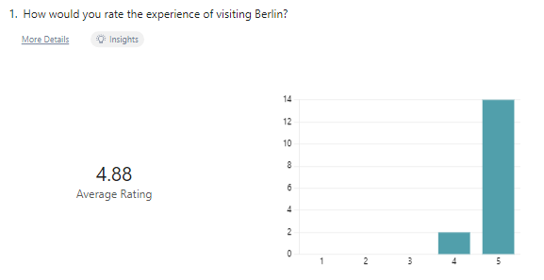
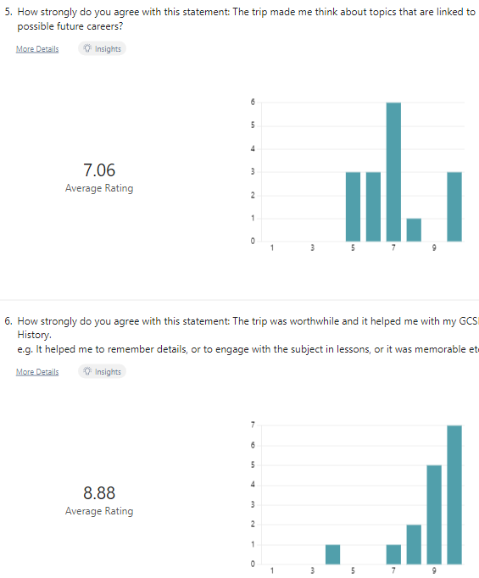
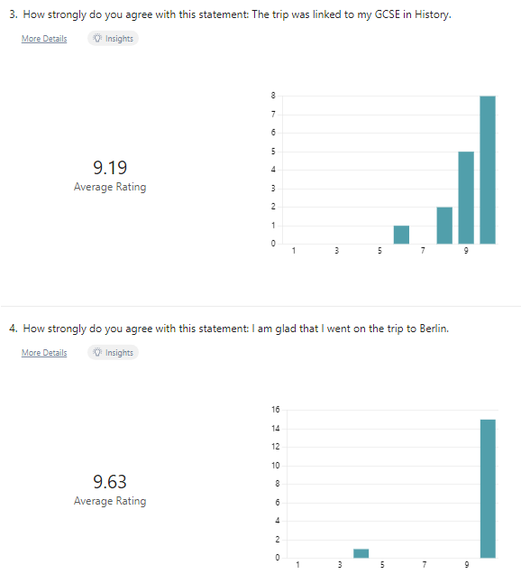
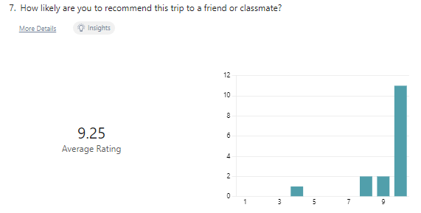
5.1
Feedback from pupils after residential trip to Berlin in autumn 2022.

Slide 5
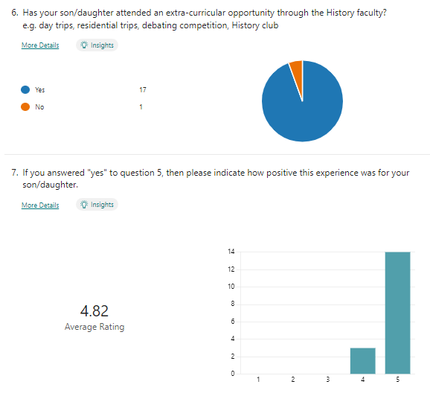
5.1
Unedited results from a parent voice survey sent to parents of all Year 11 pupils of subjects in our faculty in June 2023.

Slide 6
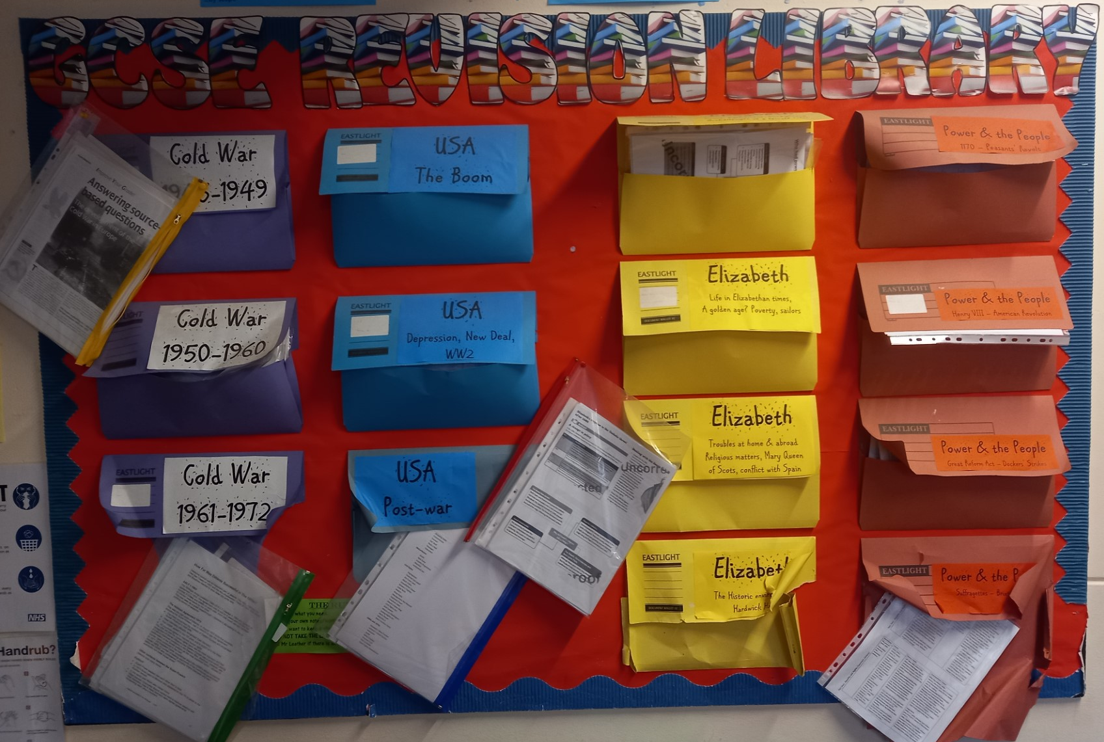
5.2
Item 1 – Example displays in classrooms bespoke to GCSE exam units with other links to lower school, supporting chronological understanding and organisation of pupils’ thought.

Slide 7
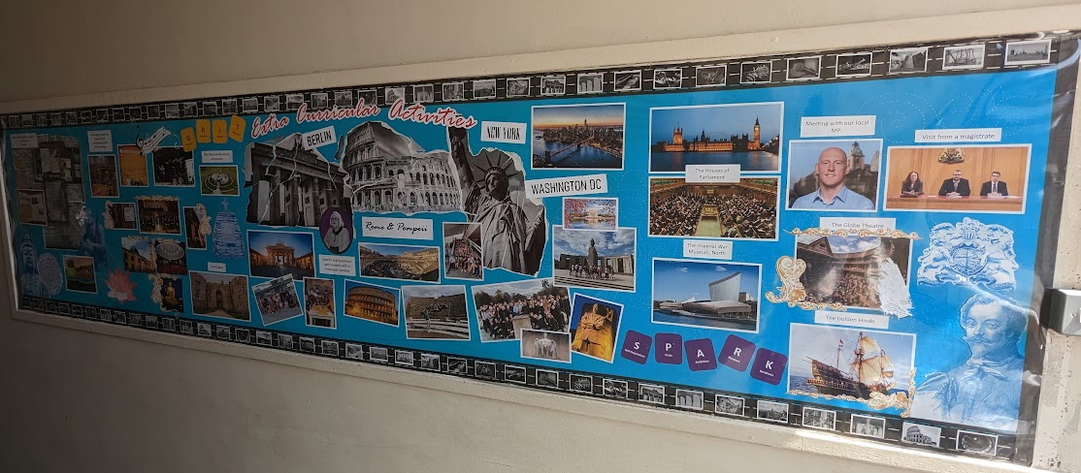
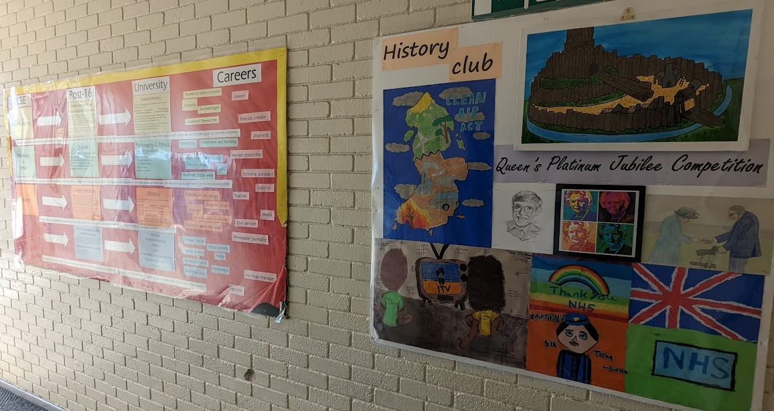
5.2
Item 2 – Example displays in the wider school

Slide 8
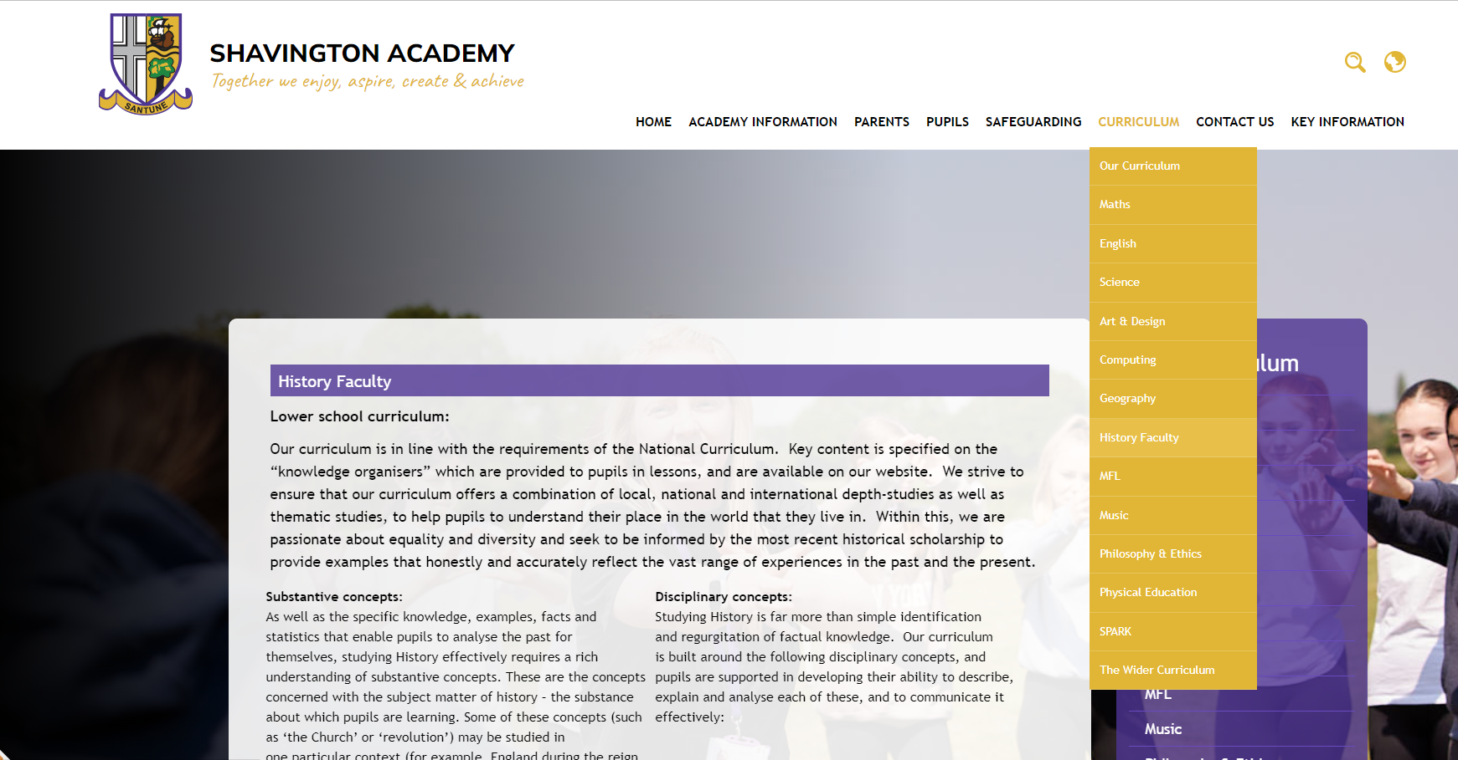
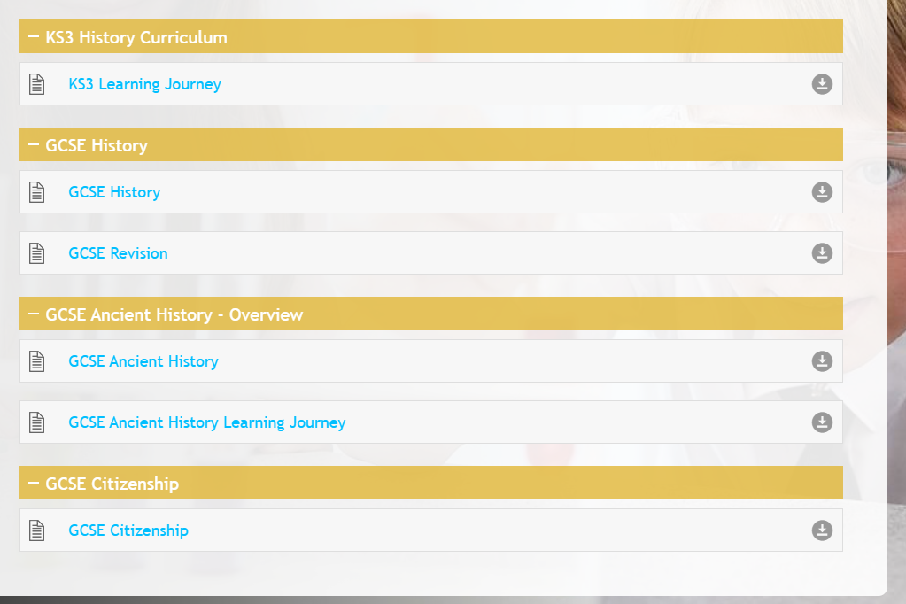
5.3 - Website
Evidence of a distinct and separate area of the website for History department information, curriculum overviews and revision guides.

Slide 9
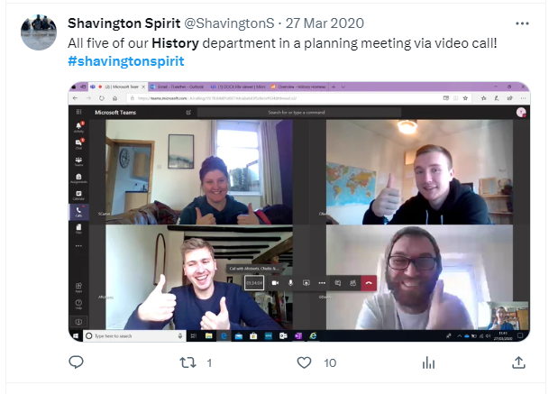
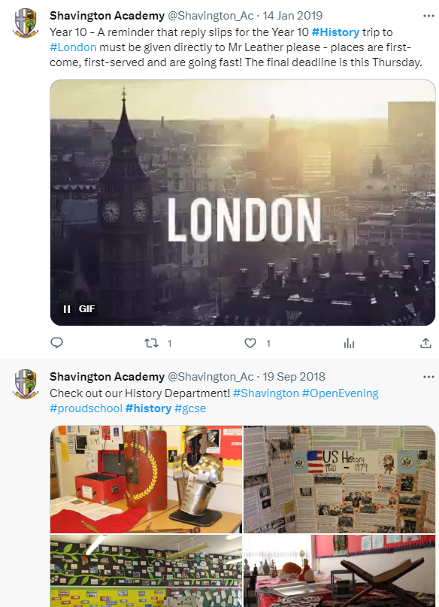
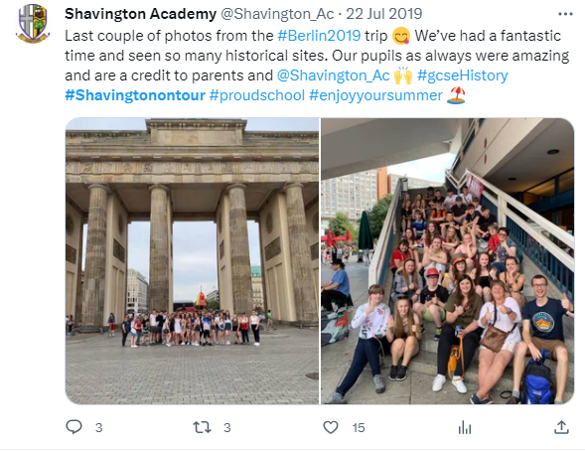
5.3
Item 1
Examples of how the History faculty contributes to communications: screenshots from Twitter, and one recent example of the Academy Newsletter: “5.3 Newsletter July 2023.pdf”

Slide 10
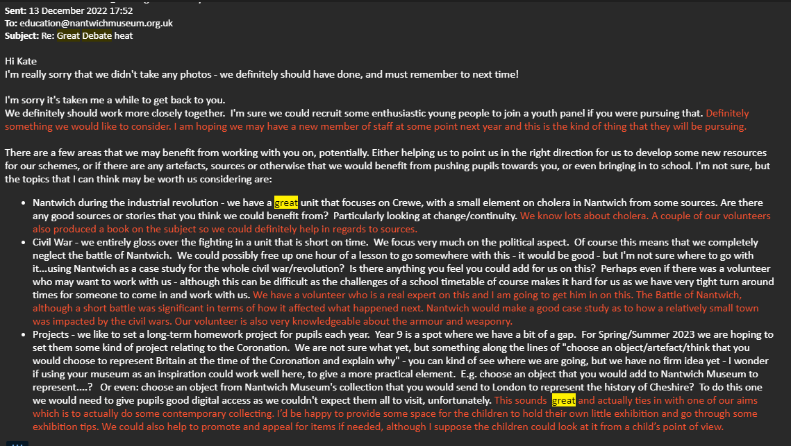
5.4
Item 1
Example email from the Director of Nantwich Museum referencing her involvement in out heat for the Great Debate, plus other schemes of involvement that impact our curriculum and our extra-curricular offer – the museum project is ongoing! (Her comments are in red)

Slide 11
5.5
Item 1
Seeks partnerships – Nantwich museum and Crewe heritage officer emails (see right, my text in white and response in red).

Slide 12
5.5
Item 1
Seeking and contributing outside of the school – participation in a Debate Mate competition judged by the local MP – evidence to the right, source: https://www.drkieranmullan.org.uk/news/newsletter-126
This included extra-curricular training for a wider group of pupils, prior to the smaller group attending the event itself.

Slide 13
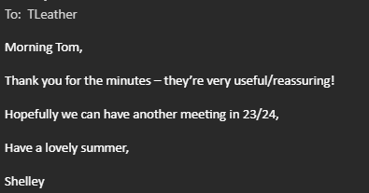
5.5
Item 2
We instigated and hosted a meeting of the local network of History teachers in summer 2023 – the first for several years – see example of email sending minutes out and an example response. As a follow-up, we were visited by a Head of History from another local school who was seeking good practice and discussion focused on the curriculum.

Slide 14
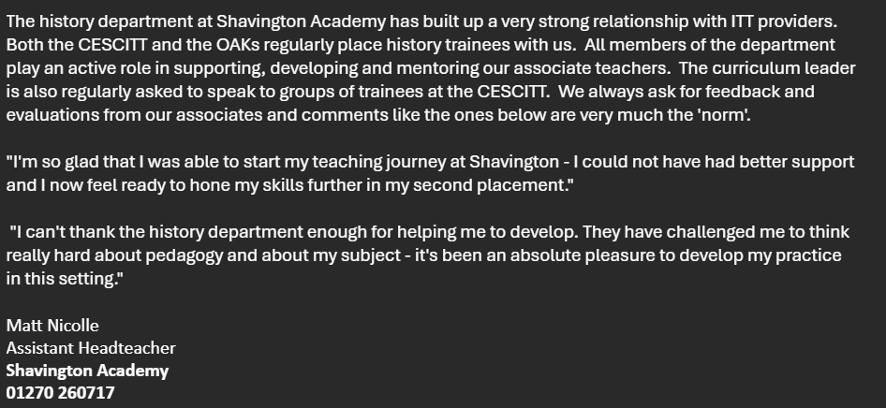
Item 3
Shavington Academy history department is consistently chosen by local ITT providers for trainee placements.

