Slide 1
HA QM
04 Achievement

Slide 2
4.1
Item 1
Exam results over time – consistently outstanding results for pupils across all groups.
Use SISRA P8 data from 2022 as not available for 2023 yet.

Slide 3
4.2
Item 1
“4.2 History DC2 Departmental Achievement Analysis” Example achievement meeting record, showing the formal record of analysis that is carried out 3 times a year.

Slide 4
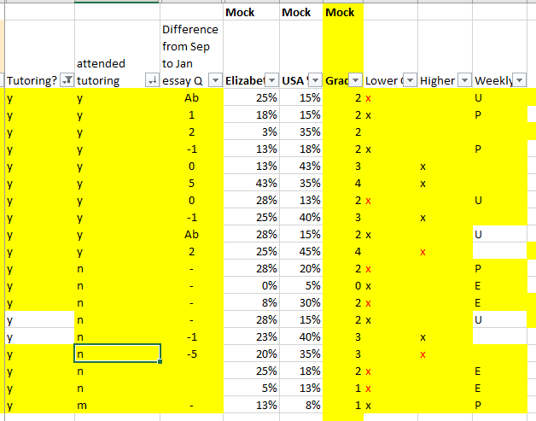
4.2
Item 2 Tracking spreadsheet shows example of monitoring:
Did they attend? (Whole school system meant not all could attend History)
Did they improve their score on USA essay question from September assessment to January mock exam?
Pupils suggested for tutoring (anonymised)
Further analysis of mock exam scores and identification of further interventions

Slide 5
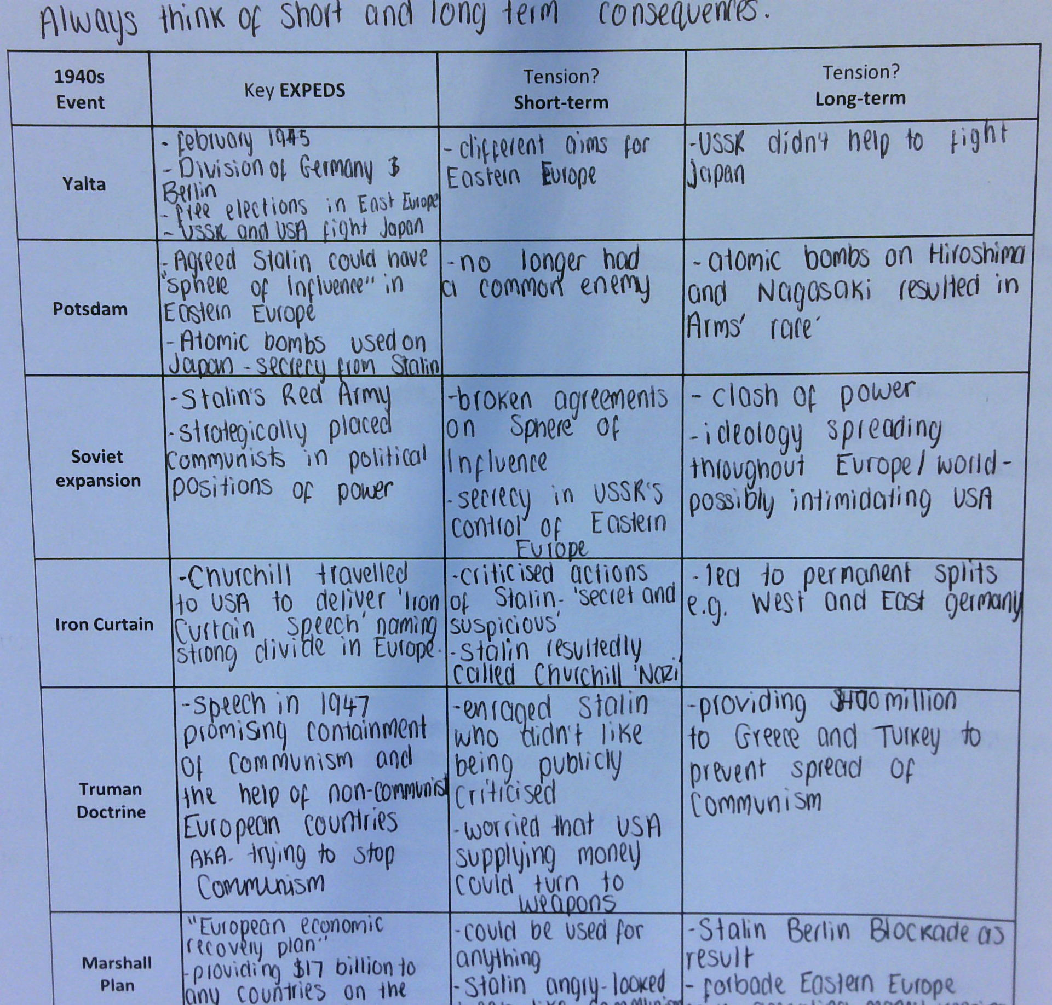
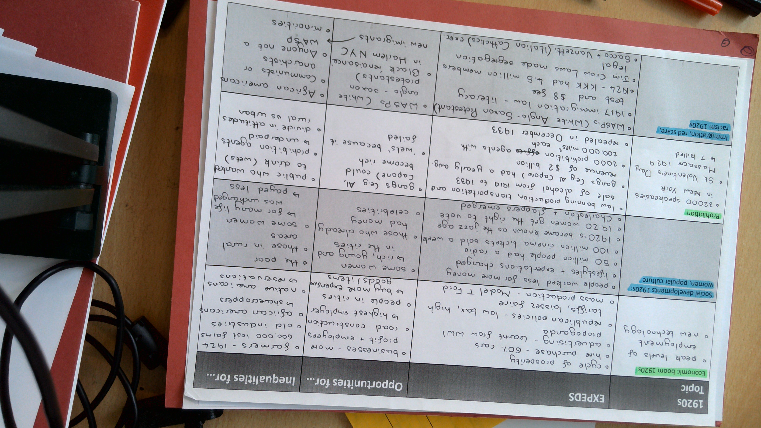
4.3
Item 1
Staff create schemas, knowledge organisers and “golden ticket” sheets that are bespoke for that unit in terms of substantive knowledge and disciplinary concepts, guiding pupils to organise their thoughts and work continuously.
These are adapted each year based on analysis of pupil performance, changing pedagogy and content, and department priorities.
Example of a GCSE Cold War “golden ticket” sheet annotated by a pupil specific to exam requirements.
Example of a GCSE American Society “golden ticket” sheet annotated by a pupil specific to exam requirements.

Slide 6
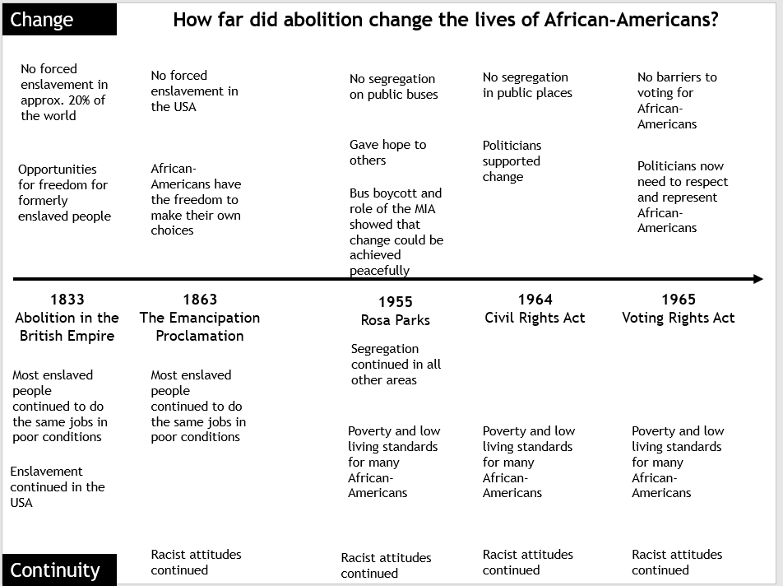
4.3
Item 1 continued
Examples of strategies to boost engagement and attainment through understanding and application of the “fingertip knowledge” necessary for success in a unit – linking substantive to disciplinary concepts. In this example for Year 8, on the left is a schema – pupils are given a blank copy to annotate themselves then given a printed one later in the unit. On the right is a knowledge organiser to complement and support the interaction between substantive and disciplinary concepts.

Slide 7
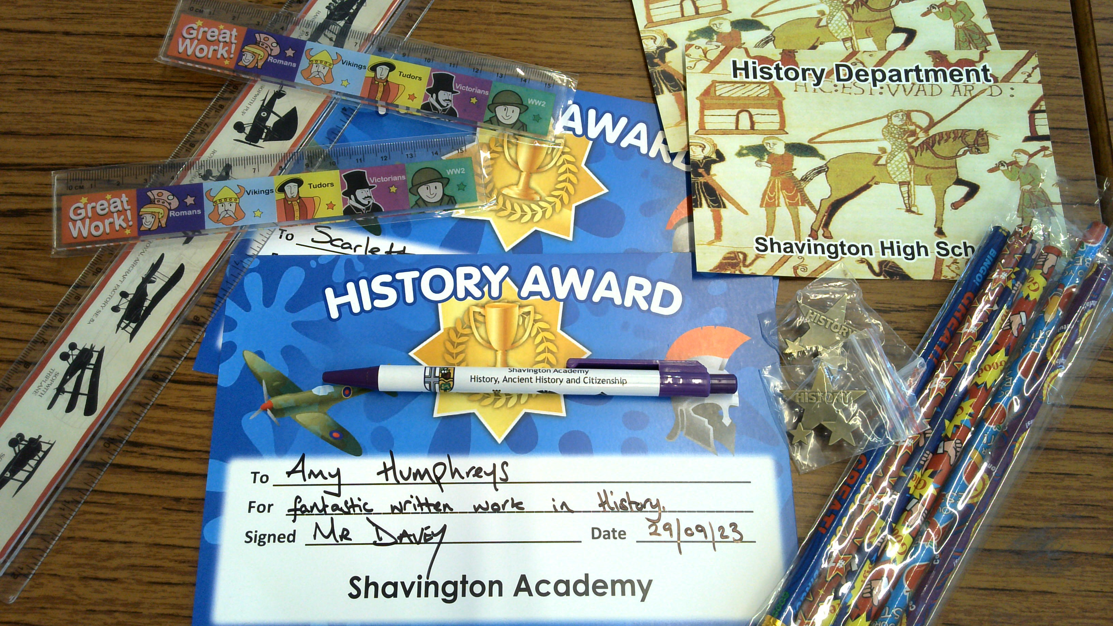
4.4
Examples to show regular awarding of praise, and celebration - Screenshot of spreadsheet from summer term 2023 tracking who has received a prize and certificate for “star of the week” from the History Faculty, and photo examples of what we award.

Slide 8
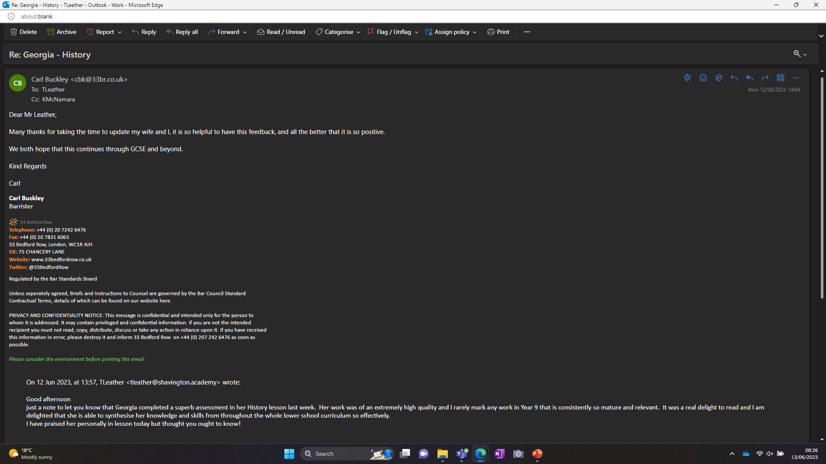
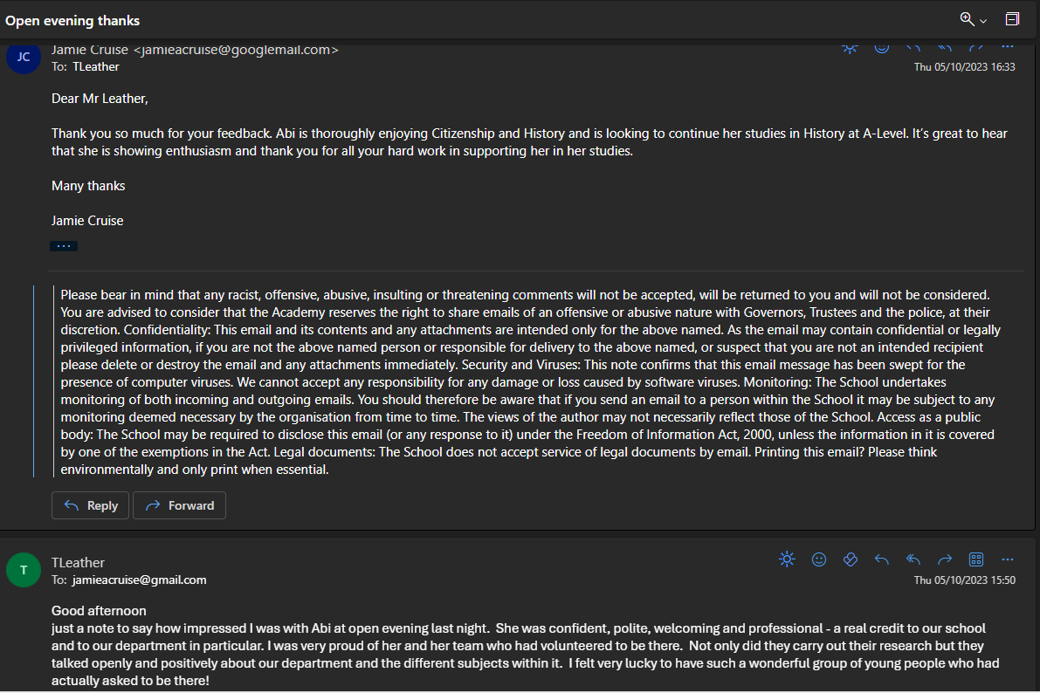
4.4 Item 2
Examples of communication with parents celebrating achievement

