Slide 1
Notes for teachers
Here are six character cards, which can be used alongside the story of Edward Lee, Archbishop of York, and the activities on the Teacher PowerPoint. Characters can be asked how they would have felt about each event in the timeline as the story develops.
All the characters here are real except for Sarah Harkness (character 5). She was included to demonstrate the highly probable involvement of poor women in the Pilgrimage of Grace and to illustrate the impact that the dissolution of the monasteries would have had on marginalised groups, particularly those who were dependent on charitable giving from religious houses (e.g. widows). The other characters are all real and were involved in the events of the Reformation, dissolution or Pilgrimage of Grace in some way.

Slide 2
Character 1: Edward Lee
You began your career as a Catholic traditionalist and academic. In the 1520s, you were anti-Protestant, and this fitted well with Henry VIII’s views, allowing you to rise in his service. You are a learned man and have been engaged in diplomacy for the Tudor court, including acting as an ambassador to Spain. You were part of a group tasked with the tricky goal of persuading Katherine of Aragon to accept an annulment from Henry; you failed, but despite this, you won rewards from the King for your loyalty to his cause, and you rose to become Archbishop of York in 1531, taking over the role from Cardinal Wolsey. Wolsey died in 1529 of natural causes but while under arrest, and you are aware that had he lived, he would probably have been executed for failing to secure the King an annulment from the Pope. Wolsey had done little to ensure that the monasteries in York were kept in good order, and you know that the anti-Catholic faction at court, led by Thomas Cromwell, will soon seek to find evidence of corruption in religious houses.

Slide 3
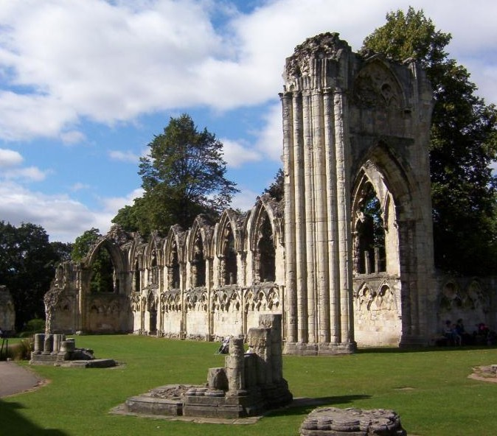
Character 2: William Thornton, Abbot of St Mary’s Abbey, York
You joined the monastery and were ordained a priest in 1510. Born in Yorkshire, you seem to have received all your education at the Abbey and were probably less educated than many abbots in this position. The Abbey was the richest and most important abbey in the North of England. You carried out some duties for the King in aiding defence against the Scots, and sought to curry favour with Thomas Cromwell in 1533, granting him an annual payment of £10 from the Abbey funds.
Notes:
Image: https://commons.wikimedia.org/wiki/File:St_Marys_Abbey_Church_York.jpg

Slide 4
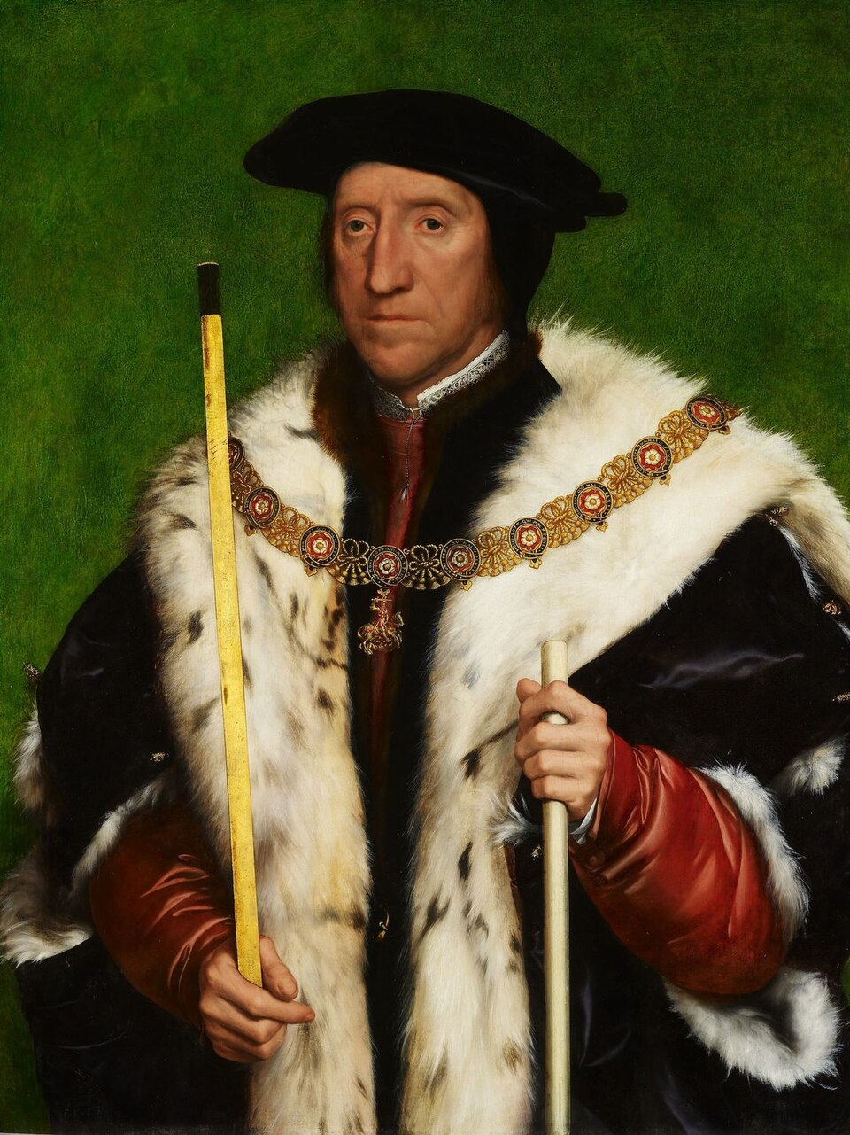
Character 3:
Thomas Howard, Duke of Norfolk
You were the third Duke of Norfolk and uncle to Anne Boleyn, who became Henry VIII’s second queen. You gained considerably from your niece Anne’s rise in favour and marriage to Henry in 1533, but the birth of a girl and a subsequent miscarriage meant that Anne’s influence with the King was already shaky by 1534. Although you benefited from Henry’s break with Rome, you and your family remain traditional in most religious matters, disliking many Protestant innovations. Indeed, you once declared proudly that you would never read the Bible in English! Nonetheless, you are careful to criticise the wealth and luxury of monasteries publicly, knowing that this will please the King.
Notes:
Image: © Royal Collection Trust

Slide 5
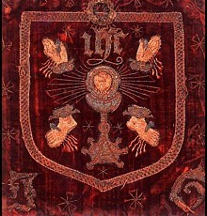
Character 4: Robert Aske, lawyer and son of a fairly wealthy landowner in Yorkshire
Born and bred in Yorkshire, you are a lawyer who travels frequently to London for work. You are an unmarried young man, and you are committed to the Catholic faith and the Pope. You are shocked by the King’s desire to divorce his wife, Katherine of Aragon.
Banner of the Five Wounds of Christ
Notes:
Image: https://tudortimes.co.uk/military-warfare/the-pilgrimage-of-grace

Slide 6
Character 5: Sarah Harkness
You are a poor widow living in the City of York in the 1530s, following the death of your husband in an accident. You have no surviving children and you are growing too old for work. You live hand to mouth and are often dependent on charity. You have heard that the King wishes to divorce his wife, which seems unfair as she has been a loyal woman.

Slide 7
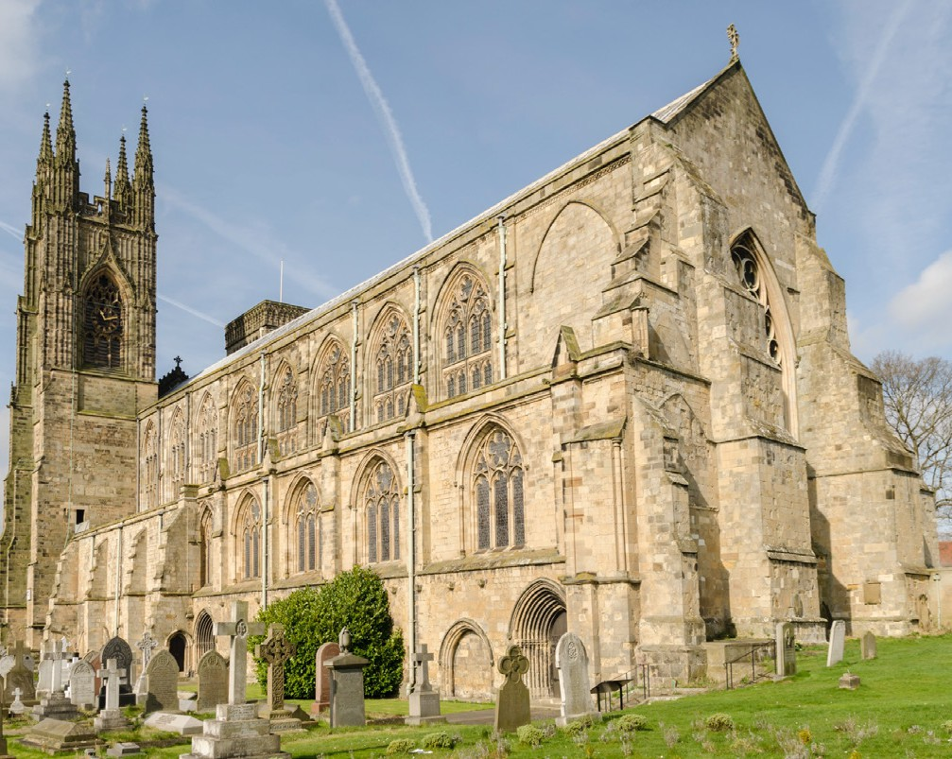
Character 6: John Pickering, from Bridlington in Yorkshire
Born in Bridlington, Yorkshire, you entered the friary (monastery) of Bridlington in 1510 and you were ordained a priest in 1516. Soon, you moved to a monastery in London, but you disapproved of their newfangled ideas and reformist tendencies; it’s traditional Catholicism all the way with you so you moved back to Yorkshire! You attended the official meetings in York where the Royal Supremacy (acknowledging Henry VIII as Head of the Church of England) was discussed, and you were appalled by how heavy-handed the royal approach was, demanding that all agree to this. When the northern clergy wrote in 1532 that they would accept Henry as Head of the Church, you wrote against this in protest. You may also have resigned as the prior (head) of your abbey in protest at the changes.
Bridlington Priory today
Notes:
Image: https://en.wikipedia.org/wiki/Bridlington

