Slide 1



Note to teachers
This PowerPoint contains a series of activities related to the story of Edward Lee, who was an orthodox Catholic in the household of Henry VIII prior to the Reformation, and took over as Archbishop of York from Wolsey in 1529. During the rest of his life, there seems to have been underlying tension between his traditional theology and his desire to maintain his illustrious career during changes wrought by the Reformation – a classic case study in the conflict between the demands of God and Mammon. His involvement in key events of the reign makes him particularly useful as an example for the classroom. These events included: attending the Field of the Cloth of Gold, where he seems to have undertaken the research for Henry VIII’s text The Assertion of the Seven Sacraments (for which Henry was awarded the title of ‘Defender of the Faith’ by the Pope); forming part of the group who tried to persuade Katherine of Aragon to accept an annulment; carrying out visitations of the monastic houses in his diocese on the eve of Reformation (thus providing evidence of the moral and financial state of the Catholic Church in the North); personal involvement in the Pilgrimage of Grace and suffering the subsequent reprisals against the North by Henry VIII; the Wakefield Conspiracy; and the royal progress north in 1541, during which Katherine Howard is believed to have committed the indiscretions that led to her execution. I have created a story encompassing these different events with the aid of AI, and made character cards of different figures in the tale for students to use to enhance their engagement and understanding of diverse responses to religious change. The backdrop and source work is focused on St Mary’s Abbey, York, one of the wealthiest monasteries in the country, about which there is considerable evidence and research, and which was also involved in many of these events. This PowerPoint provides the activities in the order in which I used them, but you could adapt this material in a variety of ways, depending on your needs.
Notes:
Henry on Tour, in conjunction with the University of York, carried out considerable research at St Mary’s Abbey, York. This session includes some of the new findings.

Slide 2
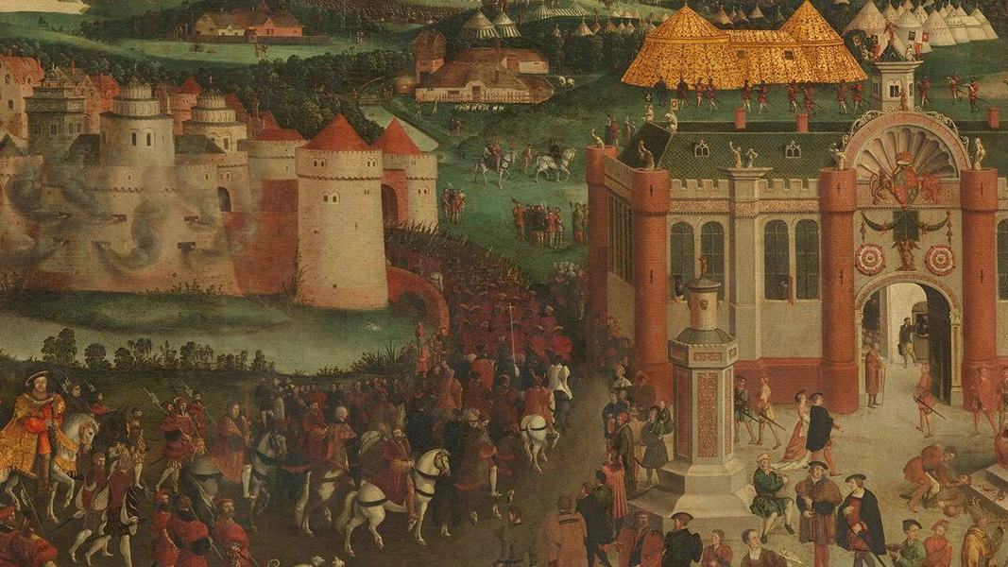
Enquiry 2
What was the impact of the Reformation on York?

Slide 3
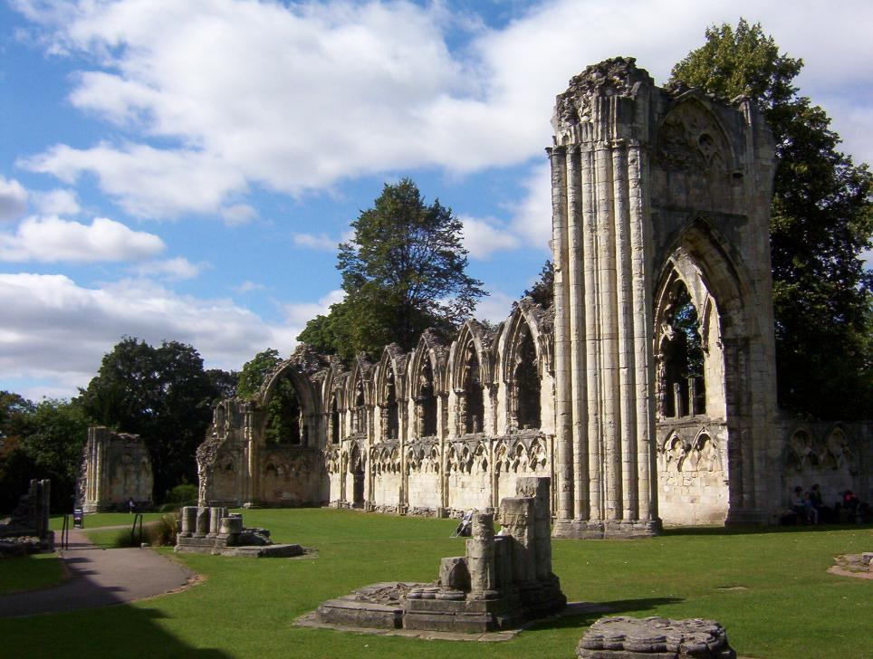
What was the impact of the Reformation on York?
Aims:
To develop an understanding of the key events of the Reformation and reactions to it
To evaluate the responses of different groups to the Reformation, using York as a case study
Notes:
Henry on Tour, in conjunction with the University of York, carried out considerable research at St Mary’s Abbey, York. This session includes some of the new findings.
Image: https://commons.wikimedia.org/wiki/File:St_Marys_Abbey_Church_York.jpg

Slide 4
GROUP ACTIVITY 1
Questioning narratives

Slide 5
What questions would you like answered about this story?
The wind howled through the narrow streets of York as Edward Lee dismounted his horse. Cloaked in the finest robes of his station, he bore the weight of both his faith and his political entanglements. The year was 1534, and the storm of the Reformation was reaching its crescendo.
Lee had spent years navigating treacherous waters. Once a scholar engaged in fierce theological debates with Erasmus, he now found himself an unwilling pawn in Henry VIII’s break from Rome. He had witnessed the King’s fiery defiance of Martin Luther and had even helped to craft the very words that earned Henry the title of Defender of the Faith. But that title was now a cruel irony, for Henry had turned against the Pope, against Rome and, in many ways, against the faith that Lee had sworn to protect. Lee himself had sought to gain the King his coveted annulment, petitioning the Pope and urging the obdurate Spanish queen to accept the ending of this accursed marriage, but to no avail. And his conscience troubled him. Should he have accepted the King as Supreme Head of the Church? He could not still the voice inside him whispering that it was because of lust for that harlot Anne Boleyn that the King had forced through these changes, and not for faith...
He wrested his mind back to the business at hand. His journey this day led him to St Mary’s Abbey...
Notes:
Presenter reads the story aloud, slowly and dramatically – a technique that can work particularly well for a starter activity. A printed/electronic text can be provided for students to annotate with questions that they would like answered about it, aiming for at least five questions. No prior information needs to be provided.

Slide 6
Discuss in your groups the story and annotate the sheet with any questions that you would like answered about it.
Notes:
Here, peer support is given via small-group discussion. Then the teacher can take whole-group feedback and key questions should be written on the board. In a classroom setting, students should write down questions that they did not think of, so that they can answer them as the lesson progresses or as a plenary.

Slide 7
Who wrote the story and how accurate is it?
Notes:
This is an obvious question and one that many participants are likely to ask. While valid, it is not the key focus for this activity, so I recommend providing a brief answer and moving on. For background, the story was drafted by ChatGPT, using prompts written by me ‘to create a thrilling tale’, with information that I took from Claire Cross’s article about Edward Lee in the Oxford Dictionary of National Biography. I then edited the AI story slightly. It can be worth flagging to students that Oxford DNB is a very respected resource, and one that they may wish to use for research/coursework if the school has access.

Slide 8
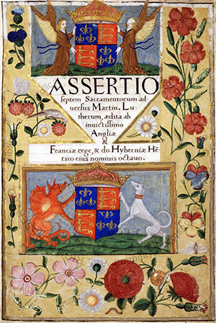
Let’s meet the real Edward Lee in his early career as a Catholic traditionalist...
Lee was a highly educated Catholic priest from a well-off family.
He assisted Erasmus with a new Latin translation of the New Testament, but they argued. Lee enraged Erasmus by circulating a list of alleged errors in the translation after it had been published. Both Thomas More and Polydore Vergil tried to mediate in the quarrel, but to no avail.
Lee followed traditional Catholic teaching.
In 1520, he became a royal chaplain under Henry VIII and attended the Field of the Cloth of Gold.
Title page of the Assertio Septem Sacramentaorum, published by Henry VIII in 1521. © The Vatican Libraries
Notes:
After reading the story, give a short overview of the early career of Edward Lee, who later became Archbishop of York. He is to be the central character throughout the enquiry. It is worth noting that he attended the Field of the Cloth of Gold as royal chaplain (this was the focus of the last workshop, so provides a nice link). While at this event, some contemporaries felt that Lee was doing the background research for Henry VIII’s book The Assertion of the Seven Sacraments, in which the King defended the importance of the Catholic faith. It can be emphasised that, early in Lee’s career, being a Catholic traditionalist helped him because Henry was too!

Slide 9
Let’s meet the real Edward Lee in his early career as a Catholic traditionalist...
Lee probably did the background research for Henry VIII’s book Assertio Septem Sacramentaorum, published in July 1521, which rejected Luther’s ideas. This earned Henry VIII the title ‘Defender of the Faith’ from the Pope.
In 1525, he sent warning to Henry and Wolsey that all copies of Tyndale’s English translation of the New Testament should be excluded from England because of its Protestant ideas.
Title page of the Assertio Septem Sacramentaorum, published by Henry VIII in 1521. © The Vatican Libraries
Notes:
It’s worth noting that Lee’s early career success was at least largely owing to his religious orthodoxy, which married with Henry VIII’s own views. This can be used to help students to understand Henry VIII’s own early traditionalism.

Slide 10
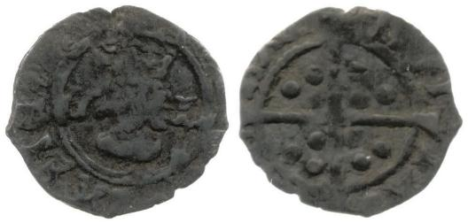
… but Edward Lee was also the King’s servant
1527: As an ambassador in the Spanish court, he spent much time trying to discredit the validity of the marriage of Henry VIII and Katherine of Aragon.
1530: Lee was part of an embassy led by Thomas Boleyn to the Pope and the Emperor Charles V (Katherine of Aragon’s nephew) to persuade them to agree to the marriage being annulled. He failed but gained promotions for his efforts.
July 1530: Lee signed a petition to Pope Clement VII to grant the divorce. He also argued with Katherine of Aragon when she sought to have her case tried in Rome.
1531: Lee was rewarded for his efforts for Henry with the Archbishopric of York.
Coins minted while Lee was Archbishop of York – he was the last archbishop to have the right to mint coins
Notes:
It is important to explain that Lee’s actions here were in line with traditional Catholicism; there was plenty of precedent for people trying to annul (prove to be invalid) their marriages within the Catholic Church. Indeed, from the perspective of many in the English court, it would have been far easier if the annulment had been granted, as it would have avoided the ‘break with Rome’. However, there were theological and political challenges facing those seeking to get Henry and Katherine of Aragon’s marriage annulled, which proved insurmountable: Katherine’s nephew, Charles V, was Holy Roman Emperor and, during the Sack of Rome in 1527, captured the Pope; Katherine was hostile to the proposed annulment; the previous Pope had signed a decree authorising the marriage of Katherine and Henry despite Katherine’s previous marriage to Prince Arthur, etc.
With reference to the picture, Lee was the last Archbishop of York to have the right to mint coins – a right removed owing to the Reformation. The earlier right to mint coins again provides evidence of the power of the Catholic Church and its senior clergy pre-Reformation.
Image courtesy of the Henry on Tour project.

Slide 11
GROUP ACTIVITY 2
Exploring place through archaeological and written resources
Notes:
Here, St Mary’s Abbey in York was introduced to the students. The reason for this was to demonstrate the wealth and status of the Abbey (and thereby the Roman Catholic Church) prior to the Reformation. Together, the class can examine some pictures on the next slide and the video footage of the ruined abbey, noting the beautiful carvings, its size/height, the use of master craftsmen, etc., to set the scene prior to the forthcoming Reformation. St Mary’s was one of the ten richest monasteries in England when Edward Lee became Archbishop of York. The art that it displayed and its religious practices would have been entirely in line with Edward Lee’s theological views.

Slide 12
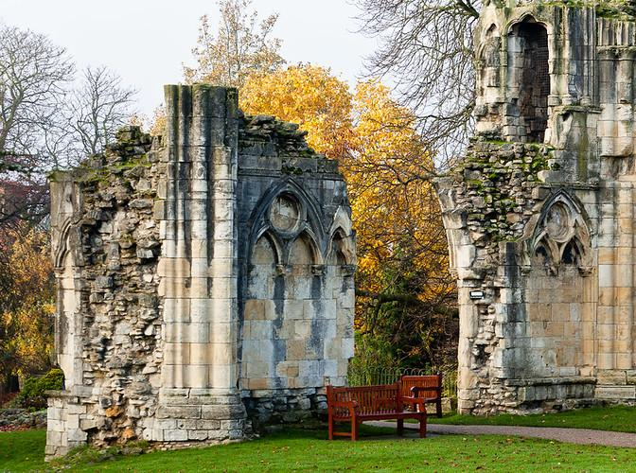
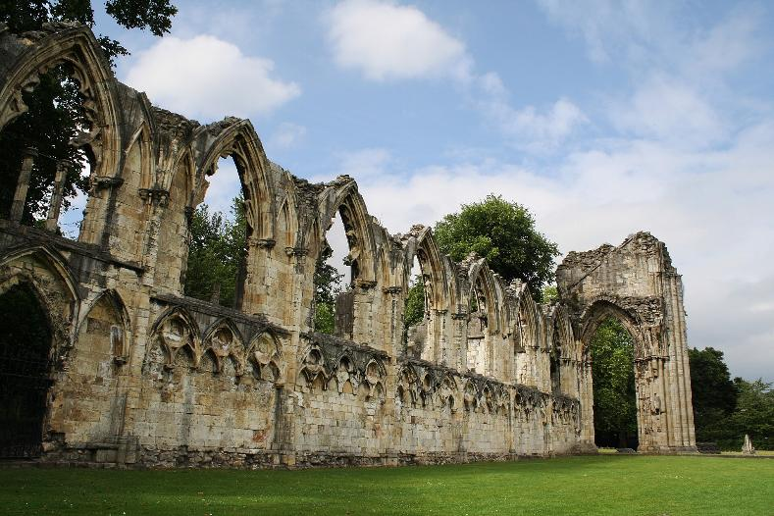
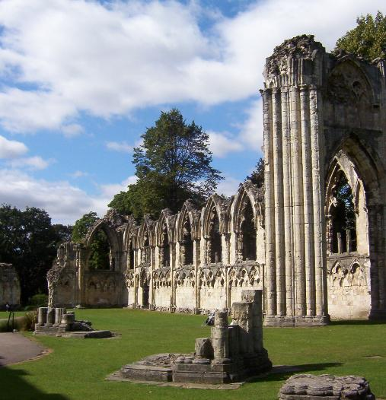
Welcome to St Mary’s Abbey in York
Notes:
Images: “St Mary's Abbey ruins” by alh1, CC BY-NC-SA 2.0; https://commons.wikimedia.org/wiki/File:St_Mary%27s_Abbey,_York.jpg; https://commons.wikimedia.org/wiki/File:St_Marys_Abbey_Church_York.jpg

Slide 13
Let’s take a walk…
www.york360.co.uk/movies/st-marys-abbey.htm
Notes:
This link, from one of the project partners of Henry on Tour, York360, allowed participants to imagine walking in the ruins of the Abbey to get a sense of ‘place’. It can easily be displayed on a screen in the classroom for free.

Slide 14
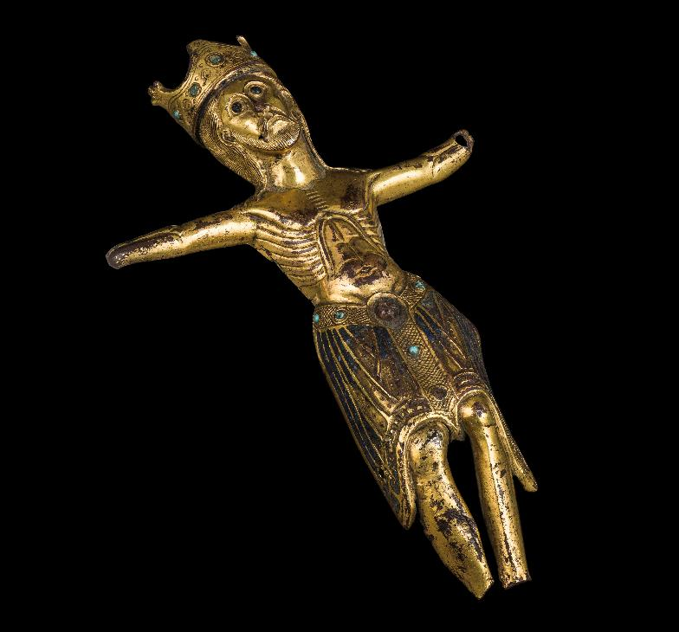
How can studying buildings help us to understand the impact of religious change in Tudor society?
In groups, explore the archaeological and written sources provided, discussing these questions:
What do they show about the position of the Abbey in society before the Reformation?
Why might the Abbey be either supported or criticised and by whom?
Think back to the story that we read at the start of the session and use the timeline. Why might Edward Lee be visiting the Abbey in 1534?
Notes:
For this activity, students can be given the various sources relating to St Mary’s Abbey that are available on the HA website (and most are also on the slides that follow). The image shows a copper gilt Christ, which would have been on a cross originally. Look at the close-up images to see traces of expensive enamel from Limoges. Copper gilt is an expensive commodity. This piece of art (16” tall) was sculpted by master craftsmen. The fact that it was owned by St Mary’s indicates the wealth of the monastery and its importance as a patron of the arts. Further details are available in the source pack on the HA website.
Image: www.yorkshiremuseum.org.uk/collections/collections-highlights/st-marys-figure-of-christ

Slide 15
Source: Crown licence, 1483
Crown licence, given on 30 September 1483 to Thomas Booth, Abbot of St Mary’s, to allow him to retain Richard Cheyholme, bricklayer N.B. The king at the time was Richard III. It is customary for a monarch to refer to themselves with the pronoun ‘we’.
Richard Cheyholme Richard etc To alle maner oure officers liegemene & subgettes thise oure lettres forto see or here greting / Forsomoche as we understande that Richard Cheyholme (Brekemaker) Brekeleyere with iiij servaunteswith him is Reteigned in the same his occupacione with oure righte trusty & welbeloved in god Thabbotof oure Monastery of seint Marie besides oure Citee of York /
We wolle the said Richard and his said servauntes to contynue there as long as it shalle please the said Abbot /
Charge you alle thereforethat ye suffre them soo to doo without letting interupcione or takyng to oure werkes or others in any wise as ye wolle advoide our displeasure
Notes:
This licence is from King Richard III to a brickmaker and bricklayer called Richard Cheyholme in 1483 (pre-Reformation). It highlights that Cheyholm and his four servants were being employed by ‘our right trusty and well-beloved’ Abbot of St Mary’s in York. It emphasises that these men were to remain working for the Abbot for as long as the Abbot wanted them, and that they should not be interrupted or removed from these jobs, even for employment on royal works ‘if you will avoid our [royal] displeasure’. This highlights the importance of the Abbey and the standing of the Abbot pre-Reformation. A full translation into modern English is provided in the source pack.

Slide 16
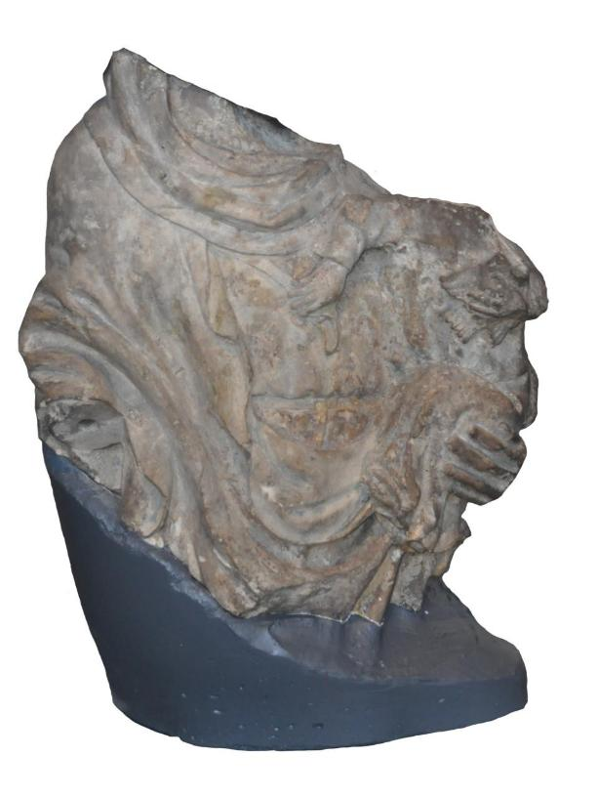
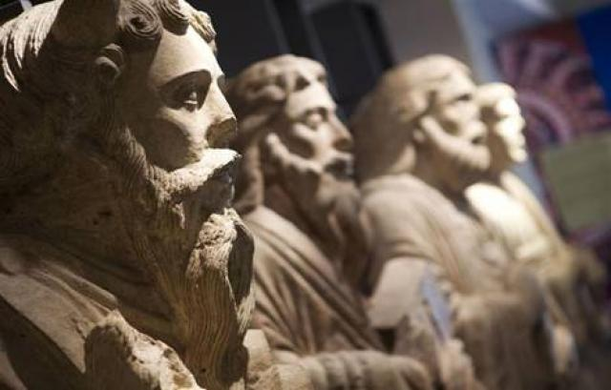
St Mary’s Abbey, York
Notes:
It is important to let students know that the statues on the left were life-sized, largely undamaged and buried completely underground. Once the students have come up with theories about why this might have happened, you can let them know that historians/archaeologists are uncertain of the exact reasons, but the statues were of prophets and were possibly buried to protect them from iconoclasm. The image on the right is the torso of a Virgin Mary, holding the infant Jesus. Both have been decapitated, presumably during the Reformation. After the statue had been attacked, it appears to have been left outside, as there is evidence of the severed necks being weathered. At an appropriate point in the enquiry (I did this towards the end), the teacher can discuss with students the very public statement made here by iconoclasts – they were not only destroying religious art but also leaving it out publicly in the rain/wind for passers-by to see and witness the destruction.
These sources were chosen in order to build a picture of a very high-status abbey (St Mary’s Abbey was very important and wealthy pre-Reformation), which had, prior to the Reformation, been accustomed to considerable royal favour. The left-hand image is of life-sized twelfth-century statues of saints and prophets, which were found buried underground. The reasons for their burial are unknown, but there are various possible speculations – were they buried to protect them from the iconoclasm of the Reformation, for example? The right-hand image is a damaged statue of the Virgin Mary with child – you can see her hand holding the child. Note that it appears to have been decapitated and then left outside (there is evidence of weathering after it was broken). This was used later in the workshop to unfold the story of iconoclasm and the Reformation.
Images: (left) www.historyofyork.org.uk/themes/norman/saints-and-prophets-statues-from-st-marys-abbey; (right) © York Museums Trust, YORYM: 2011.325 CC BY-SA 4.0

Slide 17
GROUP ACTIVITY 3
People and place: Stories and role-play
Notes:
This section can be used to develop the story of Edward Lee’s career further and to encourage greater audience participation via character cards and role play.

Slide 18
ACTIVITY 3: People and place: It’s 1534…
That June, Lee rode out, grey cloak snapping in the wind, a cold resolve hardening within him. He would assert his authority and reclaim the dignity of his office. The summer of 1534 saw him travelling from abbey to abbey, cloisters echoing with the sudden arrival of a man that many had thought only a name on paper. He interrogated monks, inspected ledgers, judged morals. Some welcomed him. Others plotted behind walls older than memory. Lee had entered a battlefield of silence, where loyalty to Rome ran deeper than the rivers and rebellion festered behind pious smiles.
He was no longer simply a bishop. He was a man at war – with his king, his Church and his soul.
Notes:
The continuation of the story can be read to/by students in a dramatic manner. Speculate: What is happening next? What is the significance of the date? Referring to the Reformation timeline (available via the HA website) may be useful here.

Slide 19
People and place: How can we link them?
In groups, take a card each. You each now have a different role. The announcement of the visit is provided. THINGS TO CONSIDER:
What would your character’s view of the Abbey of St Mary’s be in 1534?
Would you be a supporter or a critic of the Abbey at this stage and why?
Notes:
Each person can be given a ‘character card’ (characters listed on the next slide). There are six characters per group. Character cards are available on the HA website. Note that the only fictional character is ‘Sarah Harkness’, and if you have a group of five then she is the best character to leave out. The announcement by Lee of his planned visitation was also provided (see Slide 21).

Slide 20
People and place: Characters
Edward Lee: Archbishop of York
William Thornton: Abbot of St Mary’s Abbey
Thomas Howard: Duke of Norfolk, uncle to Anne Boleyn
Robert Aske: Lawyer and son of a fairly wealthy landowner in Yorkshire
Sarah Harkness: A poor widow living in the city of York
John Pickering: from Bridlington in Yorkshire, a friar (a monk) but not at St Mary’s Abbey
Notes:
Characters were chosen to combine well-known names of the period – to provide revision for A-level students and as a ‘hook’ – as well as lesser-known figures, to add greater knowledge and detail and to demonstrate some of the diversity of the impact of the Reformation.

Slide 21
People and place: How can we link them?
Translated from the Latin, this is part of the letter sent by Edward Lee, Archbishop of York, to the monastery of St Mary’s, York on 1 September 1534, announcing his planned visitation:
Because we intend, by the grace of God, on Thursday, namely the seventeenth day of the present month of September, to visit you in the chapter of your said monastery, for the correction of your souls, and to exercise the office of visitation among you with pious affections, we enjoin and command you by the terms of the present, and also… summon you, that you, all and each, on the said day and place, appear before us, or our commissioners... to undergo and receive our office of visitation and our salutary warnings, corrections and injunctions, with due and marked reverence, from which the Most High may produce fruit, which, as we piously desire, may benefit you to your salvation. Moreover, you shall inform your confreres [brother monks], now absent, if there be any… that on the said day and place they will attend with you, and will do and receive according to the quality of the aforesaid what justice will suggest.

Slide 22
People and place: Discuss (in character)
Introduce yourself.
In 1534, what is your opinion of the Abbey of St Mary’s in York?
You know that Archbishop Lee is coming to York to carry out visitations (inspections) of the different religious institutions. What are your views on this?
Notes:
Role play in groups allows participants to consider the diversity of reactions to a planned visitation by Lee. It’s important to highlight that Henry VIII has NOT ordered visitations by Cromwell’s men yet – here, Lee is choosing to inspect his diocese, possibly to ‘lick them into shape’, as he knows that more hostile eyes are coming to view the monasteries. Is this an act of seeking to protect the monasteries or simply seeking to protect his own career? We can’t be sure of Lee’s motivations here, but speculation can be a profitable exercise in developing students’ understanding of the context and the individual.
Note that part of the aim here is to highlight that ‘visitations’ were not an entirely new concept brought in by the Reformation (a common misconception). In fact, bishops, etc., always had the right to carry out visitations, and many did. However, Wolsey, who had been the previous Archbishop of York, had not done so in the diocese of York. Additional prompts by the presenter could get participants to consider what this shows about Wolsey’s leadership of the Church in England during his time as Cardinal, and also to speculate about why Lee may have decided to take a very different approach. Was it simply a difference in personality? Was Lee concerned about being found to be lax because he was a traditional Catholic in his theology, and knew that factions within the court were challenging this?

Slide 23
People and place: Lee’s visitation of September 1534 and injunctions of 1535
Lee visited the monasteries in his diocese, carrying out inspections (‘visitations’) to check the morality and behaviour of the monks.
This was a very different approach from his predecessor, Cardinal Wolsey, who had rarely visited York.
Why was Lee visiting? Was this the ‘pre-Ofsted’ health check?!
Notes:
Note to teacher: It appears that Lee’s predecessor (Wolsey) had a ‘hands-off’ approach to his diocese of York, rarely visiting the monasteries or insisting on particular standards of behaviour. When Lee took over the role, however, he was immediately keen to check that monks, etc., in his diocese were behaving, carrying out visitations. This can be used by teachers to highlight that the visitations of the Reformation were not an entirely new concept – monasteries prior to the Reformation were supposed to be subject to inspection by their bishops. Here, Lee appears keen to carry out a visitation to ensure that there was not bad behaviour on his watch, presumably because he was aware that the King and his advisors were preparing to carry out the much harsher visitations shortly, as they prepared to compile the Comperta Monastica and the Valor Ecclesiasticus.
Discuss Lee’s possible reasons for carrying out visitations in York just prior to the Reformation.

Slide 24
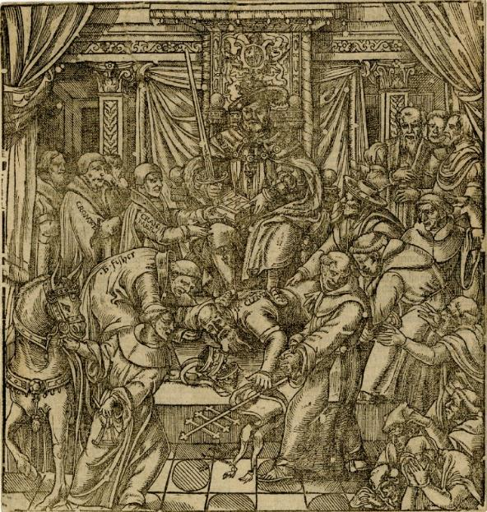
November 1534: Act of Supremacy
This requires all clergy to take an oath accepting Henry VIII as Head of the Church of England. Lee takes the oath, but the Imperial Ambassador, Eustace Chapuys, comments in a letter to the Spanish king that, like the Bishop of Winchester, Lee is uneasy in his conscience.
Henry VIII suppressing the Pope, taken from John Foxe’s Book of Martyrs
Notes:
Teacher reminds students of this key date and Act.
Image: https://upload.wikimedia.org/wikipedia/commons/d/dc/Illustration_Foxe%27s_Book_of_Martyrs_1570.jpg
Reference for the Chapuys letter: www.british-history.ac.uk/letters-papers-hen8/vol6/pp79-89

Slide 25
People and place: Edward Lee
READ the ‘injunctions’ (the report or set of orders) following the visitation of Archbishop Lee to St Mary’s Abbey, which were issued in 1535. DISCUSS: How would your different characters react?
Notes:
A printed version of the injunctions was given to students to read in groups. This material is available on the following slides (26–30) OR in printable form via the source pack on the HA website. Note that a short summary of the key allegations is provided on Slide 31, which was used to bring everyone up to speed and to support those less able to read long documents quickly.

Slide 26
People and place: Injunctions
Injunctions (orders) to the Abbot and monks of St Mary’s York, following the visitation, issued in 1535:
Edward, etc., to his beloved sons, the abbot and convent of the monastery of Blessed Mary of York, greetings, grace and blessing.
When we, having lately performed our office of visitation with pious affections at your... house, having found something to be reformed and corrected there, we, with paternal affection desiring to apply a suitable remedy, have resolved to observe the underwritten injunctions, for the salvation of your souls and the growth of your religion, and the usefulness of your monastery.
Notes:
This text of the injunction (order/report) issued by Lee to the Abbot and monks of St Mary’s is available in a more printable format on the HA’s website in the source pack linked to this enquiry.

Slide 27
First of all, we charge you, abbots and the aforesaid interviewees, that each and every one of you will observe the order and rule of St Benedict, expressly professed by you, unfailingly, and that the brothers who wilfully violate the rule itself are punished according to the same strictness.
And because, according to the public report, it has reached our hearing that you, John, abbot of the aforesaid monastery, contrary to the vow of your religion and – observance of the rule, had and still have a very familiar and suspicious conversation with a certain Elizabeth Robynson, a married women, of Overton, in our diocese of York... therefore, in virtue of holy obedience, we charge you [to] abstain altogether from all company or approach to the said woman publicly or secretly, except in the public forum or church, in which places no evil suspicion can arise; nor let her, or any other suspect person, approach you.
Note: The text refers to the abbot being called ‘John’, but this seems to be an error, as the abbot at this time was William Thornton.

Slide 28
We also enjoin you, abbot, that you always reside in the monastery where you are, unless you are prevented from being absent for a just cause, and that you be as often as possible in society with the brethren, keeping a watchful care and careful diligence about everything, that you may render to God a ration of the duty entrusted to you.
And because in your aforesaid monastery we found disparate robes among you, that is to say, some in worsted and other precious clothes, not without great offence to your religion, while others were mean, though honest, and having a habit more suited to religious men, whose custom we praise. Since you deserve one and the same regular life being professed, and for that one and the same habit, rejecting all disparity... we strictly forbid that any of the monks of the said monastery should wear the worsted or other precious clothes, but they should all wear clothes of the same colour and of low price, so that from the cheap habit, contempt is shown to the dress and exercise of the... secular world, because when all are equal, they show themselves and in clothes in the name of fraternity equals.
Note: ‘Worsted’ was a type of high-quality woollen cloth.

Slide 29
Also, according to the present tenor, we enjoin and command that the abbot of the aforesaid monastery once a year, in the presence of the whole council, or to some of the older and wiser men appointed for this purpose by the council or chapter of the same house, shall give a full account of the state of the monastery and its administration, under penalty of law.
Likewise, we enjoin the aforesaid abbot, that he shall not hereafter or hereafter, under the Cloister and precinct of his aforesaid monastery, sell wine to any of his brethren, or to any other place, or permit a wine-shop to continue there, under penalty of contempt.

Slide 30
Since everyone’s outward behaviour shows the intrinsic honesty of behaviour through decency, and also because we know that monks are forbidden all disorderly or elaborate worship and adornment in clothes; I say to you, John, the abbot, in virtue of obedience and under penalty of contempt, we charge and command that you do not in any way wear silk on your hood or sleeves, or in any of your clothes, inside or outside... in whatever clothing you wear, and that you do not wear gilded shoes [sic], nor horse saddles or bridles with any silk equipment... under penalty of contempt.
All and every one of these injunctions we enjoin upon you, the abbot and the interlocutor, and command in virtue of holy obedience, as far as they respectively touch and concern you, you will unfailingly observe, since you wish to escape and avoid the punishment due in this respect.

Slide 31
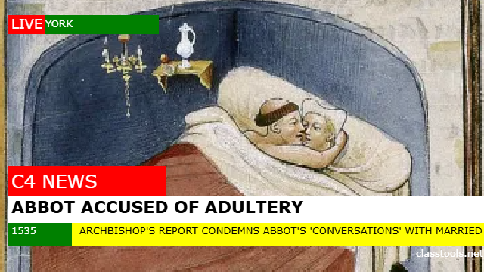
1535 newsflash!
Abbot’s sexual misconduct with married woman implied
Criticism of abbot and monks for lavish clothing
Ban on the sale of wine from the monastery
No travelling from the monastery without good cause
Notes:
This provides a round-up of the key findings from the injunctions, particularly to help bring up to speed students who might not have fully understood the longer text. I used Russell Tarr’s Classtools.net website to create the image. The teacher can lead a class consideration of how different ‘characters’ from the cards would have reacted to the injunctions from Lee.

Slide 32
GROUP ACTIVITY 4
Character reactions
Notes:
This section is designed to introduce the Reformation visitations, particularly the characters of Cromwell, Layton and Legh.

Slide 33
People and place: The story continues...
Rumours whispered through cloisters and over altar stones – of agents, cruel and calculating, descending from the South, bearing scrolls signed not with the cross but with Cromwell’s name. Archbishop Edward Lee had heard their names before: Richard Layton, sharp-tongued and relentless, and Thomas Legh, the younger of the two, whose soft manner belied a merciless eye for heresy and wealth. These were inquisitors of a new order. Knowing that time was slipping through his fingers, Lee issued one final set of injunctions – his last command to the monastic houses of his diocese. With trembling quill, it was a final attempt to preserve the sanctity of the old ways before Cromwell’s wolves could sink their teeth into the northern abbeys.
Exactly one week later, the authority to inspect the monasteries was ripped from Lee’s hands. Cromwell’s men crossed into the North like a tide of judgement, beginning their tour in the bleak chill of January 1536. Their arrival marked not only the end of Lee’s jurisdiction but also the beginning of a campaign that would leave monasteries burning, relics shattered and secrets uncovered that could shake even the strongest faith.
Notes:
Dramatic reading of the next stage of the story to students. Crucially, this section of the story introduces Layton and Legh and the new Reformation visitations.

Slide 34
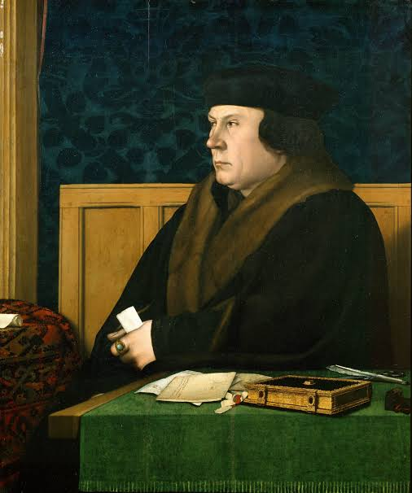
What are the key sources of visitations by Cromwell’s men?
Comperta Monastica (or ‘Black Book’) was compiled by Cromwell’s staff, notably Layton and Legh, to document the scandalous details of life in England’s monastic houses. Its aim was to discredit them. The returns only partially survive for the North of England.
Valor Ecclesiasticus was a financial account of the land and assets in monasteries, compiled by the government just prior to the dissolution. Both were commissioned by Henry VIII in 1535.
Notes:
Teacher gives details of key sources for the visitations by Cromwell’s men.
Image: https://en.wikipedia.org/wiki/Thomas_Cromwell

Slide 35
GROUP WORK: Examine the sources
DISCUSS:
How would your character react to the visitations of Legh and Layton?
How would they view the charitable work of the monastery?
What is the Archbishop of York, Edward Lee, worried about?
Notes:
Group work/discussion. Sources are available on Slides 36–38 or via the source pack on the HA website.

Slide 36
Source 1
Richard Layton, writing to Thomas Cromwell on 13 January 1536, describing his visitations in Yorkshire to inspect the monasteries:
Here in Yorkshire we find great corruption amongst religious persons, even as we did in the South, and worse, if worse may be in kinds of knavery [such] as withdrawing the penis just prior to ejaculation to prevent reproduction and nuns taking drinks to prevent conception. Today we begin with St Mary’s Abbey, where we expect to find much evil disposition both in the abbot and convent.

Slide 37
Source 2: Poor relief at St Mary’s Abbey
DAILY
WEEKLY
YEARLY
A daily distribution made to three poor people at the time of the high mass, for the soul of William Nesfield and of his foundation.
A ' widow-right’ was distributed every Sunday to ten widows, each receiving 1 penny.
Similar alms (charity) were distributed on the anniversary of William Wells, formerly Bishop of Rochester.
The same ten widows and other poor people received ‘Frereright’, rations of food and drink.
This was distributed every Wednesday and Saturday (if they came to the monastery). Rations consisted of:
bread and ale
105 quarters of wheat, at 5 shillings per quarter
135 quarters of barley malt
Modern summary from A History of the County of York of the arrangements made for poor relief by the Abbey of St Mary’s in York at the time of the visitation of Layton and Legh
Notes:
This modern summary of the poor relief provided by St Mary’s Abbey, York, was taken and slightly adapted from: Page, W. (ed.) (1974) ‘Houses of Benedictine monks: Abbey of St Mary, York’ in A History of the County of York: Volume 3, London: Dawsons, pp. 107–12, British History Online, www.british-history.ac.uk/vch/yorks/vol3/pp107-112 [accessed 20 August 2025]

Slide 38
Source 3
Archbishop Lee, writing to Henry VIII on 14 January 1536 (the ‘Syon’ referred to in the source was another monastery in the area)
When Drs. Layton and Leghe were with me as your visitors on Jan. 13, they very straitly examined me concerning words that I was supposed to have spoken to the general confessor of Syon or to one sent by him, viz., that I would stand against your title of Supreme Head even to the death, if I thought that I might prevail. Never spake with the said confessor, nor sent any counsel to him, nor received any messenger from him or any one at Syon in matters concerning your Highness.
Notes:
Translation provided by H. Carrel:
When Drs Layton and Legh were with me as your visitors [inspectors] on 13 January, they very strictly examined me concerning words that I was supposed to have spoken to the general confessor of Syon, or to one sent by him, as follows: that I would oppose your [Henry VIII’s] title of Supreme Head [of the Church] even if it meant death, if I thought that I might succeed. [I] never spoke with the confessor, nor sent any advice to him, nor received any messenger from him or any one at Syon in matters concerning your Highness.
N.B. A ‘general confessor’ of a monastery is the priest who hears the confessions of the monks who live there and acts as their spiritual guide. Syon is another monastery in the diocese. In this source, Lee is clearly very concerned that this report commenting negatively on his loyalty to Henry VIII has reached the King’s ears, and he is anxious to deny the charges of disloyalty to the Crown and to the Reformation.

Slide 39
Activity 5: Pilgrimage of Grace
Where did our characters’ loyalties lie? Did heads roll?
Notes:
The story moves to York’s participation in the ‘Pilgrimage of Grace’. Here, the students find out how their characters acted during this famous rebellion. Prior knowledge of the Pilgrimage of Grace is recommended before teaching this section, but it is not essential.

Slide 40
OCTOBER
Robert Aske begins a journey to London for work. He travels through Lincolnshire and meets a group of rebels in Louth, protesting against church property being confiscated by royal officials in the area.
Aske takes an oath of loyalty to the rebels and returns to Yorkshire.
Situation in 1536
MAY
Anne Boleyn executed. Her uncle, Thomas Howard, Duke of Norfolk, presides at her trial.
1536
1537
JANUARY Visitations begin of monasteries in York, including St Mary’s, carried out by Layton and Legh on Thomas Cromwell’s orders. Edward Lee no longer has the power to inspect his own diocese.
Aske encourages rebellion in Yorkshire, and his supporters march through the city of York, calling for the rights of the religious houses to be restored.
Notes:
Teacher gives an overview of the key timeline, some of which directly involves characters used in the role play. This can be used as the ‘reveal’ section of the enquiry.

Slide 41
Pilgrimage of Grace, 1536
Proclamation made by Aske about the rebels’ aims in Yorkshire (the Pilgrimage of Grace):
For thys pylgrymage we have taken hyt for the presevacyon of Crystes churche, of thys realme of England, the kynge our soverayne lorde, the nobylytie and comyns of the same, and to the entent to macke petycion to the kinges highnes for the reformacyon of that whyche is amysse within thys hys realme.
Aske seems to have been the first rebel to call the rebellion the ‘Pilgrimage of Grace’.
The rebellion is supported by many leaders of religious houses in the area, including John Pickering, although some, like Abbot William Thornton, desperately try to remain loyal to the Crown.
Notes:
Translation by H. Carrel:
For this pilgrimage we have taken it for the preservation of Christ’s Church, of this realm of England, the king our sovereign lord, the nobility and commons of the same, and to this intent: to make petition to the King’s Highness for the reformation of that which is amiss within his realm.
Again, this features some of the characters from the cards.
Information and quotation from: Hoyle, R. (2008) ‘Aske, Robert (c. 1500–1537), lawyer and rebel’ in Oxford Dictionary of National Biography, https://doi.org/10.1093/ref:odnb/797 [accessed 20 August 2025]

Slide 42
Pilgrimage of Grace, 1536
Aske heads with his rebels to Pontefract Castle, where Edward Lee is based with a number of local Yorkshire dignitaries.
The rebels seize the castle. Lee and the others agree to support the rebels and take oaths of loyalty to them, although it is likely that they were forced to do this.
Thomas Howard, Duke of Norfolk, travels north to stop the rebels. He realises quickly that force alone will not succeed and seeks to negotiate with them, but tells the King to ‘take in gode part what so ever promes I shall make unto the rebells... for sewerly I shall observe no part theroff’.
Notes:
The quotation reads:
take in good part [i.e. take with a pinch of salt] whatsoever promise I shall make to the rebels... For surely I shall not observe any part thereof
Translation by H. Carrel
Information and quotation from: Hoyle, R. (2008) ‘Aske, Robert (c. 1500–1537), lawyer and rebel’ in Oxford Dictionary of National Biography, www.oxforddnb.com/view/10.1093/ref:odnb/9780198614128.001.0001/odnb-9780198614128-e-797 [accessed 20 August 2025]

Slide 43
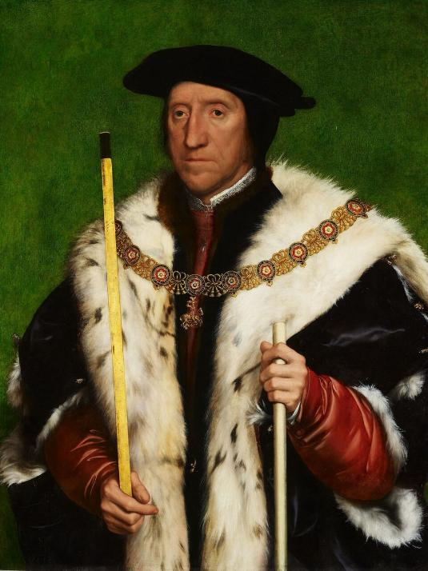
CHARACTERS: Thomas Howard, Duke of Norfolk
Norfolk initially negotiates and gets the rebels to disperse, but when revolt again breaks out in January 1537, he uses force.
Norfolk is a fairly traditional Catholic and an enemy of Thomas Cromwell, the religious reformer. However, Norfolk does profit from the monasteries being sold, gaining land.
Notes:
At this stage, the teacher can give an overview of what happened to the different characters, using this and subsequent slides (Slides 43–48).
Image © Royal Collection Trust

Slide 44
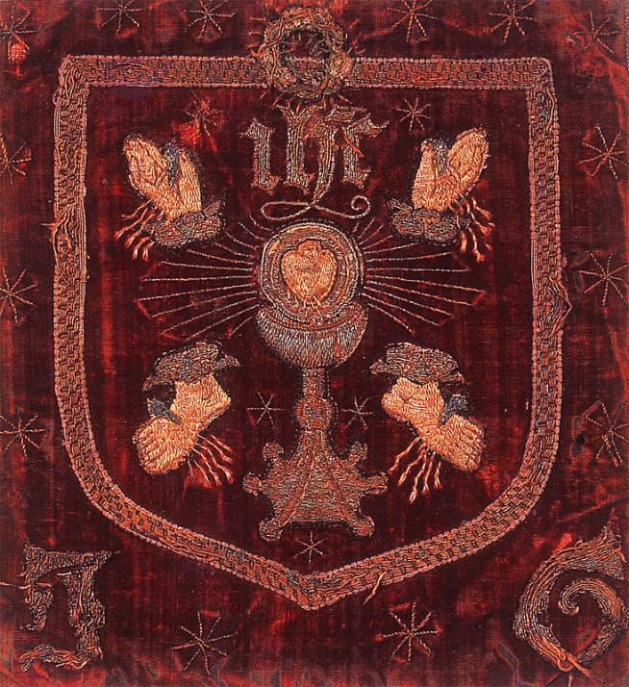
CHARACTERS: John Pickering of Bridlington
Pickering is captured as a ringleader of the rebels and executed.
Notes:
Image: https://tudortimes.co.uk/military-warfare/the-pilgrimage-of-grace

Slide 45
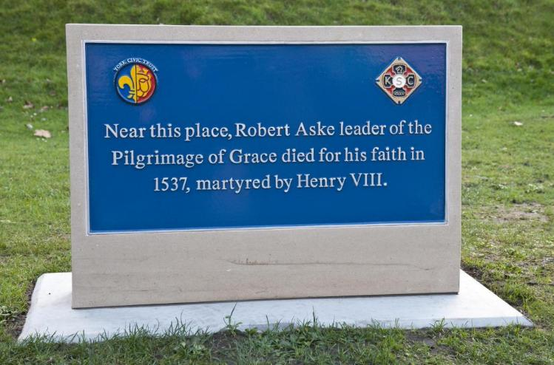
CHARACTERS: Robert Aske
Aske negotiates with Howard and also with Henry VIII himself at one point. He then agrees to persuade the rebels to disband.
March 1537: He travels through the North with Norfolk and in return is given a letter of commendation from Norfolk for the King, but Norfolk has tricked him. He is arrested when he gets to London.
He is executed at York, being hanged from a chain on 12 July 1537.
Notes:
Image: https://commons.wikimedia.org/wiki/File:Robert_Aske_%28died_1537%29_%2846129957291%29.jpg

Slide 46
CHARACTERS: William Thornton
Thornton is forced to join the uprising by the rebels, but he quickly writes to Cromwell to assure him of his loyalty!
He tries to persuade Cromwell to let the Abbey stay open as a collegiate church, but his pleas are ignored.
The Abbey is closed down in 1539, following the Act of Parliament suppressing the larger monasteries.
Thornton retires with a pension.
Notes:
When discussing Thornton, the teacher can combine it with discussion of the iconoclasm hinted at in Activity 2 if desired.
Image: York Museums Trust, YORYM: 2011.325

Slide 47
St Mary’s Abbey, York
The statues of the prophets and saints Were they buried to protect them from iconoclasm?
Notes:
When discussing Thornton, the teacher can combine it with discussion of the iconoclasm hinted at in Activity 2 if desired.
Image: https://www.historyofyork.org.uk/themes/norman/saints-and-prophets-statues-from-st-marys-abbey

Slide 48
CHARACTERS: Sarah Harkness
Sarah Harkness, a poor widow living in the city of York
Sarah is the only fictional character. She would have probably suffered as a result of the closures of the monasteries, because of the reduction in available alms-giving, and is likely to have been made desperate by the closures. Only one woman, of much higher rank, was executed for participation in the rebellion, but it is entirely plausible that others took part.
Notes:
Harkness is introduced for the purpose of giving participants a sense of the diversity of the pilgrimage.

Slide 49
ACTIVITY 6
Creating historical hypotheses
Notes:
This section focuses on exploring the impact of the dissolution on monasteries (specifically St Mary’s Abbey in this case) and using archaeological and written evidence to explore the levels of destruction created by the Reformation, as well as the repurposing of buildings for secular purposes. It also explores the famous history of the 1541 progress to the North, using recent historical research from the Henry on Tour team, allowing teachers to emphasise history as a living and developing subject, where we are still making new discoveries. The role of Katherine Howard in the 1541 progress – and the former St Mary’s Abbey as the probable site of her alleged adultery – is sure to excite student interest.

Slide 50
The story continues...
The bells of St Mary’s had not tolled in months. Once a sacred sound sweeping across the moors, it had now faded into silence, like the voices of the monks who had prayed beneath its vaults. The Abbey, ancient and magnificent, stood like a wounded beast – its bones still proud, but its soul stripped bare.
Archbishop Lee arrived under the shadow of dusk, his cloak drawn tightly against the Yorkshire wind. He was a man of God, yes, but these were no longer godly times. The Pilgrimage of Grace had risen like a storm –thousands of rebels marching for faith, for tradition, for the monasteries that Henry VIII had begun to tear down. But the King’s reply had been swift and merciless. Heads rolled in York and Lincoln, traitors swinging like scarecrows on the roads.
Lee had walked a tightrope during the uprising. Neither rebel nor royal favourite, he was spared – allowed to keep his archbishopric. But mercy from Henry VIII was often just the eye of the storm. Now, every knock on his door was a question of loyalty; every silence from court was a threat. And now the court was in turmoil again. In 1540, everyone knew that Henry was displeased with his new bride, Anne of Cleves. Could Lee use this to his advantage?
In a realm where faith bent to politics and abbeys burned like kindling, Edward Lee had chosen the only altar left to kneel before: survival.
Notes:
Teacher reads next chapter of story.

Slide 51
St Mary’s Abbey: In 1539, after the dissolution
What does this evidence, taken from the financial accounts of Leonard Beckwith, receiver of the revenues of the lands of the dissolved monasteries in Yorkshire, suggest? Which queen is the building being repaired for?
Extract 1: In 1539–40, a sum of £58, 3s, 9d was spent ‘on divers buildings within the site of the monastery of St Mary’s York now called the King’s Manor, which are reserved for the King’s councillors in the North’.
Extract 2: In 1540–41, £8, 10s, 2d was spent on ‘dighting and cleansing’ the King’s Manor before the King and Queen’s arrival, and an official called Clement Throckmorton was made responsible for ‘reparing and beautifying’ the houses ‘that the king intends to resort unto in his progress’ and gained a sum of £833, 6s, 8d for the purpose, of which £400 was to be spent on ‘St. Mary’s Manor’.
Notes:
Further information about this visit and the repairs can be found at: https://henryontour.uk/blog/sovereign-2023-kings-manor-short-history and in Tillott, P.M. (ed.) (1961) ‘The castle, Old Baile and King’s Manor’ in A History of the County of York: the city of York, London: Oxford University Press, pp. 521–31, British History Online, www.british-history.ac.uk/vch/yorks/city-of-york/pp521-531 [accessed 20 August 2025].
The extracts provided are found in ‘The King’s Manor’, in An Inventory of the Historical Monuments in City of York, Volume 4, Outside the City Walls East of the Ouse (London, 1975), British History Online, https://www.british-history.ac.uk/rchme/york/vol4/pp30-43 [accessed 26 April 2026]

Slide 52
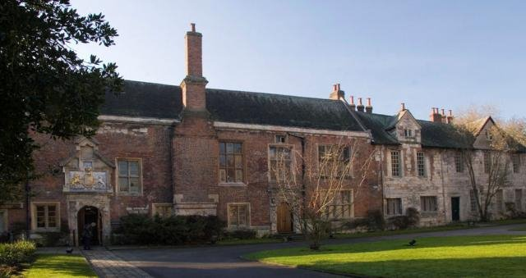
The King’s Manor
The former house of the Abbot became the offices of the King’s Council of the North after 1539.
It is now part of the University of York.
Notes:
Image: www.york.ac.uk/campus-investment/current/kings-manor

Slide 53
The final chapter…
Lee’s alliance with Thomas Cromwell had given him a measure of safety – Cromwell, the calculating architect of England’s new religious order. Yet their alliance was uneasy at best. Lee’s soul still clung to the old faith, to Latin chants and papal supremacy, even as his lips whispered the words of the King’s English liturgy. Now, Cromwell’s star was dimming, eclipsed by the fury of a king humiliated by a bride that he despised.
‘I like her not – I like her not!’ Henry had spat when he first laid eyes on Anne of Cleves, his fourth wife. The words echoed through Whitehall like a curse. Cromwell, who had brokered the disastrous marriage, was marked. Lee, who had aided in the legal unravelling of the union, hoped that his role would earn the King’s gratitude. Instead, he found only silence – and the cold dread that silence brought.
Notes:
Presenter provides a reading of this longer section of the story (Slides 53–55).

Slide 54
Then came Katherine.
Barely 17, she was as radiant as springtime and twice as dangerous. A Howard by blood, and Anne Boleyn’s cousin, she danced into Henry’s heart and pushed Cromwell to the scaffold. Now she was queen – and Henry, intoxicated by youth and beauty, sought to parade his new prize before the people.
But the North remembered. The fires of the Pilgrimage of Grace had been doused in blood, yet the embers glowed still beneath Yorkshire’s surface. Whispers of the Wakefield Conspiracy reached the King’s ears – new plots, new rebels. Henry’s patience wore thin.
‘I will go to York,’ he declared, pounding the table before his lords. ‘Let them see their king and know that God’s anointed does not cower from cowards.’

Slide 55
Lee, upon hearing of the royal progress, felt the chill of fate wrap around him. The King, in all his wrath and glory, would walk the streets of York. With Katherine at his side, a crown on her golden hair, Henry would seek to subdue not just a city but a spirit – the defiant spirit of the North.
As the banners were raised and trumpets readied, Lee knelt alone in York Minster, whispering a Latin prayer that he dared not speak aloud in court. For he knew the truth: this was not merely a visit. This was a reckoning. The King was coming north – not just to show his strength but to test the loyalty of those who had once defied him.
And Lee? He stood on a knife’s edge between two worlds – between a faith no longer safe and a crown that demanded absolute obedience. In the shadow of royal wrath and northern resistance, he feared that even archbishops would bleed when kings went hunting ghosts.

Slide 56
RESEARCH FINDINGS
These are some research findings from the project about Henry VIII’s visit to York in 1541. What do they indicate to you about the purpose of his visit?
A progress north in the late 1530s was suggested on a number of occasions, but health considerations, royal pregnancies and security concerns had delayed it.
There was an attempted uprising at Pontefract Castle in 1541.
Henry planned to meet King James of Scotland in York, but the Scottish king never turned up.
Notes:
The information here is based on findings by the Henry on Tour academic project team and was presented at the introductory workshop for Teacher Fellows at Hampton Court in January 2025. I am grateful to Anthony Musson and Kate Giles especially, for their assistance with this material. This information (which is available on one sheet via the HA website or provided on Slides 56–57 here) can be used to inform a class discussion on the uncertainties of the royal household’s movement – a reminder of the insecurity and uncertainty of Henry VIII in the face of possible opposition and (arguably) his growing paranoia. It can also be used to discuss the situation with Scotland during this time period; the fact that King James did not turn up to Henry’s meeting caused a great deal of royal rage! The attempted rising at Pontefract is linked to the Wakefield Conspiracy.

Slide 57
During the progress north, the amount of game hunted was enormous, even by Tudor royal standards, with the royal court killing vast quantities of animals as they moved to the area and then dining on their kills.
The city of York planned elaborate pageants to celebrate the King coming, and took advice from neighbouring towns about how best to please the King. They all agreed to wear plain-coloured clothes and not colourful garments.
The King and his closest courtiers were housed in the former dining room of St Mary’s Abbey; Queen Katherine and her ladies-in-waiting were housed in the former dormitory. Both areas were expensively refurbished for the occasion. After the visit, however, they quickly fell into disrepair and lacked some roofing by 1545.
Notes:
The information here is based on findings by the Henry on Tour academic project team and was presented at the introductory workshop for Teacher Fellows at Hampton Court in January 2025. I am grateful to Anthony Musson and Kate Giles especially, for their assistance with this material.
Note the quantity of game, which is perhaps a sign of punishing the nobility of the North, many of whom were seen to have been disloyal during the Pilgrimage of Grace. The use of plain rather than coloured garments was a sign of penance for the former rebellion. The preparations for the royal progress were extremely lavish and a sign that the area was extremely worried about the King’s visit, which they thought would be used to punish them for former disloyalty during the Pilgrimage of Grace.

Slide 58
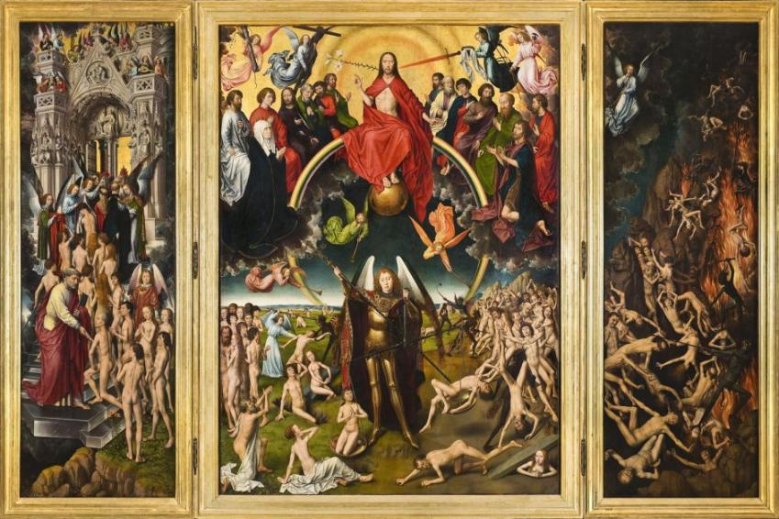
Assertion of power in York, 1541
Henry’s 1541 progress was all about asserting his power. In York, he even refused to enter by the gate where a pageant was planned, instead riding to a different entrance and insisting that all the officials of York came out to wait upon him at this new entrance.
Then those who had supported him during the Pilgrimage of Grace were allowed to stand on his right, while those who had supported the rebels – including Edward Lee – were obliged to kneel on his left in the mud, and publicly beg for forgiveness.
Hans Memling (c. 1433–94), The Last Judgment (c. 1466–73), oil on panel, dimensions not known, National Museum, Gdańsk, Poland (public domain)
Notes:
The teacher could talk the class through the information on this slide; it’s worth pointing out that by dividing loyal and disloyal subjects, on his right and left respectively, Henry was echoing the biblical text of Matthew 25 (about dividing the sheep and the goats at the Last Judgment). This division of good from bad was the subject of the many Doom paintings in churches of the period. The information is based on findings by the Henry on Tour academic project team and was presented at the introductory workshop for Teacher Fellows at Hampton Court in January 2025. I am grateful to Anthony Musson and Kate Giles especially, for their assistance with this material.

Slide 59
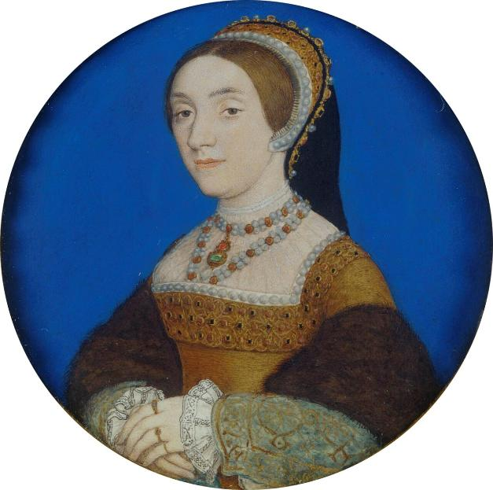
Did York have its revenge on Henry?
It was while on progress north that Queen Katherine consorted with Dereham and Culpepper, both of whom she had had relationships with prior to marriage. The most recent research suggests that it was at St Mary’s Abbey that her assignations – possibly adulterous – took place.
Notes:
This is not essential, but it is an interesting (and somewhat salacious!) element here – the most recent research suggests that it was in the King’s Manor (former Abbot’s House of St Mary’s) that Katherine Howard’s assignations with her (alleged) lovers took place in 1541.
Image © Royal Collection Trust

Slide 60
PLENARY DISCUSSION
What was the impact of the Reformation on York?
Which character suffered most/least due to the Reformation? Which groups gained from the Reformation?
How typical was York’s experience of religious change?
Notes:
Whole-class discussion.

Slide 61

Thank you

