Slide 1
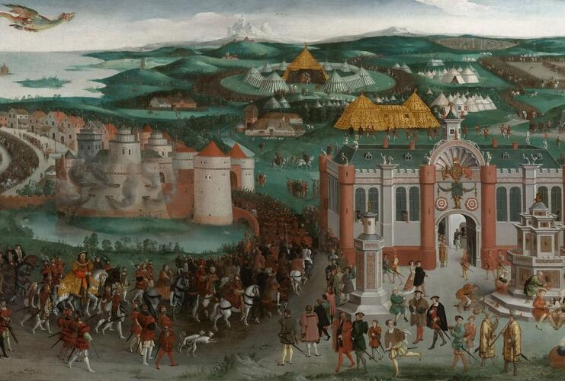



Note to teachers:
These slides are designed to be adapted to fit your teaching needs. There are notes at the bottom of the slides to explain images/sources that may be unfamiliar. I have included ‘translations’ of sources in Middle English to modern English in the notes under the relevant slides. I hope that you find them useful!
H. Carrel
Helen.carrel@googlemail.com
Notes:
The Field of the Cloth of Gold, painted c. 1545 © Royal Collection Trust / His Majesty King Charles III

Slide 2
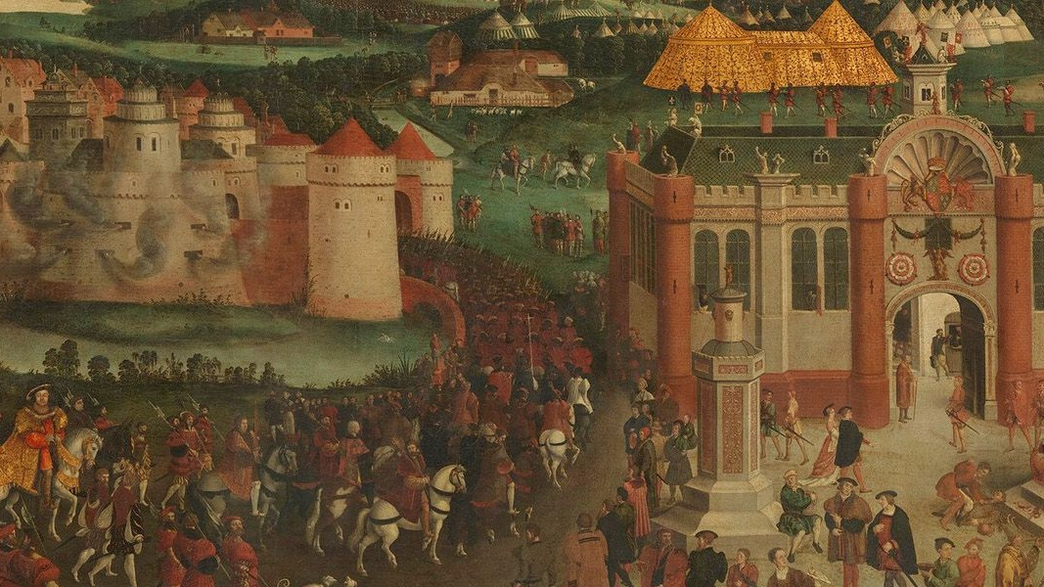
Enquiry 1
What does the Field of the Cloth of Gold tell us about monarchy in the time of Henry VIII?
Notes:
Introducing title question

Slide 3
What does the Field of the Cloth of Gold tell us about monarchy in the time of Henry VIII?
Aims:
To explore the cultural and political impact of the Field of the Cloth of Gold through primary sources
To develop techniques for analysing and evaluating primary sources

Slide 4
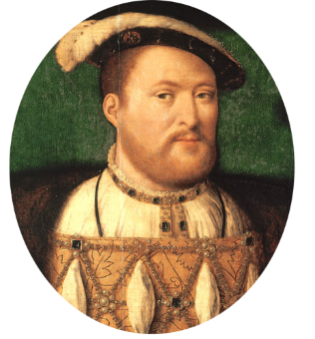
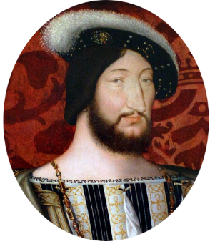
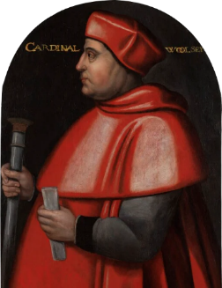
What was the ‘Field of the Cloth of Gold’?
Meeting between Henry VIII and Francis I, the king of France, between 7 and 24 June 1520 in a valley subsequently called the Val d’Or, near Guisnes (south of Calais)
Diplomatic meeting between France and England, organised by Cardinal Wolsey, Henry’s key advisor
Purpose was to improve Anglo–French relations and consolidate the 1518 ‘Treaty of Universal Peace’ (also called the Treaty of London), which had been signed by various European countries
Notes:
This focus on diplomacy reflected the growing intellectual idea, supported by figures such as Thomas More and Erasmus, that diplomacy and peace – rather than warfare – were ways for a king to gain honour.
The event derived its name from the lavishness of the materials used for the tents and other furnishings, and contemporaries commented on its opulence and extravagance.
Ultimately, the Treaty of Universal Peace could not last. Two weeks after the Field of the Cloth of Gold, Wolsey arranged another meeting between Henry and Emperor Charles V, hoping to secure a new alliance between England, France and the Holy Roman Empire.
However, both Charles and Francis were suspicious of Wolsey’s motives, and the alliance did not come about.
By the middle of 1521, Francis and the Emperor were back at war, after Charles attacked French territory. England was drawn into the conflict and peace in Europe was shattered.
Images: https://commons.wikimedia.org/wiki/File:1491_Henry_VIII.jpg; https://en.wikipedia.org/wiki/Francis_I_of_France; https://en.wikipedia.org/wiki/Amicable_Grant

Slide 5
GROUP ACTIVITY 1
Mystery object

Slide 6
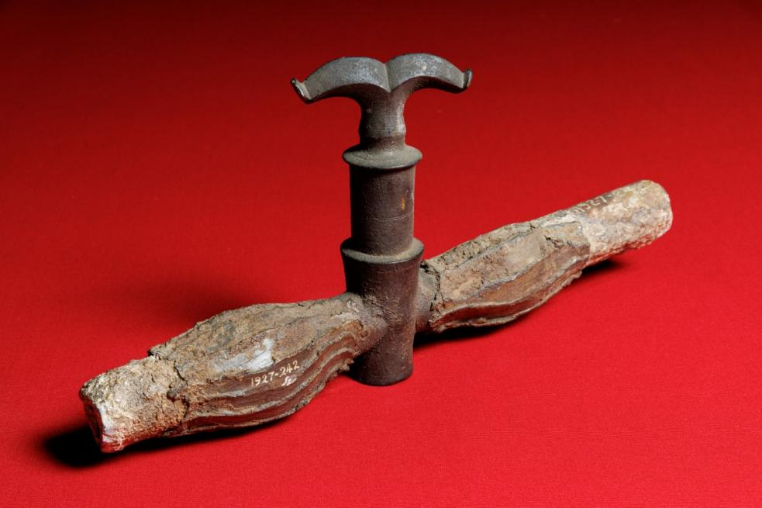
ACTIVITY 1: Discuss in groups
This is an object from the collections of Historic Royal Palaces.
What is it and what does it tell us about the society that created it?
© Royal Collection Trust, currently on display at Hampton Court Palace
Notes:
This is a ‘double tap’, taken from the Tudor World exhibition at Hampton Court (Historic Royal Palaces). It was designed to allow both red and white wine to flow from a wine fountain as part of royal ‘entries’ or other public celebrations. Note the stylised and skilled work on the pipes and tap.

Slide 7
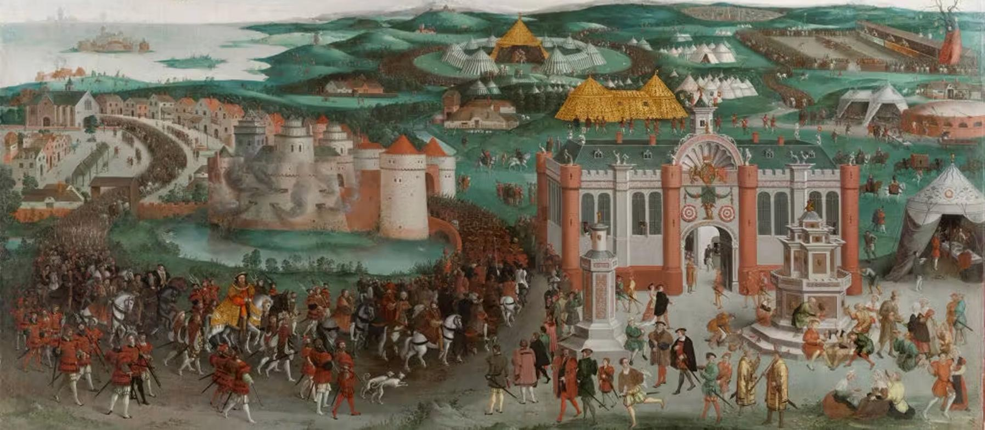
Field of the Cloth of Gold, c. 1545, painted by multiple artists in a workshop, probably for Henry VIII
© Royal Collections Trust, currently on display at Hampton Court Palace
Notes:
The image is the Field of the Cloth of Gold painting, c. 1545, from the Royal Collections Trust, Oil on canvas | 168.9 x 347.3 cm (support, canvas/panel/stretcher external) | RCIN 405794, Wolsey Room 4, Hampton Court Palace
Provenance: It was created by multiple artists (in a workshop). It was probably painted for Henry VIII. A wine fountain, providing different types of wine, can be seen on the right-hand side as you look at the painting, and is mentioned by many contemporaries who visited the Field of the Cloth of Gold.

Slide 8
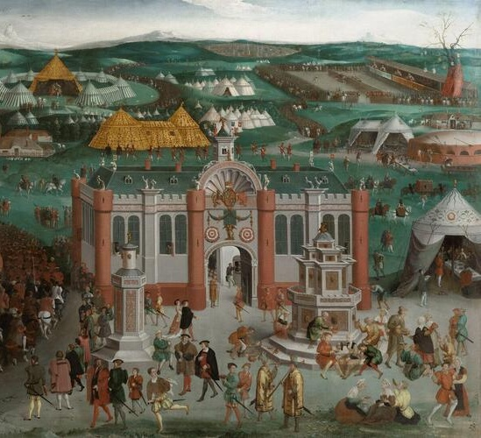
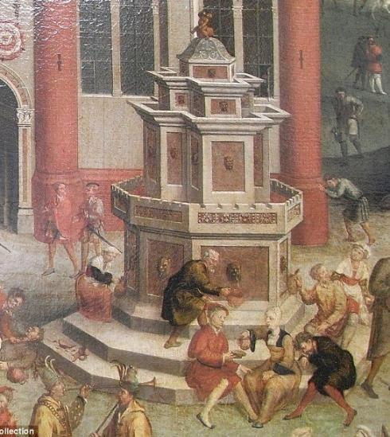
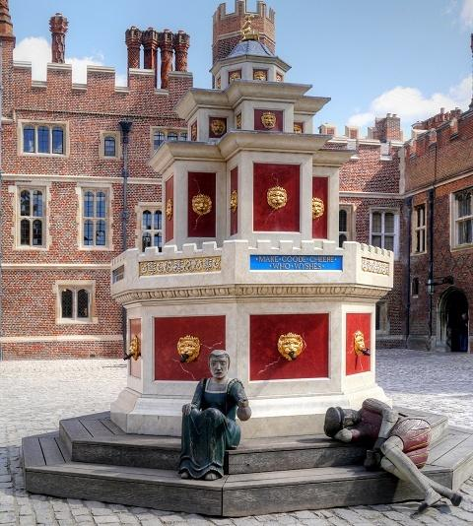
Reconstruction: Wine fountain
Notes:
Here we see two close-ups from the Field of the Cloth of Gold painting on the previous slide, and on the right-hand side you can see a replica of this wine fountain, which was designed by London architects and is situated at Hampton Court Palace (and even sometimes put to use as a wine fountain for special events!).
Use the Field of the Cloth of Gold painting to draw out themes:
Henry on tour – the complexity and lavishness of the arrangements made for Henry VIII and his entourage when they visited France for the Field of the Cloth of Gold in 1520
the importance of cross-referencing sources, which is central to historical research, and the growing focus on interdisciplinary approaches
the fact that history is a living subject, as shown by the reconstruction of the wine fountain in the painting by a team of London architects; you could use this to highlight the range of careers on offer for those interested in taking history further
Image of wine fountain: https://commons.wikimedia.org/wiki/File:Tudor_Wine_Fountain_at_Hampton_Court_Palace_(geograph_4434287).jpg

Slide 9
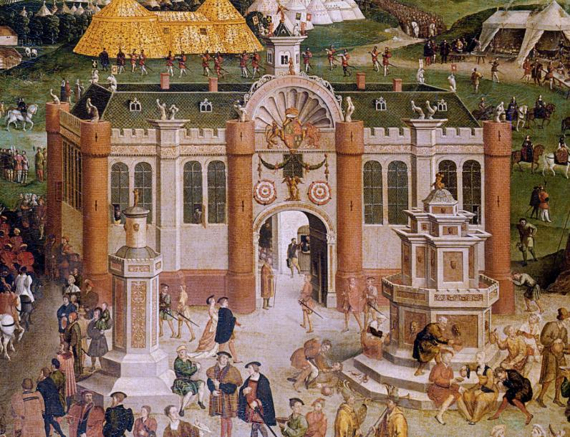
WINE FOUNTAIN: Edward Hall’s Chronicle (1548)
‘At the enteryng into the palays before the gate, on the playne grene was buylded a fountayne of enbowed woorke, gylte with
fyne golde,... ingrayled with anticke woorkes, the olde God of wyne called Bacchus byrling
the wyne, whych by the conduyctes in therth
ranne to all people pleteously with red, white and claret wyne.’
Notes:
We know from other sources that wine was a big feature of the Field of the Cloth of Gold. This is an extract from Edward Hall’s Chronicle, published in 1548, taken from: https://archive.org/details/hallschronicleco00halluoft, p. 603
Translation into modern English (by H. Carrel):
At the entrance into the palace before the gate, on the plain green was built a fountain of arched work, gilt with fine gold... inlaid with ancient works, the old god of wine called Bacchus serving the wine, which by the pipes in the earth ran to all people plenteously with red, white and claret wine.
(Note: the difference between ‘red’ and ‘claret’ wine here seems to be to do with the region from which the wines originated.)

Slide 10
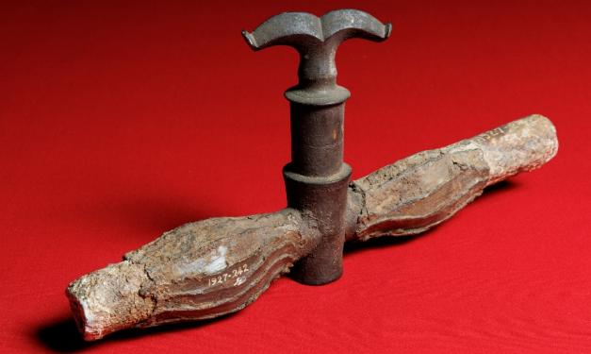
Further insight…
‘During this triumph so much people of Picardie and west Flauders drew to Guysnes to se the kyng of England & his honor, to whose vitailes of the court were in plentie, the conduicte of the gate ranne wyne alwaies, there were vacaboundes, plowmen, laborers & of the bragery, wagoners & beggers that for drunkenness lay in routes and heapes, so great resort thether came, that both knightes & ladies that wer come to see the noblenes, were faine to lye in haye and strawe, & helde theim therof highly pleased.’
Edward Hall’s Chronicle, 1548
© Royal Collection Trust, currently on display at Hampton Court Palace
Notes:
Edward Hall’s Chronicle continues (translation below by H. Carrel):
During this triumph so many people of Picardy and West Flanders came to Guisnes to see the king of England and his honour, and the plentiful food of his court, and the pipes of the gate ran with wine always. There were vagabonds, ploughmen, labourers and others of the riff-raff, waggoners and beggars, who because of drunkenness lay in piles and heaps; so many came hither that both knights and ladies who had come to see the nobles were happy to lie in hay and straw and regarded this as a cause of high pleasure.

Slide 11
Linking the ‘double tap’ artefact to other sources
As historians, we should ask ourselves:
How typical of the period is this source?
What do I know about the period that tells me how commonplace/extraordinary this event was?
Wine fountains were not unique to the Field of the Cloth of Gold or Henry VIII. They were a ‘set-piece’ of royal visits to towns and cities in the late Middle Ages or for key royal events.
© Royal Collection Trust, currently on display at Hampton Court Palace
Notes:
How can historians use an artefact like the ‘double tap’? We must link it to other sources in order to understand its use and impact in the Field of the Cloth of Gold. However, it is also important to consider its TYPICALITY. Were wine fountains rare or typical?
In fact, wine fountains were quite a ‘set-piece’ of royal visits to towns/cities during this period.

Slide 12
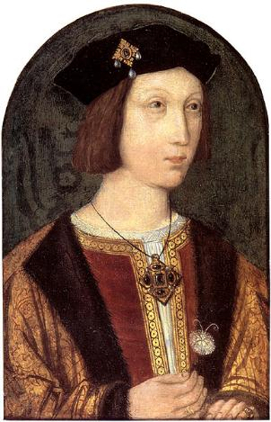
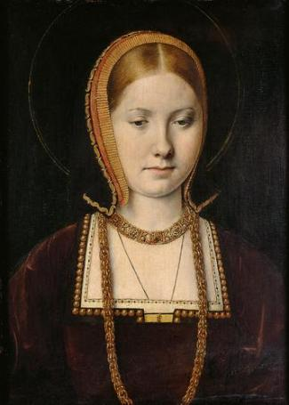
For example…
At the wedding of Prince Arthur and Katherine of Aragon, the public enjoyed a never-ending wine fountain near the west door of St Paul’s Cathedral. As the young couple left the church, they were greeted by a pageant with theatrical staging, which included a mobile mountain, complete with rocks, trees, herbs, fruit and metal ore. Flowing down this was a river of wine, designed to represent the wealth of the royal family and confirm them as a source of all good things for their subjects.
© Royal Collection Trust, currently on display at Hampton Court Palace
Notes:
Information from: Bennett Connolly, S. (2016) ‘The wedding of the century by Sean Cunningham’ in History... the interesting bits!, https://historytheinterestingbits.com/2016/07/24/the-wedding-of-the-century-by-sean-cunningham
Images: © Royal Collection Trust, currently on display at Hampton Court Palace; Wikimedia Commons/Private collection, https://commons.wikimedia.org/wiki/File:Anglo-Flemish_School,_Arthur,_Prince_of_Wales_(Granard_portrait)_-004.jpg; Wikimedia Commons/Kunsthistorisches Museum, https://commons.wikimedia.org/wiki/File:Michel_Sittow_002.jpg

Slide 13
GROUP ACTIVITY 2
Investigation of the Field of the Cloth of Gold painting
Notes:
Now we are going to try out some tools for investigating primary sources in greater depth, associated with the Field of the Cloth of Gold.

Slide 14
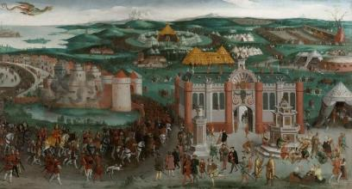
What does the Field of the Cloth of Gold tell us about monarchy in the time of Henry VIII?
How do the other sources deepen our understanding of the event?
What does this tell us about the Field of the Cloth of Gold?
Notes:
Each student should be provided with an A3 copy of this inference diagram or an electronic version, to fill in during the session. Good-quality images should also be provided in larger format and on the screen.
Initially, ask students to fill out the first (pink) box in groups: What does this tell us about the Field of the Cloth of Gold? A sheet copy of this inference diagram is provided on the HA website. Later, as the students look at different sources, they can fill in the blue box, while filling in the final section, ‘What does the Field of the Cloth of Gold tell us about monarchy in the time of Henry VIII?’, can come at the end of the enquiry as a plenary.

Slide 15
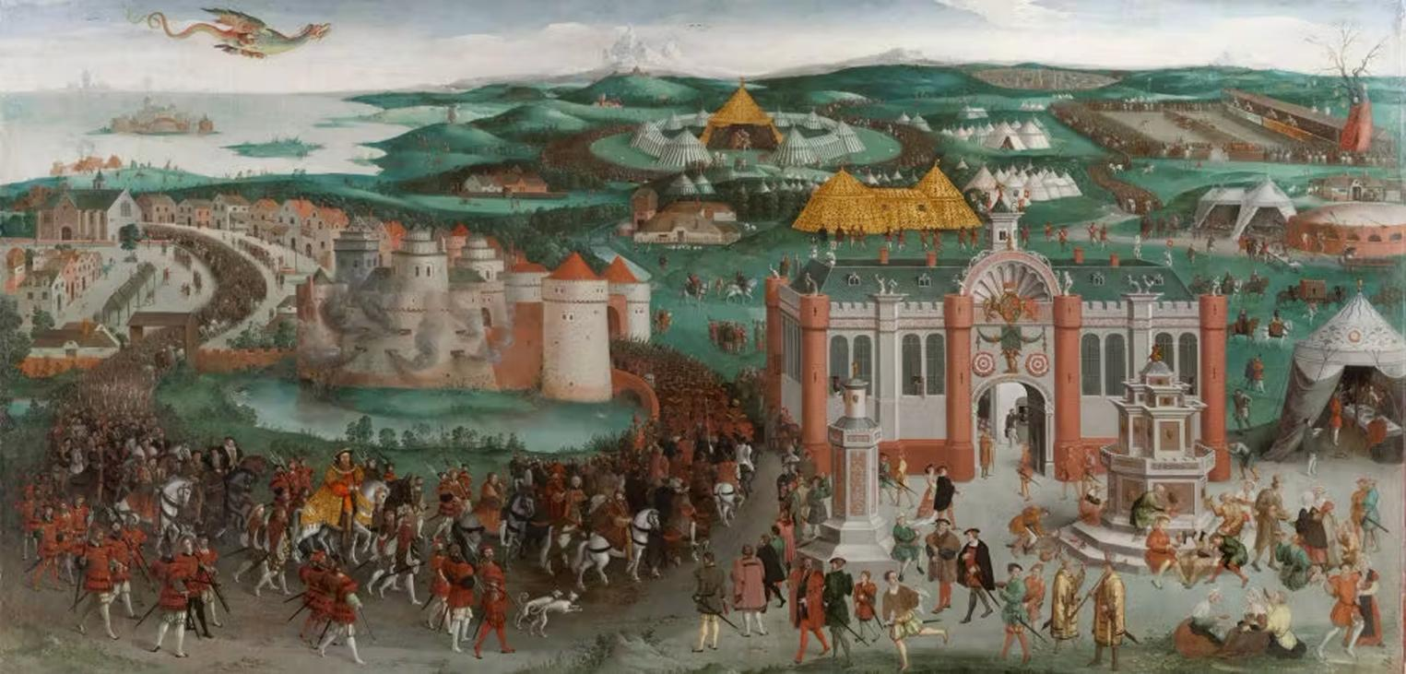
What does this painting tell us about the Field of the Cloth of Gold?
Work in your groups to complete the first box on the inference diagram.
ACTIVITY 2:
© Royal Collections Trust, currently on display at Hampton Court Palace.
© Royal Collections Trust, currently on display at Hampton Court Palace
Notes:
Field of the Cloth of Gold, c. 1545, painted by multiple artists in a workshop, probably for Henry VIII
Copyright: Royal Collections Trust, currently on display at Hampton Court Palace

Slide 16
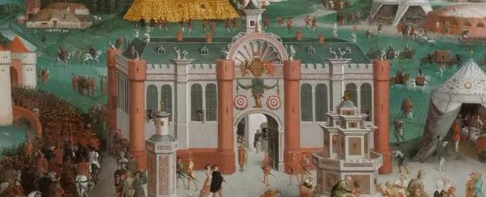
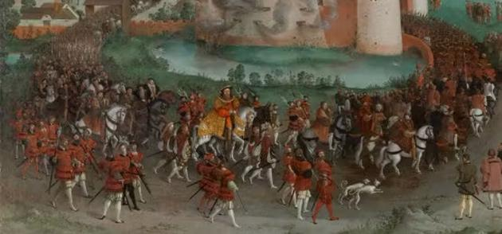
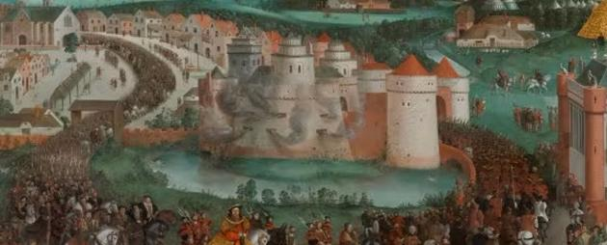
Did you spot…
the temporary palace made out of canvas and painted with artificial masonry?
Henry VIII riding his horse alongside his Chief Minister, Wolsey?
the Dukes of Norfolk and Suffolk riding behind the King and Wolsey?
the castle giving a burst of cannon fire as a royal salute, scaring the swans on the water?
Notes:
I used this ‘Did you spot...?’ exercise to bring the students through the painting. I am grateful to Russell Tarr’s Active History website for this idea, which I have adapted.

Slide 17
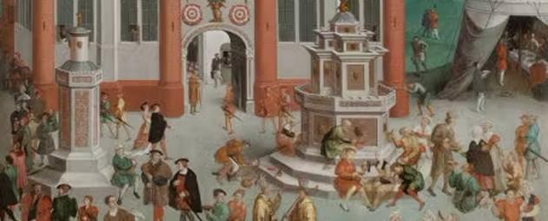
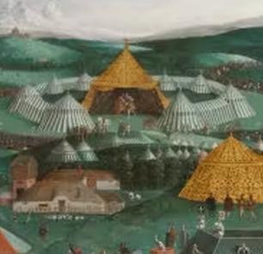
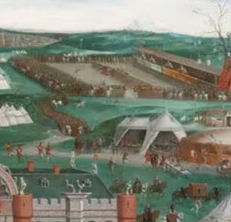
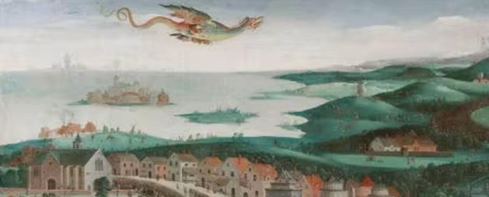
Did you spot…
a fountain pouring forth wine and people getting drunk around it?
the wrestling match between Henry VIII and Francis I?
the jousting match being watched by the King?
the giant kite with fireworks in the shape of a dragon?

Slide 18
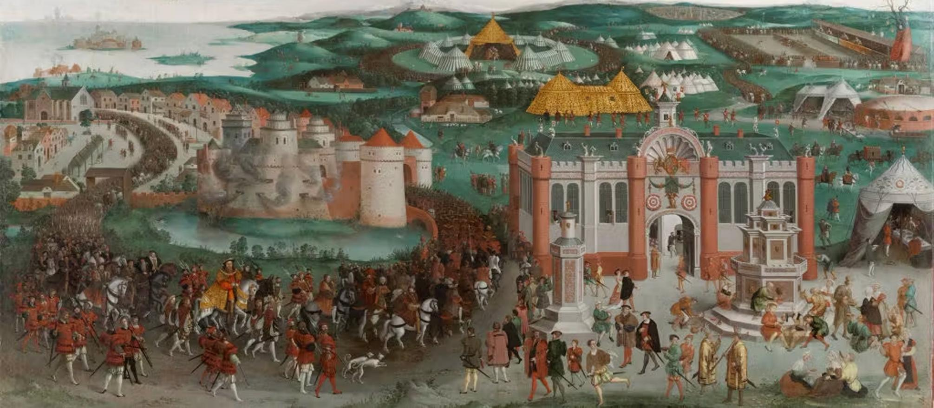
Field of the Cloth of Gold, c. 1545
© Royal Collections Trust, currently on display at Hampton Court Palace
Notes:
Let’s return to wine... and look at how to cross-reference sources.

Slide 19
GROUP ACTIVITY 3
Cross-referencing sources

Slide 20
What does the Field of the Cloth of Gold tell us about monarchy in the time of Henry VIII?
How do the other sources deepen our understanding of the event?
What does this tell us about the Field of the Cloth of Gold?
Notes:
Model how to cross-reference sources on the inference diagram, using the wine sources to begin to complete the blue box ‘How do the other sources deepen our understanding of the event?’

Slide 21
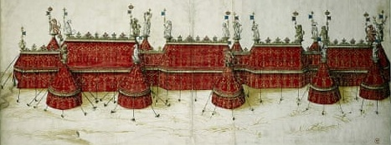
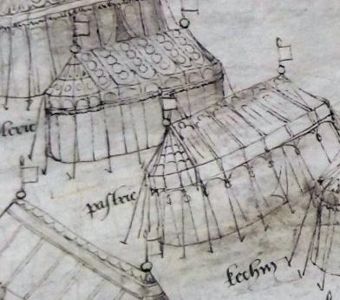
ACTIVITY 3: Discuss in groups
Explore four sources related to
the Field of the Cloth of Gold,
noting ideas on the next section
of the inference diagram.
section of Edmund Hall’s Chronicle
accounts, including costs for clothing and gildings
design for tents used at the Field of the Cloth of Gold
designs for tents at other events
© Royal Collections Trust, currently on display at Hampton Court Palace.
Notes:
Provide a set of four sources to the participants in small groups, which they can use to explore the Field of the Cloth of Gold further. The sources can be found on the next four slides. Printable versions of all the sources used in this workshop are available on the HA website.
The sources are:
section of Hall’s Chronicle
accounts, for costs of clothing and gildings
design for tents used at the event
design for tents used at other events that are contemporaneous with the period
Images: British Library; www.hrp.org.uk/hampton-court-palace/history-and-stories/the-field-of-cloth-of-gold/#gs.kr7krb

Slide 22
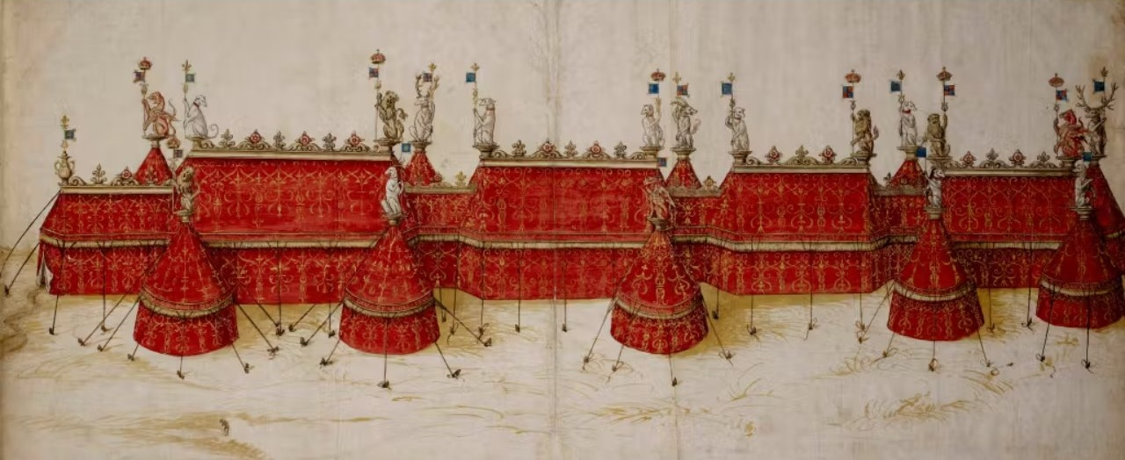
Source 1
Design for a royal pavilion in crimson and gold, surmounted by 18 King’s Beasts, said to be for Henry VIII at the Field of the Cloth of Gold
© The British Library Board, Cotton Ms. Augustus III, f.18
Notes:
Image: www.hrp.org.uk/hampton-court-palace/history-and-stories/the-field-of-cloth-of-gold/#gs.kr7krb

Slide 23
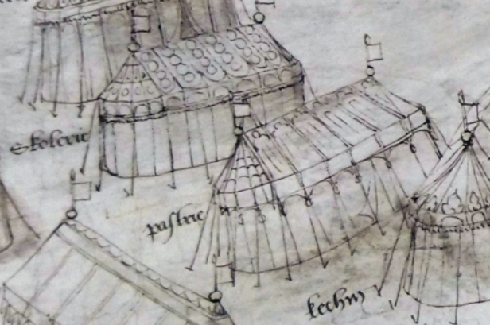
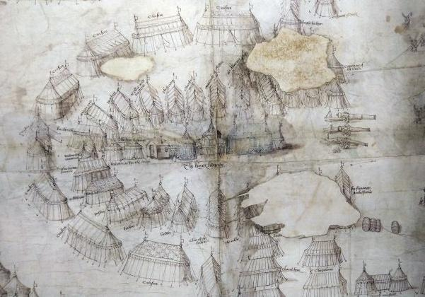
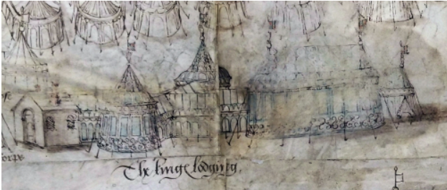
Source 2
Map of Henry VIII’s army encampment, probably dating from one of his invasions of France, which he led in 1513 and 1544
Notes:
Images: Henry VIII’s pastry tent - Medieval manuscripts blog, British Library, Cotton Roll XIII 41 (no longer available). Top right: an image from the centre of the map. Bottom right: a close-up of some of the other tents, near the centre.
Note that many of these tents were for the food preparation, as we can see from the labels. Draw participants’ attention to the similarities in design and the fact that although the Field of the Cloth of Gold was a diplomatic mission, it was also designed to demonstrate the military strength of each side. Provisioning an army and army encampments was crucial to success in battle.

Slide 24
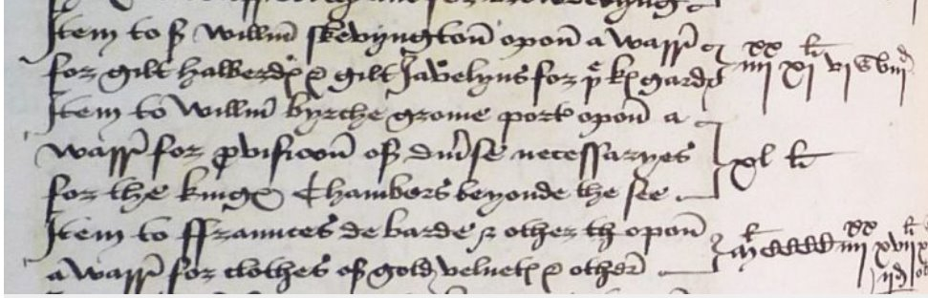
Source 3
Section from a roll of accounts listing payments for items bought for the
Field of the Cloth of Gold, 1520
Item to William Skevyngton upon a warr[ant] for gilt halberds and gilt javelyns for the king’s gardis [guards]
= £91 (4score and 11) 6s 8d
Item to William Byrche grome [groom] porter upon a warr[ant] for provision of diverse necessaryes
for the king’s chambers beyond the see [sea]
= £40
Item to Fraunnces de Barde and others the[re]upon a warr[ant] for clothes of gold velvete and others
= £1497 10s 2 ½d
Notes:
I am grateful to Prof. Anthony Musson, Historic Royal Palaces, for the transcription of this extract.
Reference: Payments for gilded halberds and javelins for Henry VIII’s guard and £1,497 spent on clothes of gold velvet for the King. Catalogue ref: E 36/215, fol. 88r, https://webarchive.nationalarchives.gov.uk/ukgwa/20250613142342/https:/blog.nationalarchives.gov.uk/the-field-of-the-cloth-of-gold-1520

Slide 25
Source 4
Edmund Hall’s Chronicle, published in 1548, in the section covering the ‘Field of the Cloth of Gold’ event:
Mondaye the iiii daye of Iune the kynges grace with all the nobles aswellthe quene with her trayne of ladyes as other, with all the whole... nobles remoued from Calis to his lordship royall of Guisnes into the most noble and
royall lodgyng before sene, for it was a palays, the palays was quadrant… This palayce was sette on stages by great connynge and sumpteous woorke.…
Notes:
Translation by H. Carrel:
Monday the 4th day of June the king’s grace, with all the other nobles, as well as the queen with her train of ladies as well as others, with the whole [group] of nobles left from Calais to his royal lordship of Guisnes, into the most noble and royal lodging ever before seen; for it was a palace, the palace was a quadrant… This palace was set on levels by great cunning and sumptuous work.
Extract from Hall’s Chronicle, https://archive.org/details/hallschronicleco00halluoft

Slide 26
How can cross-referencing primary sources help us to understand the past?
‘Fact-checking’ can be a valid use of cross-referencing, but as historians, we need to do more than this. For example, we can ask some of these questions:
How can an interdisciplinary approach help?
What is the nature of the sources and how does this impact their reliability?
Is what this source is describing typical for the period? If not, why not?
What can the sources, working together, reveal to us about Henry VIII’s monarchy?
Notes:
Consider these questions with the participants in small groups and then as a whole-group discussion.

Slide 27
How we use primary sources can vary:
‘Freestyle’: What do you see? What does it tell you?
Having questions that we are seeking to answer: This provides more of a focus, but it can limit our interpretation.
The best approach is to remain flexible: You view sources with a purpose and with a toolkit of questions that are likely to help you to analyse them, but you allow yourself to be surprised and to change tack if necessary.
Notes:
Make explicit the different methods of using sources, considering the pros and cons of each with the group. This helps participants to understand their own learning (metacognition), assisting their development.

Slide 28
GROUP ACTIVITY 4
Using a source frame
Notes:
This activity is designed to provide students with more concrete and advanced tools with which to analyse sources.

Slide 29
Can you make links between what the source says and precise pieces of background knowledge?
What are the creator’s religious and political viewpoints? Do these influence the source?
How does the creator want the audience to react and how are they likely to react?
What is the date of the source? How does this impact what the source says?
Is the author a single person or a group (e.g. Parliament, the Privy Council)? If a group, who were the leading figures in that group at that date?
What evidence is the creator basing their source on (e.g. eyewitness accounts, rumour, financial information)?
Who paid for/wanted this source to be created (who commissioned it)? Why? How does that impact the content of the source?
What is the creator’s attitude towards the reigning monarch? How is this demonstrated in the source?
Does this source shed light on information provided by another source you are using?
How wide was the audience likely to have been (e.g. was it printed, only for certain groups, etc.)?
What is the author trying to achieve by creating this source?
Is the source typical for the time or unusual? Why?
What type of source is this? Will this affect the content?
What does the source reveal about the period?
Notes:
This source frame was provided to participants on A3 paper, with the central rectangle cut out as a hole. The source then appears in the centre with the questions around it. A copy of this frame is available on the HA website.
This technique has been used extensively at Tormead with A-level students, and we have found that it substantially improves student understanding of how to evaluate primary sources when used regularly in the classroom, significantly improving our results in the relevant papers. This frame is focused on Tudor sources, but could easily be adapted for other time periods.

Slide 30
What does the Field of the Cloth of Gold tell us about Henry VIII’s monarchy?
As a group, examine your next set of sources and try the source frame for at least some, noting down your ideas on the inference diagram.
Notes:
An additional set of sources was provided for participants to work on in small groups. A number of these sources are available on the following slides (31–34), as the group-work was followed by general discussion. The full range of sources are available in item 5 of this resource pack.

Slide 31
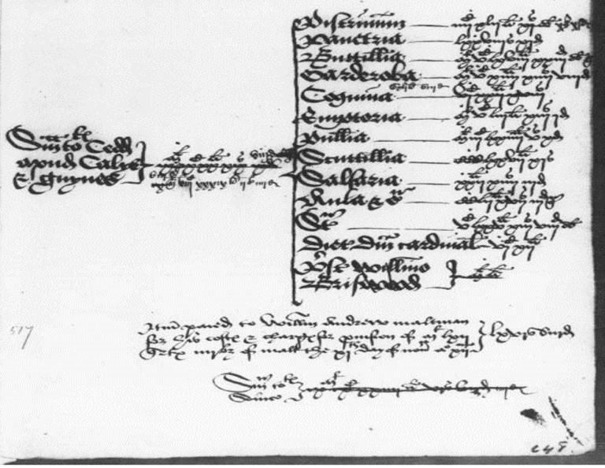
Source 5: Costs of provisioning Henry VIII’s household
The costs of provisioning of Henry VIII’s household at Calais and Guisnes:
Bakery: £442, Pantry: 78s 11d, Buttery: £1,568, Wardrobe: £1514, Kitchen: £541, Actary: £1,554, Poultry: £1,004, Scullery: £377, Saucery: £22, Hall: £252, Cardinal’s diet: £612. 31 May–16 July 1520: £9,920 19s 8d
Notes:
Accounts showing costs of provisioning Henry VIII’s household at Calais and Guisnes during the Field of the Cloth of Gold
Taken from: National Archives, Catalogue ref: SP 1/20, folios 180–244, https://webarchive.nationalarchives.gov.uk/ukgwa/20250613142342/https:/blog.nationalarchives.gov.uk/the-field-of-the-cloth-of-gold-1520

Slide 32
Source 6: Extract from diary of Marino Sanuto, Venetian, dated 11 June 1520
On the day of the first conference between the two Kings, from 3,000 to 4,000 men, horse and foot, were hidden about the country, within call of the King [Francis], but this was a secret, as the number of persons allowed to attend the conference was limited. The King of England got some hint of this, and as King [Francis] had more troops actually present than the stipulated amount, the King of England took umbrage, and well nigh determined to withdraw; but when King Francis heard of this, he desired all, under pain of the gallows, to return to the village of Ardres, save those of the King’s household; and thus upwards of 2,000 horses went back. On hearing this, the English King proceeded without hesitation.
Notes:
An account of the Field of the Cloth of Gold from a visiting Venetian
Taken from: Calendar of State Papers Venice vol. 3 (London, 1869), dated 11 June 1520, p. 62, https://archive.org/details/calendarofstatep3118brow/page/n133/mode/2up?q=on+the+day+of+the+first+conference

Slide 33
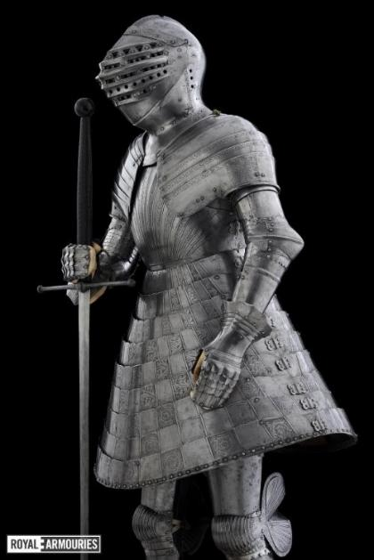
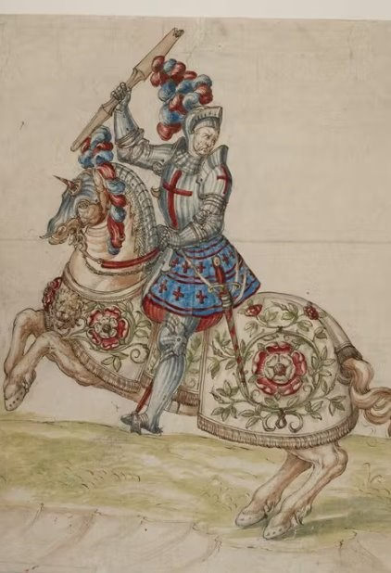
Sources 7 and 8: Tonlet armour and image of a knight (Henry VIII?) from sixteenth-century manuscript
© The Royal Armouries
© The British Library Board, Cotton Augustus III
Notes:
Images: (left) Leeds Royal Armouries, https://royalarmouries.org/objects-and-stories/stories/henry-viiis-foot-combat-armour; (right) a mounted knight, possibly Henry VIII, © The British Library Board, Cotton Augustus III, www.hrp.org.uk/hampton-court-palace/history-and-stories/the-field-of-cloth-of-gold/#gs.kr7krb

Slide 34
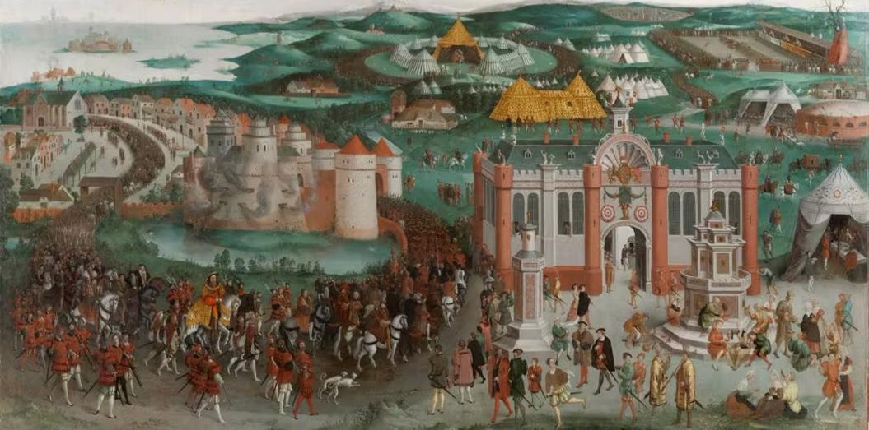
Source 9: Extract from Edmund Hall’s Chronicle, 1548
And from the palace or place into the mighty and strong fortress and royal castle of Guisnes, was a gallery for the secret movement of the king’s person into a secret lodging within the same Castle, the more for the king’s ease.
Notes:
Hall’s Chronicle, translated into modern English by H. Carrel
Original text taken from: https://archive.org/details/hallschronicleco00halluoft
This comment can be used to highlight various themes about Henry VIII’s monarchy, including: concerns with security; the fact that he wanted time away from the parties/diplomatic action, so that he could spend time alone; and the focus on a ‘fortress’, which is reminding the French of English military might.

Slide 35
Plenary discussion
What does the Field of the Cloth of Gold tell us about monarchy in the time of Henry?
How can we explore the progresses of Henry VIII in the twenty-first century?
Notes:
Whole-group discussion

Slide 36

Thank you
Dr H. Carrel
Helen.carrel@googlemail.com

