Slide 1
Year | £1 | 1s (shilling) | 1d (pence)
1510 | £662.76 | £33.14 | £2.76
1520 | £520.02 | £26 | £2.17
1530 | £441.28 | £22.06 | £1.84
1540 | £21.07 | £21.07 | £1.76
LOGISTICS
The practicalities of the visits, including: preparation beforehand, welcoming the King, food and drink, entertainment, lodgings, Henry’s entourage
Also refer to your notes from the video on:
The pot
Timber
The hospitium
The gateway
Key words:
Sexton – a person who looks after a church and churchyard,
including bell ringing and grave digging
Whitsun – a Christian holiday/festival
Malt – a grain used for brewing beer
Fletcher – someone who makes arrows
Certainties – what do we learn? | Questions/things to follow up | Possibilities/theories – what could be the case?

Slide 2
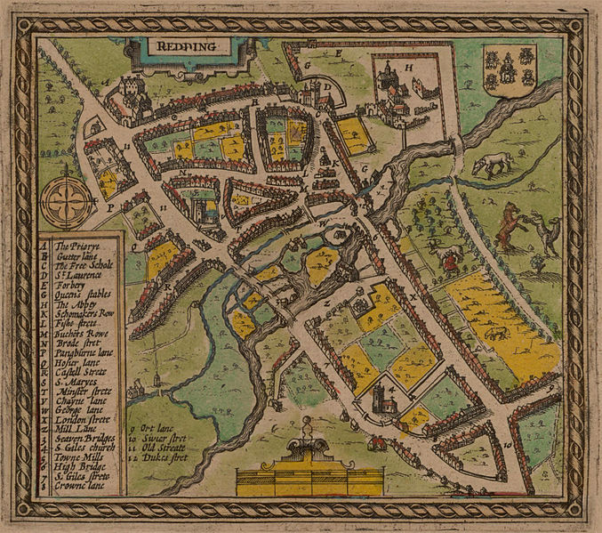
Speed map – this is the oldest map that we have of Reading (1611)
Hints
Can you theorise anything about:
Henry’s route into the town?
Why the Abbey was a good location in which to stay?
Notes:
Image: https://commons.wikimedia.org/wiki/File:Map_of_Redding_by_John_Speed,_1611.jpg

Slide 3
BUSINESS
Trade agreements, the King’s business
Also refer to your notes from the video on:
The shoe fragment
Key words:
Burgess – a town leader
Fulling mill – a water-powered mill used for work with cloth
Toker/fuller/
weaver – all individuals who work in the cloth-making process
Star Chamber – a court made up of judges and privy
councillors
Certainties – what do we learn? | Questions/things to follow up | Possibilities/theories – what could be the case?

Slide 4
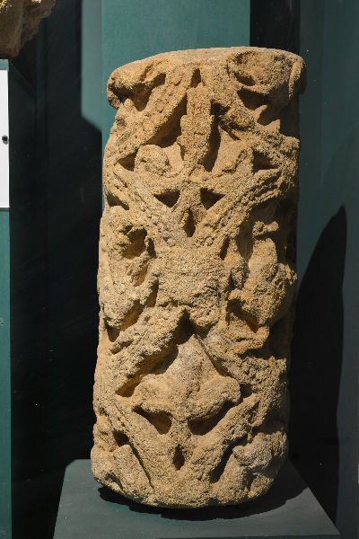
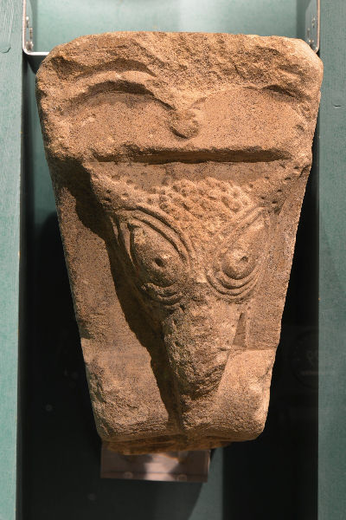
Stonework from the Abbey
A voussoir is an individual stone used to create a highly decorative arch. This one was carved from Caen stone, a fine limestone that would have been specially imported from Normandy. The standard of carving is very high. The design must have been popular with visitors because it quickly spread to other monasteries and churches in England!
This small column shaft or colonette came from a doorway or perhaps from one of the ‘blind’ arches in the cloister of Reading
Abbey. It was carved from limestone quarried at Taynton in Oxfordshire. The decoration features beasts and foliage designs in medallions.
Hints
What trade links did the Abbey have?
Can you theorise anything about:
Why the Abbey might have been a popular location for Henry?
Notes:
Images: Courtesy of Reading Museum (Reading Borough Council)
http://collections.readingmuseum.org.uk/index.asp?page=record&mwsquery=%20{collection}={archaeology}%20AND%20({place}=*{Reading%20Abbey})&filename=REDMG&hitsStart=28;
https://collections.readingmuseum.org.uk/index.asp?page=record&mwsquery=%7Btotopic%7D=%7BStory%20of%20Reading%20Gallery%7D&filename=REDMG&hitsStart=59

Slide 5
Year | £1 | 1s (shilling) | 1d (pence)
1510 | £662.76 | £33.14 | £2.76
1520 | £520.02 | £26 | £2.17
1530 | £441.28 | £22.06 | £1.84
1540 | £21.07 | £21.07 | £1.76
Also refer to your notes from the video on:
The Abbey church
The tiles
Key words:
Almoner – a servant who would dispense charity to the poor on behalf of their master
Dissolution of the monasteries – see your timeline for a definition of this
Cruse – a pot or jar
Annuity – a yearly payment
Meanest – greedy/tight with money
RELATIONSHIPS
Between the King and the town and the key players involved in the visits, patronage (gift giving)
Certainties – what do we learn? | Questions/things to follow up | Possibilities/theories – what could be the case?

Slide 6
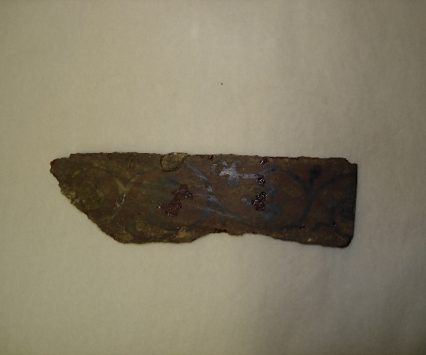
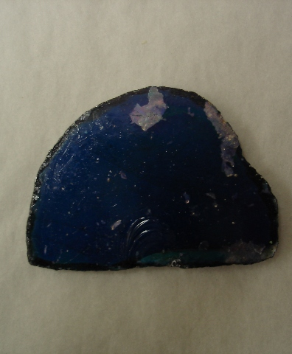
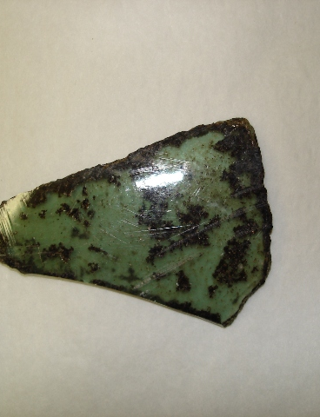
Fragments of stained glass
The church of Reading Abbey would have had enormous stained-glass windows, depicting a variety of religious scenes. Only a few small fragments of its glass have survived. Here we have examples of its red glass, blue glass (symbolising Heaven) and bright green glass (symbolising creation).
Hint
Can you theorise anything about:
Why the Abbey might have been a popular location for Henry?
Notes:
Images: Courtesy of Reading Museum (Reading Borough Council)
http://collections.readingmuseum.org.uk/index.asp?page=record&mwsquery=%20{collection}={archaeology}%20AND%20({place}=*{Reading%20Abbey})&filename=REDMG&hitsStart=31; https://collections.readingmuseum.org.uk/index.asp?page=record&mwsquery=(%7Bsearch%7D=*%7Babbey%7D)&filename=REDMG&hitsStart=158

Slide 7
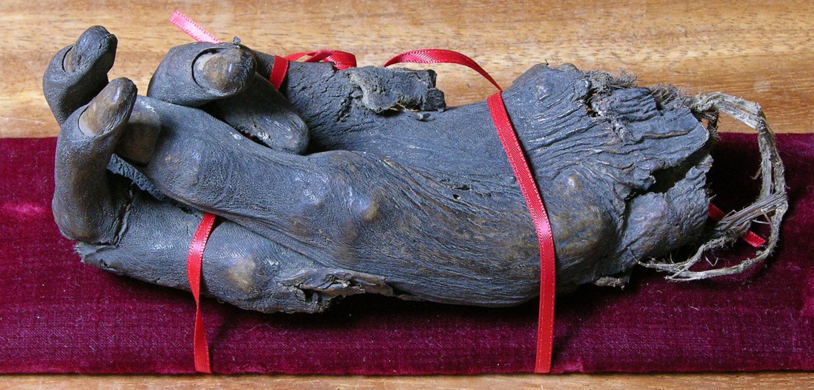
Hand of
St James
Hint
Can you theorise anything about:
Why the Abbey might have been a popular location for Henry?
By the late twelfth century, there were over 200 relics kept at Reading Abbey. These included fragments of the true cross and the hand of St James. Many pilgrims would travel to the Abbey to pray at the shrines of these relics. The hand of St James was credited with miracles such as a woman from Earley being cured of dropsy and Edward Haver of Reading being cured of a tumour. In 1786, a withered left hand was found in a wall at the east end of the Abbey church by workmen digging foundations for a new jail. It is thought to be the relic.
Notes:
Image: Courtesy of Reading Museum (Reading Borough Council)
www.readingmuseum.org.uk/blog/blood-and-bones-veneration-relics-reading-abbey

