Slide 1
Was 1973 a turning point for economic power in the Middle East?
Lesson 3: What happened in 1973?
Alex Benger, Chesterton Community College

Slide 2
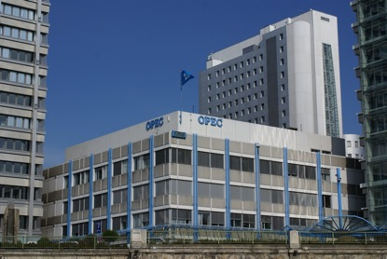


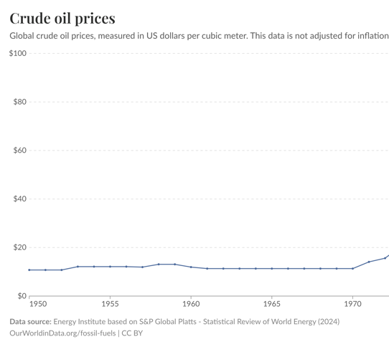
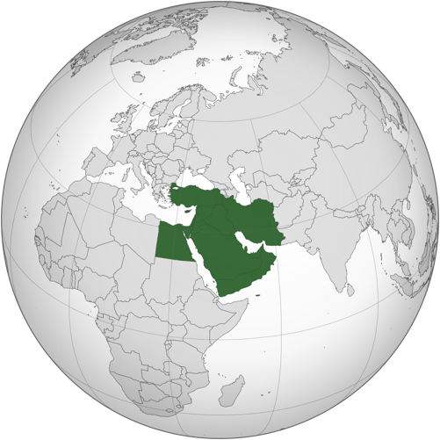
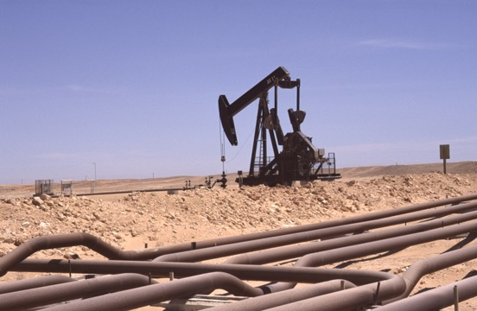



Recap: What were the aims of OPEC? How do these images help you to recall those aims?
In the 1960s, the oil-producing countries created OPEC (Organisation of the Petroleum Exporting Countries). Its founding members were Iran, Iraq, Saudi Arabia, Kuwait and Venezuela.
Increased oil wealth and higher share of oil profits
National ownership of oil
Higher oil prices
Notes:
Images (from left): https://en.wikipedia.org/wiki/File:Flag_of_the_United_Kingdom.svg; https://en.wikipedia.org/wiki/Flag_of_the_United_States; https://commons.wikimedia.org/wiki/File:State_flag_of_Iran_(1964%E2%80%931980).svg https://commons.wikimedia.org/wiki/File:Flag_of_Saudi_Arabia.svg; https://live.staticflickr.com/6048/6379201779_189efed046_b.jpg; https://commons.wikimedia.org/wiki/File:Middle_East_(orthographic_projection).svg; https://picryl.com/media/dollar-money-cash-business-finance-d77ba5
Graph: https://ourworldindata.org/fossil-fuels

Slide 3
Activity 1: What would happen to a country like the UK or USA today if there were a serious oil shortage?
Oil
Potential impacts of oil shortage
Think of the obvious impacts first and then try to think of as many knock-on impacts as possible.

Slide 4
The ‘oil weapon’ was not a traditional weapon like a bomb. It meant stopping oil supplies to other countries. In the 1960s and early 1970s, some members of OPEC discussed using the oil weapon. Why? And against whom?
Oil
Notes:
Image: https://commons.wikimedia.org/wiki/File:Middle_East_(orthographic_projection).svg

Slide 5
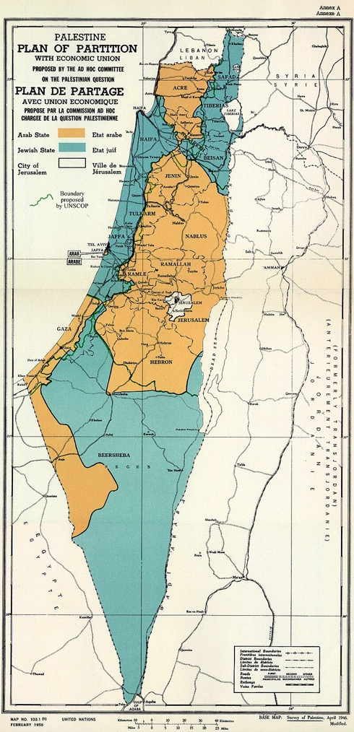
After World War II, the United Nations agreed a plan to divide Palestine into two states: an Arab state and a Jewish state. In 1948, the Jewish state of Israel was declared.
Notes:
Image: https://commons.wikimedia.org/wiki/File:UN_Palestine_Partition_Versions_1947.jpg

Slide 6
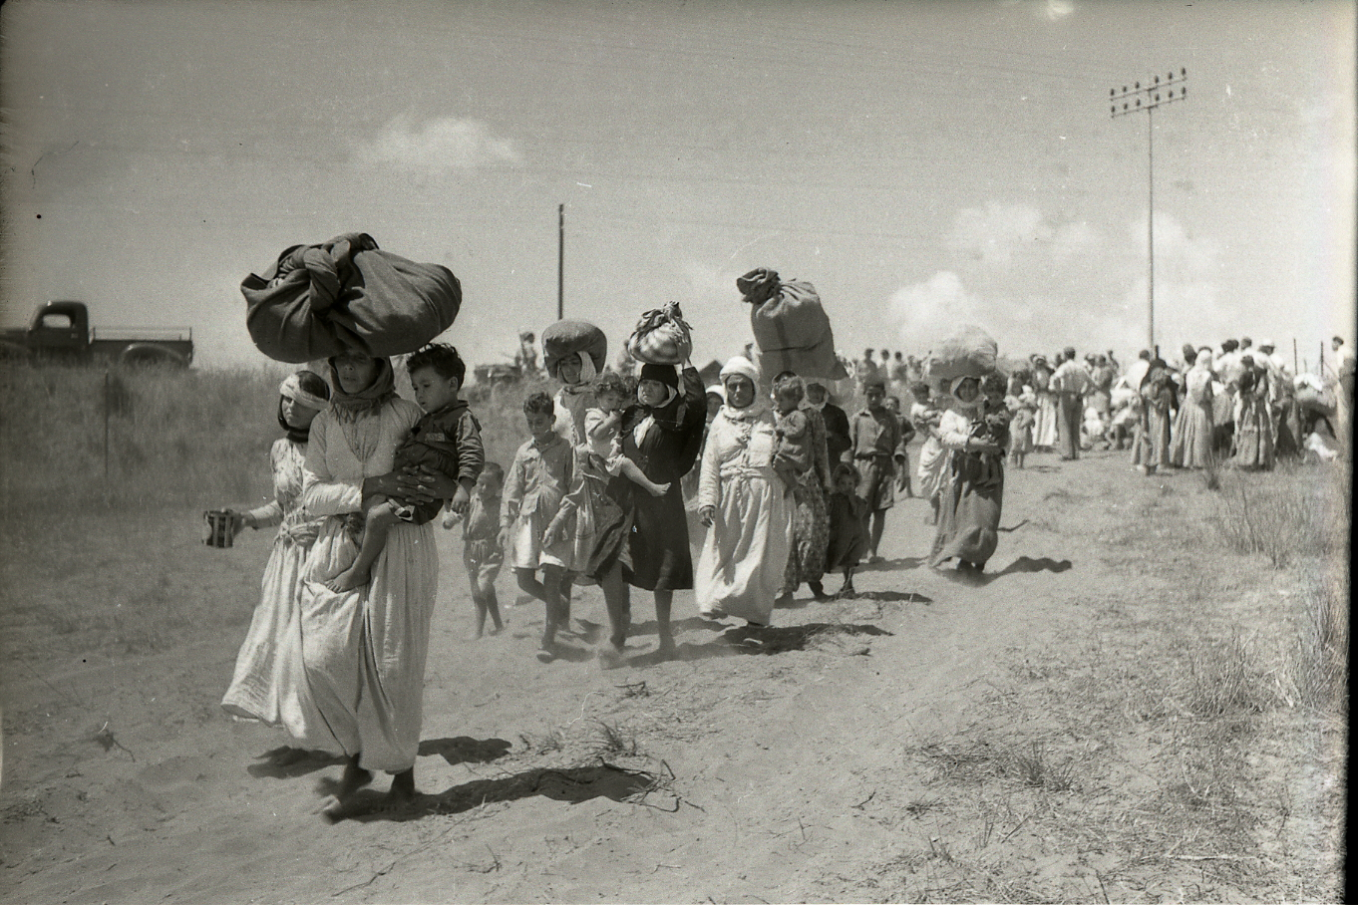
The creation of Israel led to a war in the region between the new state of Israel and the surrounding Arab states (e.g. Egypt), who did not agree with its creation. When Israel was created, hundreds of thousands of Palestinian Arabs were forced from their homes. This was called the nakba (‘catastrophe’). In retaliation, thousands of Jews were expelled from several countries, particularly Egypt, Syria and Iraq, and became refugees.
Notes:
Image: https://commons.wikimedia.org/wiki/File:Tantura_expulsion_(997008136022405171).jpg

Slide 7
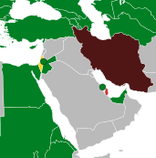
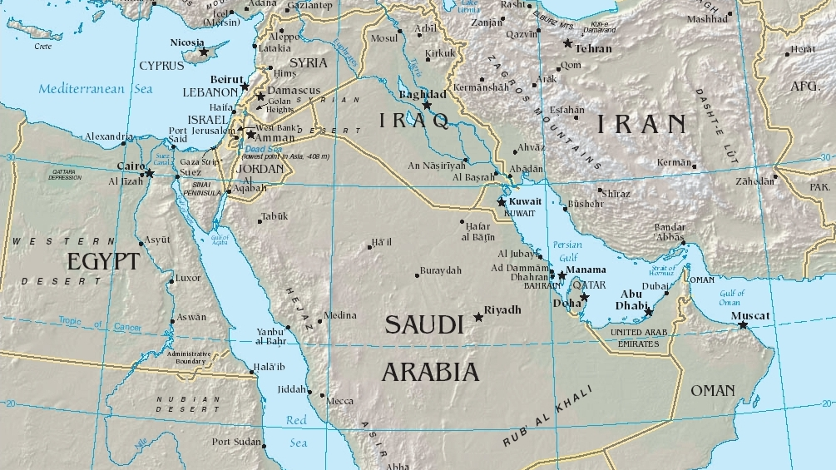
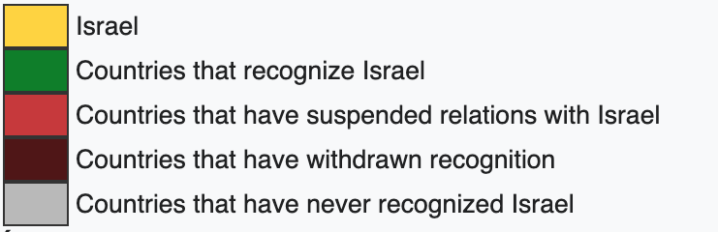
Which countries in the Middle East did not recognise Israel?
Notes:
Images: https://commons.wikimedia.org/wiki/File:Countries_recognizing_Israel.svg; https://commons.wikimedia.org/wiki/File:Middle_east.jpg

Slide 8

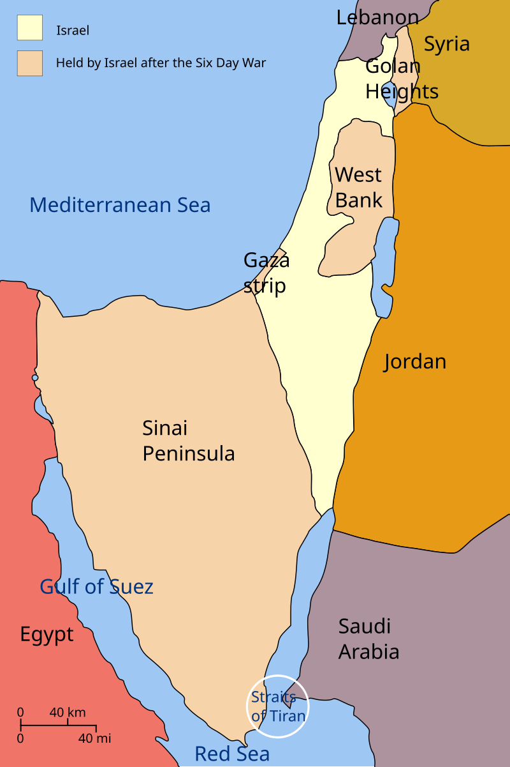
Israel expansion
After further conflicts, Israel expanded its control by occupying land beyond the borders proposed by the United Nations in 1947.
This map shows the situation after another Arab–Israeli War in 1967.
Notes:
Images: https://commons.wikimedia.org/wiki/File:UN_Palestine_Partition_Versions_1947.jpg; https://commons.wikimedia.org/wiki/File:Six_Day_War_Territories.svg

Slide 9
Activity 2: Why did some countries in the Middle East want to use the oil weapon?
Which countries might want to use the oil weapon in this conflict?
Who might they want to target with the oil weapon?
What might they want to achieve by using it?

Slide 10
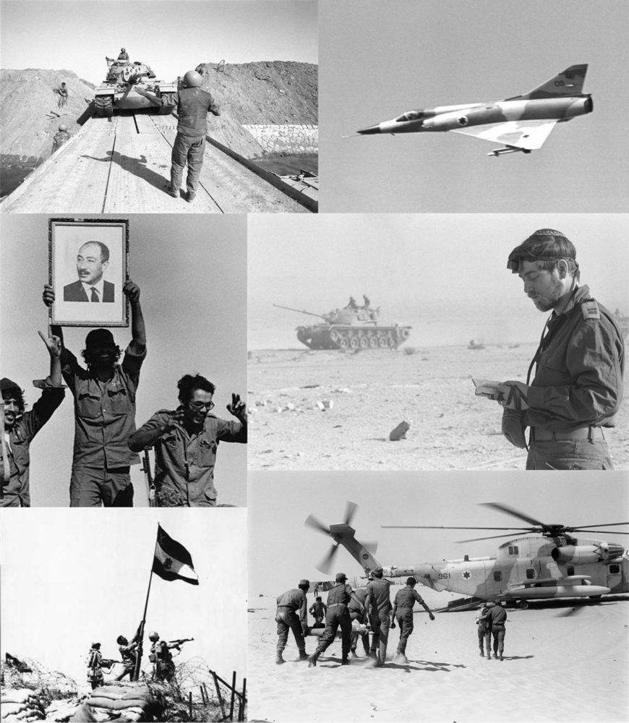

In 1973, they used the oil weapon.
Notes:
Images: https://commons.wikimedia.org/wiki/File:Yom_Kippur_War_Montage.png; https://commons.wikimedia.org/wiki/File:Gas_Stealers_Beware_1974.jpg

Slide 11

6 October 1973 The day was Yom Kippur, the holiest day in the Jewish calendar. A total of 222 Egyptian jets and 3,000 field guns roared into action against Israeli forces in Sinai, while 700 pieces of Syrian artillery opened fire on the Golan Heights.
Notes:
Image: https://commons.wikimedia.org/wiki/File:Yom_Kippur_War_Montage.png

Slide 12
6 October 1973 The aim was to shock Israel and the world into opening new negotiations that would allow the Arab nations to gain back their losses to Israel in 1967 and reach a more favourable settlement.
Notes:
Image: https://commons.wikimedia.org/wiki/File:Six_Day_War_Territories.svg

Slide 13
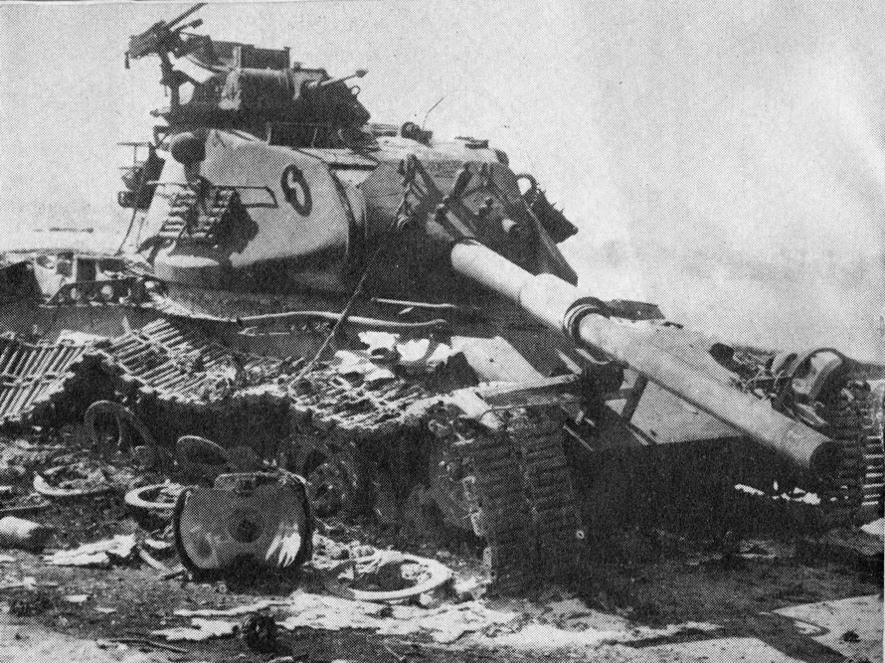
8–12 October 1973: Israel in trouble
Israel was unprepared for the attack.
The Israeli prime minister sent a letter to President Nixon of the United States, saying that the survival of Israel was under threat without greater American support.
Notes:
Image: https://commons.wikimedia.org/wiki/File:Destroyed_m60.jpg

Slide 14
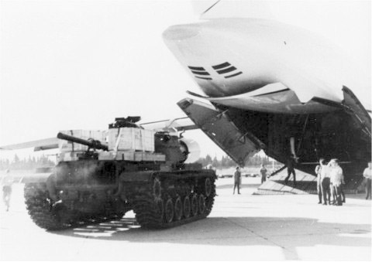
14–15 October 1973: US support
The United States agreed to help Israel but wanted to keep the extent of their support hidden. They sent a plane to deliver supplies, under the condition that it landed at night, under the cover of darkness.
Why do you think that they wanted to hide their support?
Notes:
Image: https://commons.wikimedia.org/wiki/File:Nickel_Grass_M60_C-5.jpg

Slide 15
14–15 October 1973: US support
They did not want to anger the Arab nations on which they relied for oil.
Aramco (the group of American companies that controlled Saudi oil) had warned President Nixon that support for Israel could threaten their supplies of oil from the Arab nations.
Notes:
Image: https://commons.wikimedia.org/wiki/File:Nickel_Grass_M60_C-5.jpg

Slide 16
14–15 October 1973: US support
There was a mistake. The plane was delayed. Instead of landing at night, America’s plane landed in the morning in broad daylight.
The Arab nations interpreted this as a public display of support for Israel. How would they respond?
Notes:
Image: https://commons.wikimedia.org/wiki/File:Nickel_Grass_M60_C-5.jpg

Slide 17

16–17 October 1973: the oil weapon
Saudi Arabia and other Arab oil producers agreed to support Egypt and Syria against Israel by:
Cutting all oil production by 5% a month
Creating lists of ‘friendly’ and ‘unfriendly’ countries:
‘Friendly’ countries who supported the Arab side of the conflict would continue to receive oil
‘Unfriendly’ countries who supported Israel would not get any oil
Notes:
Image: https://commons.wikimedia.org/wiki/File:Dunst_Oman_scan0321_-_%C3%96lfeld_Marmul.jpg

Slide 18
19–20 October 1973 When the USA announced $2.2 billion of aid to Israel, all of its oil supplies from Arab nations were cut. This is called an embargo.
Notes:
Image: https://commons.wikimedia.org/wiki/File:Nickel_Grass_M60_C-5.jpg

Slide 19
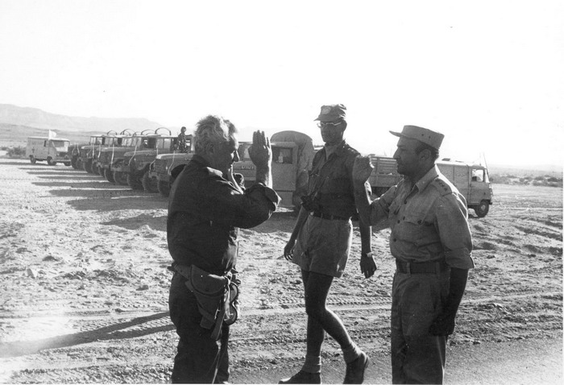
26 October 1973: ceasefire and negotiations
The war was threatening to expand further. The Soviet Union declared that it would intervene to support Egypt if it was at risk of defeat. With the USA supporting Israel, this raised the possibility of a wider conflict. The United States went on nuclear alert.
With the war threatening to spiral out of control, Egypt agreed to a ceasefire with Israel and opened negotiations to reach a settlement. This had been Egypt’s aim.
A meeting in the desert between Israeli and Egyptian generals, arranged by the United Nations in an attempt to end the conflict
Notes:
Image: https://commons.wikimedia.org/wiki/File:Israeli_and_Egyptian_Generals_Meet_in_Sinai_-_Flickr_-_Israel_Defense_Forces.jpg

Slide 20
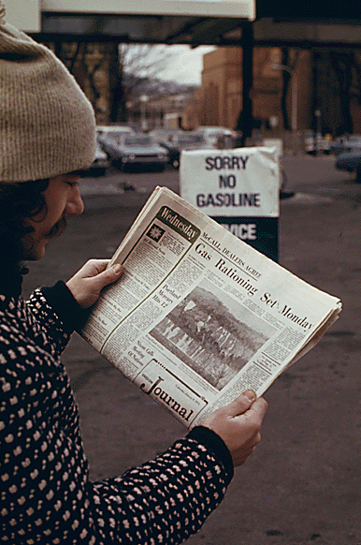
For the rest of 1973, the Arab oil embargo against the USA and other ‘unfriendly’ countries continued, to maintain pressure on Israel and its allies throughout negotiations.
This had a serious impact in the USA. Prices for gasoline increased significantly.
There were shortages and rationing and people queued in their cars for hours to fill up their tanks.
Notes:
Images: https://commons.wikimedia.org/wiki/File:No_gas_1974.gif; https://commons.wikimedia.org/wiki/File:Gas_Stealers_Beware_1974.jpg

Slide 21
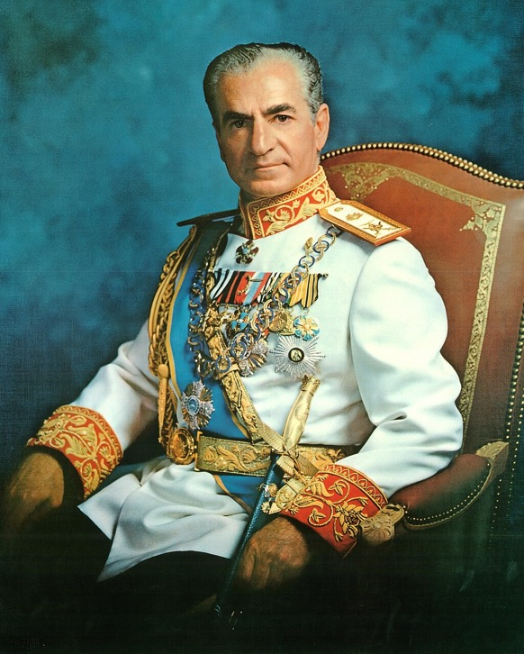
December 1973: OPEC sets the oil price
OPEC took advantage of the crisis to take control of setting the oil price. (Previously, the British and American oil companies had controlled the price.) They quadrupled the price of oil.
When the United States complained, Shah Reza Pahlavi of Iran said: ‘They will have to realise that the era of their terrific progress and even more terrific income and wealth based on cheap oil is finished… They will have to work harder.’
Notes:
Image: https://commons.wikimedia.org/wiki/File:Mohammad_Reza_Pahlavi_1973_portrait_(4x5_cropped).jpg

Slide 22
18 March 1974: the oil embargo ends
With more countries declaring support for the Arab side in the conflict with Israel, and progress being made in negotiations between Egypt, Syria and Israel (with the participation of the United States), the Arabs ended the oil embargo. It had lasted for five months.
Although the embargo was over, many people at the time believed that it represented a major turning point in economic power in the Middle East and around the world. The oil embargo showed the power of the Middle Eastern nations through their increasing control over their oil resources. The era of foreign colonial dominance over the Middle East seemed to be over.

Slide 23
Activity 3: The 1973–74 oil embargo
Read the timeline of events in 1973–74. Create a six-stage storyboard to tell the story of the key events of the crisis.

Slide 25
October 1973: Egypt and Syria launched an attack to retake land lost to Israel in 1967. | October 1973: The USA provided support to the Israeli counter-offensive. | October 1973: Arab nations aided Egypt and Syria with an oil embargo on countries that supported Israel.
October 1973: A ceasefire between Israel and Egypt was declared and negotiations began. | October 1973–March 1974: The Arab oil embargo continued and the effects of the oil shortage were felt in the USA and elsewhere. | March 1974: The oil embargo ended, after progress in peace talks and increased global support for the Arab cause.
Notes:
Scaffolded version

Slide 26
Our big question: Was 1973 a turning point for economic power in the Middle East?

Slide 27
Was 1973 a turning point for economic power in the Middle East?
Foreign economic power
1973?
Middle East economic power
Colonial domination?
National power?

Slide 28
Activity 4: Was 1973 a turning point for economic power in the Middle East?
Review the timeline again. Highlight any events that suggest an increase in the Middle East’s economic power during the crisis.

Slide 29
Judgement: Based on what we know so far, does 1973 seem like a turning point for economic power in the Middle East? Log the key evidence and your judgement in the Lesson 3 row of your overview table.
Foreign economic power
Evidence:
Middle East economic power
Evidence:
Colonial domination?
National power?

Slide 30
Middle East economic power
Evidence:
Use of the oil weapon caused economic problems for the United States and other industrial nations.
OPEC took control of setting the oil price.
Foreign economic power
Evidence:
Colonial domination?
National power?

Slide 31
Next lesson, we will look in more detail at the impact of the events of 1973–74 and decide whether it did completely shift the balance of economic power in the Middle East.
Foreign economic power
Evidence:
Middle East economic power
Evidence:
Colonial domination?
National power?

