Slide 1
How did Gottlieb explore what permacrisis might have felt like in 1938?
Notes:
Slide is for teacher use

Slide 2
Enquiry Overview
Why is Gottlieb so interested in foreign policy in 1938? LO: to develop an understanding of the events of 1938 and the idea of ‘history from within’
What sources are useful to Gottlieb in exploring what permacrisis might have felt like in 1938? LO: to develop an understanding of how different groups of people felt during 1938 and how historians know
Why is Mass Observation useful to Gottlieb in exploring what permacrisis might have felt like in 1938?
LO: to develop an understanding of how different groups of people felt during 1938 and how historians know
How did Gottlieb explore what ‘permacrisis’ might have felt like in 1938? LO: to develop an understanding of the process and importance of knowledge exchange between academics and other collaborators
Notes:
Slide is for teacher use

Slide 3
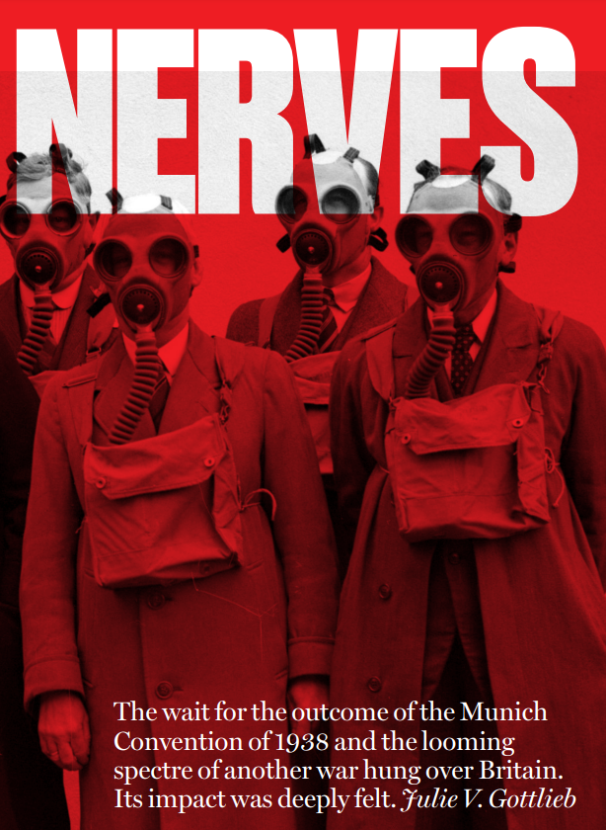
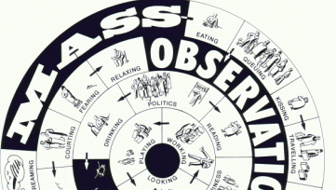
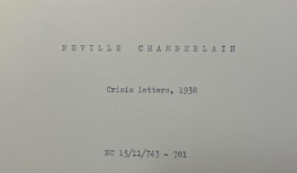
How did Gottlieb explore what permacrisis might have felt like in 1938?
Why do we need to be careful about the claims we make?
Activity 1: Discuss what you can remember with a partner. Be prepared to share with the class!
Notes:
Activating prior knowledge c. 10 mins
We asked students to discuss in pairs what they remembered about the processes and sources that historians use. We made notes on the board to capture what they could remember as a class.
Image source: https://www.sheffield.ac.uk/history/people/academic/julie-gottlieb

Slide 4
What can you add to your knowledge organiser?
Notes:
Consolidating learning c. 10 mins
We then used the interactive whiteboard to fill in the key questions in the second and third columns. Students made notes on their copy of the sheet.

Slide 5
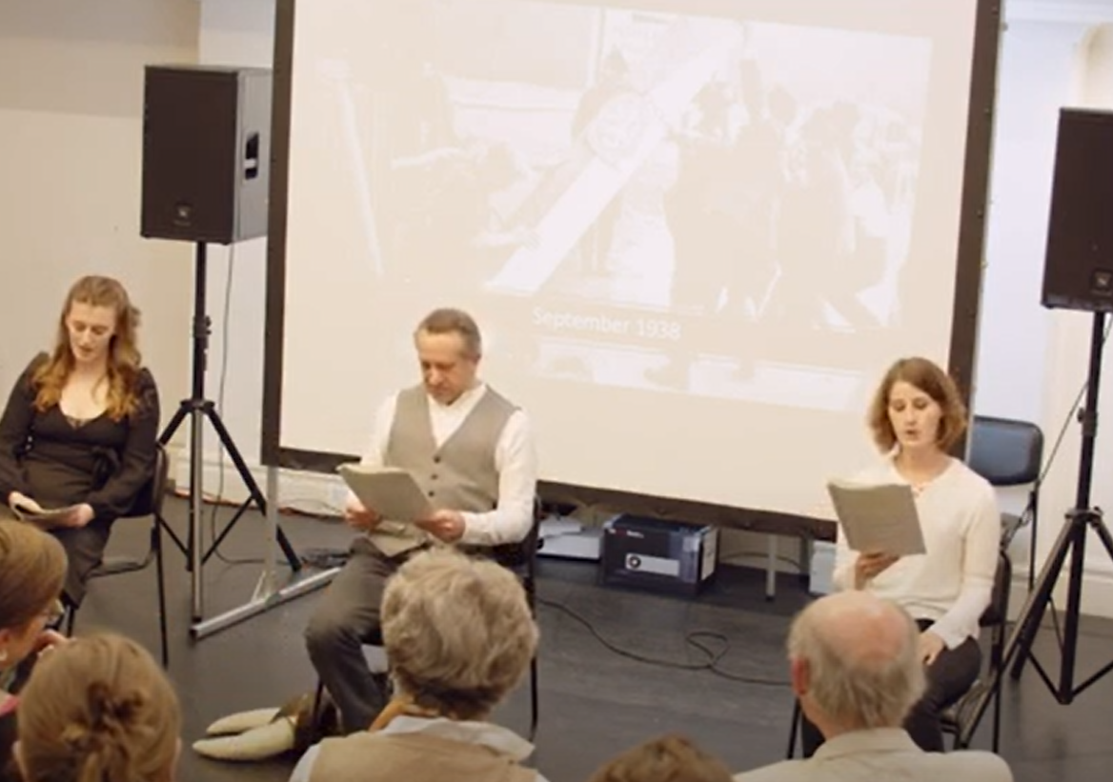
How did Gottlieb explore what ‘permacrisis’ might have felt like in 1938?
LO: to develop an understanding of the process and importance of knowledge exchange between academics and other collaborators
Can you tell me about the sources that Gottlieb used and how people might have felt in 1938? | Can you describe the collaborations that have been embarked on and their importance? | Can you explain this process to a wider audience?
Notes:
Title and Learning Objective c. 3 mins
This slide was used to reinforce key milestones for the lesson. It was only used for display.

Slide 6
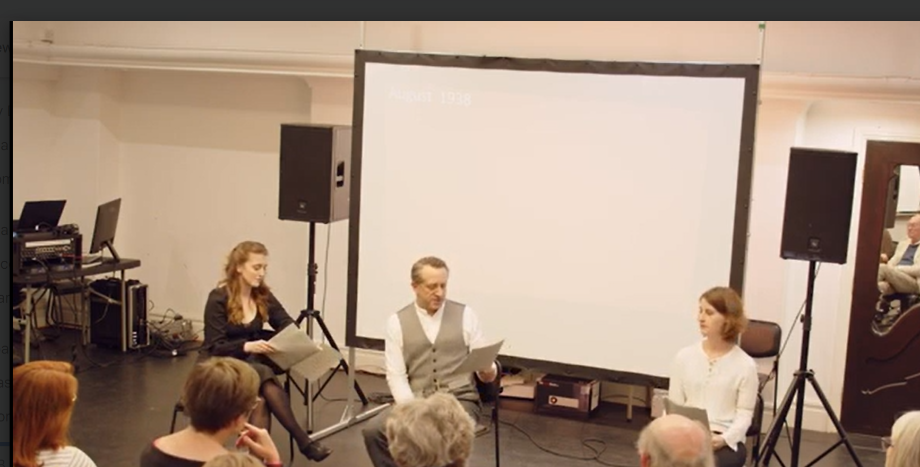
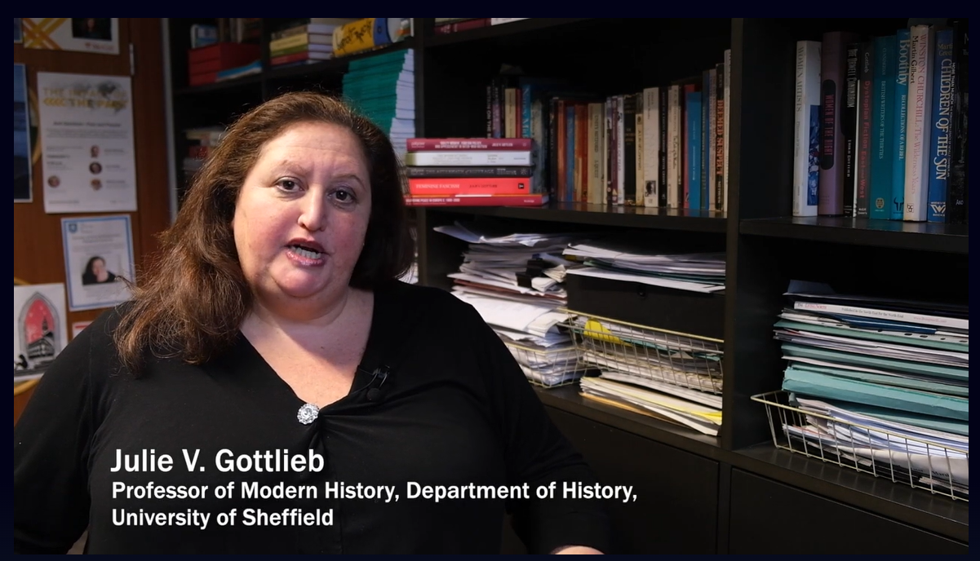
Activity 2: Why has Gottlieb tried to explore the history of emotions in this period and what does it tell us about the importance of history?
Watch the two videos to help you to discuss the questions above.
https://player.sheffield.ac.uk/events/nervous-state-collaboration-performances-and-impact
Notes:
Understanding knowledge exchange and The Nervous State c. 25 mins
We wanted students to understand that Gottlieb had worked with a range of creatives in order to reconstruct hidden voices from the past and help them to see some of the wider purposes of studying history. In the final bespoke video, Gottlieb explained this to students.
PLAY VIDEO 5
We then showed a film from the University of Sheffield player that explained in more detail the collaboration with Nicola Baldwin and her play The Nervous State. It explains how Gottlieb and Baldwin worked together to represent FL Lucas’ wife’s experience of mental illness in 1938 and his omitting of this from his journal. We then used the discussion questions displayed on the slide above to steer a discussion about the impact of history. Students made nuanced responses about the importance of respecting individual experiences and that reconstructing hidden voices helps us to understand our own world and experiences. They were also excited about new approaches to history and the fact that working with other experts allows historians to do that creatively and sensitively.
References: https://player.sheffield.ac.uk/events/nervous-state-collaboration-performances-and-impact

Slide 7
Activity 3: Create a section of a new playbill for The Nervous State that answers the questions below.
What happened in 1938 that interests Gottlieb?
What does the word ‘permacrisis’ mean and why can it be applied to that year?
What historical lenses has Gottlieb looked through to better understand this period?
What sources did Gottlieb use to explore how people might have felt?
Why do we need to be careful about the claims we can make when examining ‘history from within’?
Who has Gottlieb worked with to reconstruct hidden voices from the past?
Why is this type of work so important?
Notes:
End of enquiry task c. 25 mins
Note: some classes completed this for homework, some completed this as an additional lesson- it is flexible.
We gave students a copy of slides 9 and 10 printed double-sided onto A4 each. We asked them to answer the questions displayed on the slide above (also on the knowledge organiser) in order to write a playbill for Baldwin’s The Nervous State that explained how she had worked with Gottlieb to write the piece. The questions test students’ understanding of foreign policy in the period, history from within and below, permacrisis and the procedures that historians follow in order to investigate the past. We allowed them to use the completed knowledge organisers to help them to consolidate their ideas and act as a prompt.

Slide 8
Resources to print:

Slide 9
This playbill was written by:
……………………………………………………………….
Class:
……………………………………………………………….
The Nervous State: The War on Nerves and Permacrisis in 1938
Prof. Julie V. Gottlieb and Nicola Baldwin

Slide 10
What happened in 1938 that interests Gottlieb?
What does the word ‘permacrisis’ mean and why can it be applied to that year?
What historical lenses has Gottlieb looked through to better understand this period?
………………………………………………………………………………………………………………………………………………………………………………………………………………………………………………………………………………………………………………………………………………………………………………………………………………………………………………………………………………..
…………………………………………………………………………………………………………………………………………………………………………………………………………………………………………………………………………………………………………………………………………………………………………………...............................................................................................................................................................................................................................................................................................................................................................................................................................................................................................................................................................................................................................................................................................................................................................................................................................................................................................................................................................................................................................................................................................................
What sources did Gottlieb use to explore how people might have felt?
Why do we need to be careful about the claims we can make when examining ‘history from within’?
Who has Gottlieb worked with to reconstruct hidden voices from the past?
Why is this type of work so important?
……………………………………………………………………………………………………………………………………………………………………………………………………………………………………………………………………………………………………………………………………………………………………………………..………………………………………………………………………………………………………………………………………………………………………………………………………………………………………………………………………………………………………….........................................................................................................................................................................................................................................................................................................................................................................................................................................................................................................................................................................................................................................................................................................................................................................................................................................................................................................................................................................................................................................................................................................................................................................................

