Slide 1
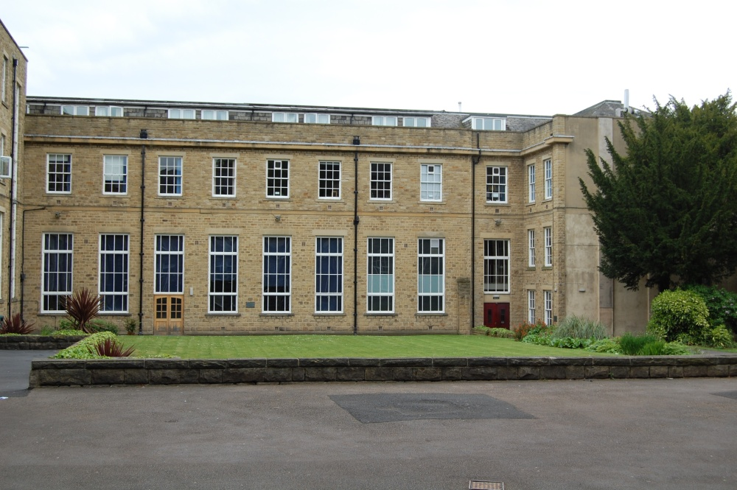
Lesson observation notes on a Year 11 IGCSE History lesson at Woodhouse Grove School in February 2023
Context: Woodhouse Grove is a selective, independent school on the outskirts of Bradford in West Yorkshire. The history department follows an IGCSE history specification offered by Cambridge International Examinations. The teacher, Donna Shoesmith–Evans, constructed a lesson using original sources on appeasement in the style of an exam paper which analyses such sources in turn, instructing pupils to deploy substantive knowledge of a period to do so. The class was a small, mixed ability one. Donna undertook her own research and extracted material to use in class.
Image of the school here
21stCenturyGreenstuff CCA by 3.0

Slide 2
Lesson starter
As pupils entered the classroom quietly, their attention was directed towards the following mind map, which was designed to retrieve prior knowledge about the Munich Conference from earlier teaching.
The text in bold type represents the recalled information which a variety of pupils were encouraged to write up in turn.

Slide 3
Why?
When?
30th September 1938
Shows weakness of Britain via appeasement
Munich Agreement
Who was there? Germany, Italy, GB, France
Where?
Munich
What was it?
The teacher then addressed each question and pupils answered on the mind map, eliciting further information from pupils through Socratic questioning. As a result of this she added extra details to the diagram. For example, it was identified that Munich was a city in Germany and that it had been the place where a Nazi Putsch had been attempted in 1923 against the Weimar Republic.

Slide 4
The Main Activity
The teacher gave out a test paper with an initial page summarising the context of Mass-Observation sources followed by these sources:
Source A – the front page of the British newspaper, The Daily Sketch, reporting on Chamberlain‘s visit to Munich with the headline “The man the world looks too” and featuring a large photograph of the Prime Minister‘s head.
Source B - a photograph of Chamberlain waving to an applauding crowd from an upstairs window at 10 Downing Street on the night of the 30th September 1938, upon his return from Munich.
Sources C, D and E - extracts from Mass-Observation reports, quoting anonymous, working class members of the public who were critical of Chamberlain.
Source F - a letter to The Guardian newspaper published on Tuesday, October 4th, 1938 by F. L. Lucas, a critic of appeasement. The latter is damning of Chamberlain and the Munich agreement. Questions were set on the sources at the end of the paper.
The latter is damning of Chamberlain and the Munich agreement.

Slide 5
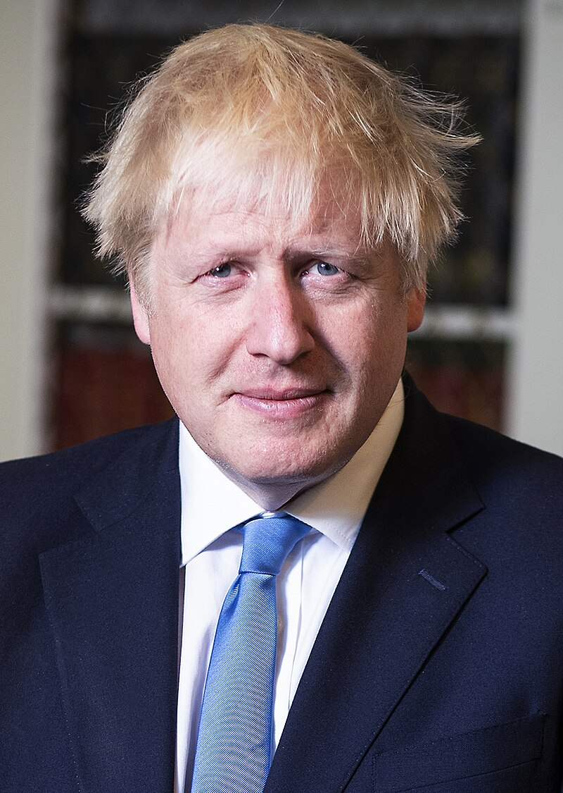
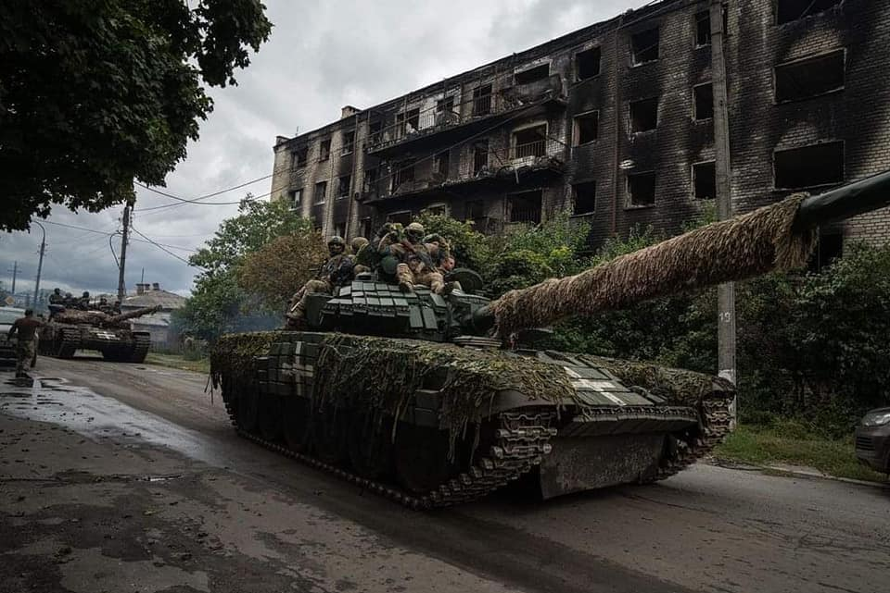
Afterwards, the teacher referred to the enquiry question at the top of the test paper “Did everyone believe that Chamberlain was a hero?”.
She first asked whether pupils had read the summary about Mass-Observation as a source at the start of the paper. Most had not. The teacher highlighted that sources C, D and E were derived from Mass-Observation. When asked what equivalent issues Mass-Observation might be covering today, pupils suggested the scandals around Boris Johnson and the Ukraine War as possibilities. The teacher then picked out certain dates from the summary about Mass-Observation to ask pupils what was going on at particular times. For example, in January 1939, when Penguin published Britain by Mass–Observation, the Munich Agreement had been signed months before but the Nazis had not yet taken over the remainder of Czechoslovakia.
Image of Boris Johnson here
Ben Shread/Cabinet Office OGL
Mil.gov.ua CC by 4.0

Slide 6
The teacher stressed the contrast between the opinions recorded by Mass-Observation and the type of sources, such as the newspaper and the photograph of Chamberlain in Downing Street, which presented a favourable view of the prime minister and his agreement.
The teacher lead questioning about each source in turn and questions on the paper related to it, teasing out its provenance and making comparisons with how information is gathered and disseminated by contrast in the present. For example, pupils identified that the newspaper’s view of Chamberlain was positive, and that this was because it was supportive of the government. It was pointed out that more people would have seen a newspaper in 1938 than would access it today when the Internet is now a more important source of news.
The context of the photograph in Downing Street was explored. Pupils expressed surprised that so many people were allowed to gather in front of the Prime Minister’s residence, compared to the tight security of today.

Slide 7
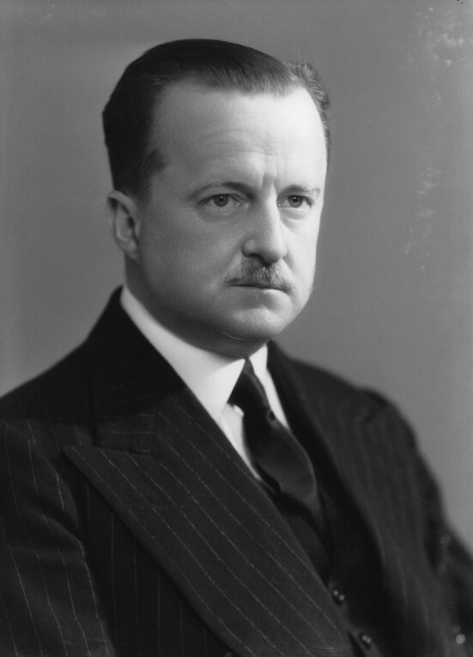
The teacher explained some of the references within the Mass-Observation extracts, for example to Duff Cooper, a government minister who resigned in protest at the Munich Agreement.
She led discussion about whether one particular source might prove that another was untrue, for example, did the working-class criticism in Mass-Observation extracts disprove the clear popularity of Chamberlain among the crowd photographed in Downing Street?
It was agreed that it was possible to have evidence of a range of views which might contradict each other, but which did not cancel each other out.
Image of Duff Cooper here
Duff Cooper MP

Slide 8
The teacher led discussion about the timing of the publication of Britain by Mass-Observation in January 1939, and explained some background detail about F.L. Lucas as a critic of appeasement. This included Lucas’s status as a University lecturer at King’s College, Cambridge, and his experience as a British officer during the First World War.
Lastly the teacher led discussion of the final question on the paper ‘Study all the sources – how far to the sources provide convincing evidence that Chamberlain was a “hero”? Use the sources to explain your answer’.
Pupils were due to answer the questions in the next lesson.

Slide 9
A second lesson which followed the same pattern of teaching was observed with a Year 10 IGCSE History class.
One major difference was that for reasons of differentiation the teacher chose to ask pupils to read extracts out loud around the class in turn with discussion taking place as this occurred. A longer discussion than in the Year 11 class occurred around the reliability and usefulness of photographs as an historical source. This included comments that photographs can be staged and nowadays faked, and that even if a photograph is authentic, it only captures the frame of the event visible to the camera at the time.

