Slide 1
Enquiry 8 overview: How did Britain respond to the Korean War? An evidential and historiographical approach
Lesson 8.1
What was the response of the Labour and Conservative governments 1950–53 to the Korean War?
Lesson 8.2
What was response of the Civil Service and the military to the outbreak of the Korean War?
Lesson 8.3
How do specialist historians approach the responses of the British elites to the Korean War?

Slide 2
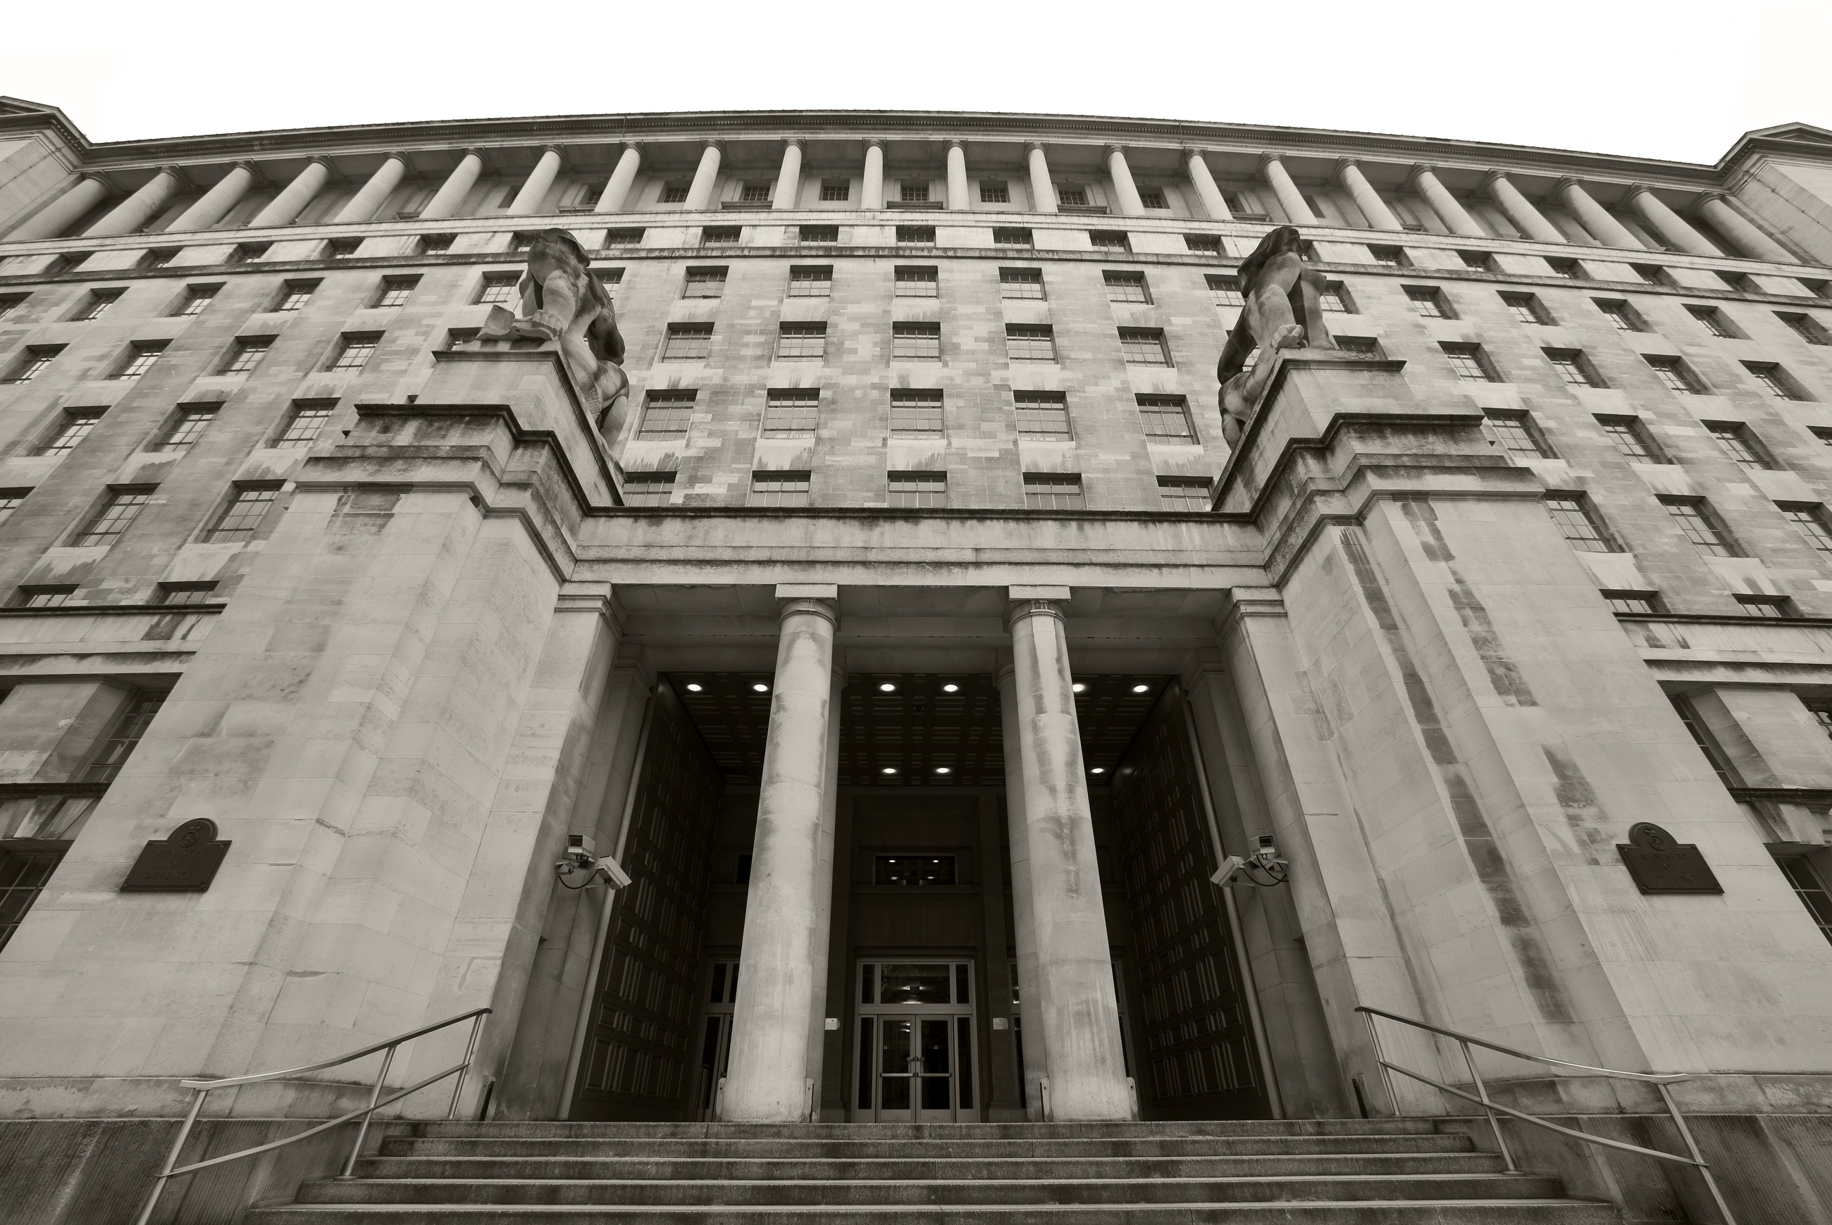
Lesson 8.2
What was response of the Civil Service and the military to the outbreak of the Korean War?
Notes:
Image: Ministry of Defence, OGL v1.0 / Photo: Harland Quarrington DDef Pub Phots Civ/MOD, https://commons.wikimedia.org/wiki/File:MOD_Main_Building_MOD_45151977.jpg

Slide 3
Lesson 8.2 Overview
Lesson 8.2
What was response of the Civil Service and the military to the outbreak of the Korean War?
Content covered in this lesson:
Civil service and military responses to the Korean War
Comparison of the responses of these institutions to those of the governments
An historian’s interpretation regarding the British ‘permanent state’

Slide 4
The influence of the Civil Service, as represented in a British comedy series from the 1980s
Starter
What does this film clip suggest about the power of civil servants?
‘Sir Humphrey Appleby: the consummate civil servant’ (YouTube) from Yes Minister, Series 3 Episode 6: ‘The Whiskey Priest’
Notes:
Video: ‘Sir Humphrey Appleby: the consummate civil servant’, YouTube, from Yes Minister, Series 3, Episode 6, ‘The Whiskey Priest’ © BBC, https://youtu.be/cIYfiRyPi3o

Slide 5
What was the response of the Civil Service and the military to the outbreak of the Korean War?
Document 2: Military discuss intervention in Korea
Document 3: Military discuss intervention in Korea
Document 4: Foreign Office correspondence on Korea
Document 5: Government minutes on ground forces being sent to Korea
Document 6: Foreign Office correspondence on Korea
Notes:
All documents used under the Open Government Licence: http://www.nationalarchives.gov.uk/doc/open-government-licence/version/3/
Document 2: DEFE 11/292 Joint Chiefs of Staff discussion 03/07/50
Document 3: DEFE 11/292 Defence Committee discussion 13/07/50
Document 4: FO 371/81655 Oliver Franks’ letter 23/07/50
Document 5: CAB 128/18/50 Labour cabinet minutes 25/07/50
Document 6: FO 371/84091 Oliver Franks’ letter 21/08/50

Slide 6
Activity 1
Working in groups, use documents 2–6 (Resource sheets 8.2A and 8.2B) to complete this Venn Diagram (8.2C) analysing responses to the Korean War

Slide 7
Document 2 DEFE 11/292 Joint Chiefs of Staff discussion 03/07/50
Notes:
Document 2: DEFE 11/292 Joint Chiefs of Staff discussion 03/07/50

Slide 8
Document 3 DEFE 11/292 Defence Committee discussion 13/07/50
Notes:
Document 3: DEFE 11/292 Defence Committee discussion 13/07/50

Slide 9
Document 4 FO 371/81655 Oliver Franks’ letter 23/07/50
Notes:
Document 4: FO 371/81655 Oliver Franks’ letter 23/07/50

Slide 10
Document 5 CAB 128/18/50 Labour cabinet minutes 25/07/50
Notes:
Document 5: CAB 128/18/50 Labour cabinet minutes 25/07/50

Slide 11
Document 6 FO 371/84091 Oliver Franks’ letter 21/08/50
Notes:
Document 6: FO 371/84091 Oliver Franks’ letter 21/08/50

Slide 12
Activity 1 discussion
How much commonality is there between the positions of the Foreign Office and the military regarding British involvement in the Korean War?

Slide 13
Activity 2
Data capture: Look at the sources again (including one extra repeated from last lesson). Fill out your own copy of this table (Resource sheet 8.2D).
Consider the relative influence of the military, the Civil Service (Foreign Office) and the government over Korean War policies. Who seems to have the most influence?
DOC & group | Position re: intervention in Korea | Position re: use of combat troops | Level of influence and why?
1 (additional) Govt
2 Military
3 Military
4 Civil Service
5 Govt
6 Civil Service

Slide 14
An historian’s interpretation of British civil servants and politicians
P. Joyce, The State of Freedom: a social history of the British state (2013)
‘… the purpose and identity of the civil servant as a “statesman” – a man of the state who in actual practice was little different in outlook and character from leading politicians: and little different in the degree to which he held power. I also consider the occupational culture and ethical stylisation of the politician. Shared outlook, social background and education united the two. Therefore, in uniting the term “governing classes” it is these people that we should have in mind, for contrary to some understandings, and to the doctrine of the separation of politics and administration, it was in both figures that the real business of government took place. The high bureaucrat, just as much as the politician, was involved in making state policy.’

Slide 15
Why is there commonality across elite power bases?
Activity 3
Read the source on the previous slide. How would Joyce explain the continuities between the state actors’ positions, as well as their levels of influence on policy?
Now watch this clip from ‘Yes Minister’. To what extent is Joyce’s interpretation of the Civil Servant akin to that presented in Yes Minister?
How can you explain any differences?
Notes:
Video: ‘Sir Humphrey Appleby: the consummate civil servant’, YouTube, from Yes Minister, Series 3, Episode 6, ‘The Whiskey Priest’ © BBC, https://youtu.be/cIYfiRyPi3o

Slide 16
Plenary
Construct a visual representation (it can be a cartoon or any type of image) that conveys your understanding of the nature of the relationship between the government, the Civil Service and the military.
If you are looking for inspiration, visit this site: The Political Cartoon Gallery.

