Slide 1
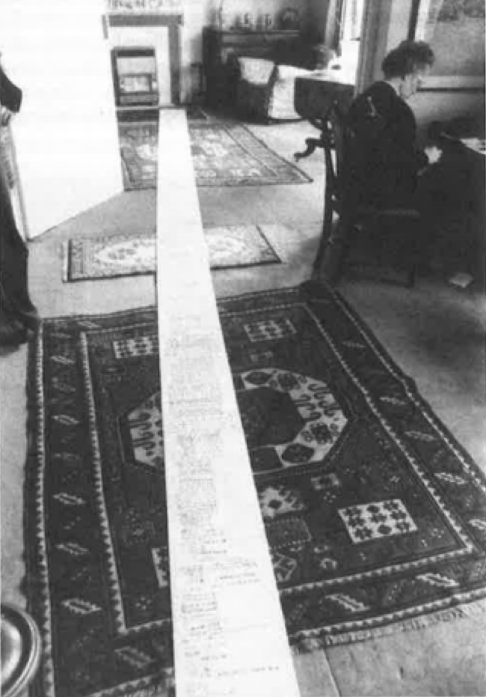
Enquiry 6: Contested evidence Why is the use of biological weapons in the Korean War a controversial subject?
Notes:
Image: © Estate of Hewlett Johnson; University of Kent Special Collections – The Hewlett Johnson Papers
https://blogs.kent.ac.uk/specialcollections/tag/hewlett-johnson-papers/

Slide 2
Enquiry: Why is the use of biological weapons in the Korean War a controversial subject
Lesson 6.1
Why and how did allegations of biological warfare by the USA develop during the Korean War?
Lesson 6.2
How convincing is the evidence about US biological warfare?

Slide 3
Lesson 6.1 overview
Lesson 6.1
Why and how did allegations of biological warfare by the USA develop during the Korean War?
Content covered in this lesson:
The context – the Korean War up to 1952
What are biological weapons?
The accusations against the USA
An academic perspective: evaluating Milton Leitenberg’s conclusions about the accusations

Slide 4
Starter
What do you think this could be?
Why is it so long?
Why has someone taken a photograph of it in this way?
Notes:
Image: © Estate of Hewlett Johnson; University of Kent Special Collections – The Hewlett Johnson Papers
https://blogs.kent.ac.uk/specialcollections/tag/hewlett-johnson-papers/

Slide 5
The petition
This photograph shows a petition. It was signed by over 13,000 Chinese people, including 410 Chinese Protestant pastors (church leaders).
It was brought back to the UK from China by the Dean of Canterbury, Hewlett Johnson.
It was a petition against the alleged use of bacteriological weapons by the United States against China.
Johnson himself was known as the ‘Red Dean’ and was a well-known supporter of Stalin and the Soviet Union. He had been awarded the Soviet Order of the Red Banner of Labour and also the Stalin International Peace Prize in 1951.
Discuss
Are there any details here that are surprising or shocking or that you would like to investigate further?

Slide 6
Context: The Korean War to 1952
1950–1951 was the ‘movement’ phase of the war, as UN and communist forces retreated and advanced rapidly.
The USSR achieved nuclear weapons capability in 1950.
July 1951: Armistice negotiations began to try to end the conflict in Korea.
War reached stalemate phase around the 38th parallel. There were high casualties on both sides but little movement of the front lines.
The communist regime in China had only been in power for three years at this point and was still establishing itself. Its intervention in Korea should be seen as part of this.
Allegations of bacteriological warfare surfaced in the spring of 1952; China and North Korea accused the United States.

Slide 7
What are biological weapons?
Biological weapons are germs deliberately spread to harm your enemy. They are also sometimes called bacteriological weapons and germ warfare. They all mean the same thing.
Biological weapons are an example of weapons of mass destruction (WMD).
There are three main categories of WMD: Biological, chemical and nuclear.
The concept of WMD is modern, particularly associated with the 2000s and the Iraq War. However, the use of biological weapons was prohibited as early as 1925 under the Geneva Protocol – which was agreed at the League of Nations.
In the 1950s, the biggest fear was that of nuclear weapons. However, the Cold War increased popular awareness and fear of a wide range of weapons that could be used against civilians.
This is reflected in popular culture, where various film and TV programmes of the time depicted germ warfare – notably the 1960s James Bond film On Her Majesty’s Secret Service. The villain, Blofeld, is brainwashing his ‘Angels of Death’ to smuggle biological weapons (such as anthrax germs) into Britain and around the world. (Click the green icon to view the film poster.)
Notes:
https://en.wikipedia.org/wiki/On_Her_Majesty%27s_Secret_Service_(film)#/media/File:On_Her_Majesty's_Secret_Service_-_UK_cinema_poster.jpg

Slide 8
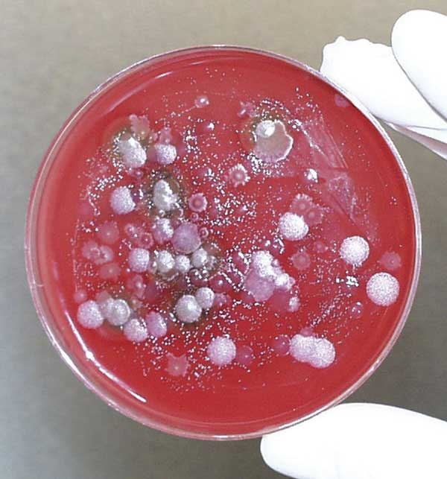
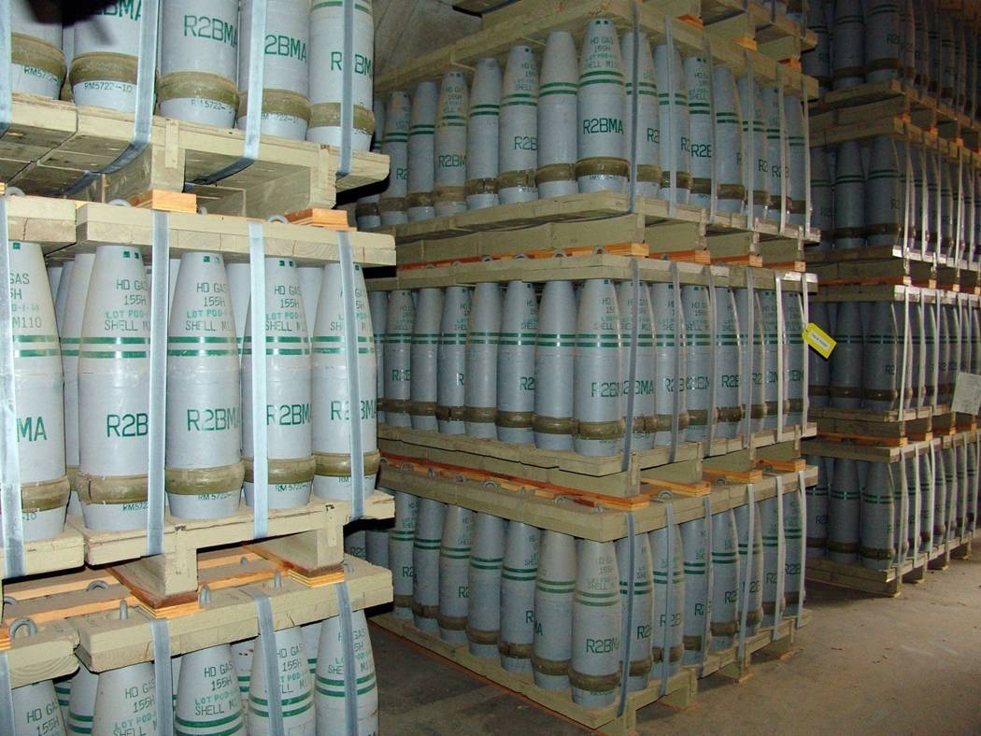
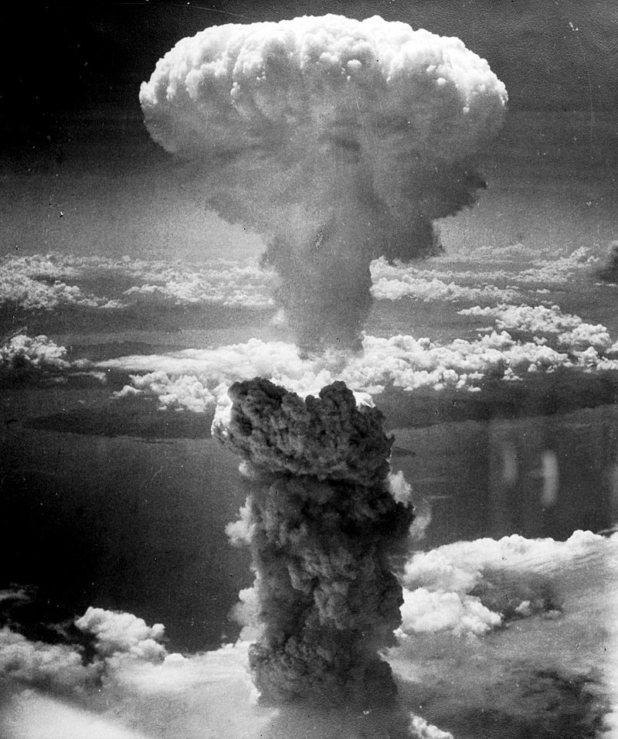
Weapons of mass destruction (WMD)
A biological weapon: anthrax germs
A chemical weapon: mustard gas
A nuclear weapon: atomic bomb at Nagasaki, 1945
Activity 1
Why do countries build WMD?
Why is the use of WMD controversial?
How do biological weapons differ from other WMD?
Why might a country use biological weapons rather than other WMD?
Notes:
Left: US Centers for Disease Control, https://commons.wikimedia.org/wiki/File:1993_Kameido_site_fluid_petri.jpg
Centre: US Army, https://commons.wikimedia.org/wiki/File:155mmMustardGasShells.jpg
Right: US National Archives and Records Administration, https://commons.wikimedia.org/wiki/File:Nagasakibomb.jpg

Slide 9
What is the big story of the allegations against the USA?
Early 1952: North Korean and Chinese governments formally alleged use of biological weapons by the USA. Allegations included that flies, mosquitos, spiders and fleas, carrying diseases such as plague, smallpox and cholera, had been dropped by US planes.
March 1952: The US immediately refuted the allegations and Secretary of State Dean Acheson called for an International Red Cross investigation. This was vetoed by the Soviet Union at the UN Security Council.
September 1952: The Needham Commission (established by an organisation called the World Peace Council) confirmed that there was evidence that the US had used biological weapons against Korea.
February 1953: Chinese government produced two captive US Marine Corps pilots to confirm that the allegations were true.
These allegations have been strenuously denied by the USA to this day, while Chinese and North Korean governments continue to support the claims. Historians are divided on the issue.

Slide 10
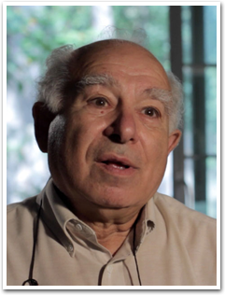
Academic reading task
Activity 2
What is the big story of the allegations against the USA?
You will be given an article written by historian Milton Leitenberg (Resource sheet 6.1A). It tells you the big story of how the allegations developed and how the USA responded to them.
Read through the extract.
Summarise the key points from the extract – using the questions and chart on the next slide (or Resource sheet 6.1C). Summarise your answer to each question in 50 words or less.
Notes:
Image: Milton Leitenberg, https://cissm.umd.edu/

Slide 11
Summarise Leitenberg’s answer to each question in 50 words (or less!)
1. What claims were made about US biological weapons development before the Korean War?
2. What specific allegations did China make about the use of biological weapons during the Korean War?
3. What were the main ‘investigations’ launched by China and NK into the use of biological weapons?
4. What were some weaknesses of these investigations identified in the extract?
5. What was the US response to these allegations?
6. What weaknesses about the allegations emerged after the war?

Slide 12
What is the big story of the allegations of US biological warfare during the Korean War? Answers
1. What claims were made about US biological weapons development before the Korean War?
- Soviets alleged US use against Alaskan Inuits.
- Chinese said that US colluded with Japanese WWII General Ishii, who had used germ warfare in that conflict against China.
2. What specific allegations did China make about the use of biological weapons during the Korean War?
- NK first alleged US use of smallpox in May 1951.
- NK then claimed US dropped plague- and cholera-infected insects by air.
- China claimed over 800 attacks on over 70 cities in NK.
3. What were the main ‘investigations’ launched by China and NK into the use of biological weapons?
- Soviets raised the issue at UN.
- Chinese rejected WHO offer of investigation.
- Chinese then commissioned IADL and ISC investigations – these corroborated allegations.
4. What were some weaknesses of these investigations identified in the extract?
- Neither did any field investigations of their own.
- They accepted Chinese and North Korean evidence fairly uncritically.
5. What was the US response to these allegations?
-They denied them publicly at the UN.
-They criticised the ISC report and said that the insects in the allegations would not have been able to carry those diseases.
6. What weaknesses about the allegations emerged after the war?
-There were reports that paper packets of insects had been placed in the snow by Chinese soldiers.
- Some Chinese officials themselves have been reported at separate times as saying that the claims were fabricated.

Slide 13
Activity 3:
EXTRA CHALLENGE:
Spotting Leitenberg’s viewpoint
What appears to be Leitenberg’s attitude to or viewpoint on the allegations?
What evidence from the text supports your view?

Slide 14
Consider these three extracts from Leitenberg’s article. What do they suggest about his view of the strength of the allegations?
Extract 2
The most significant aspect of both the jurists’ and ISC ‘investigations’ is that neither group did any field investigating of their own. They were presented with ‘evidence’ by the Chinese and North Koreans, which they accepted, on faith, as fact.
Extract 1
The Chinese and North Koreans rejected repeated offers of on-site investigations by the World Health Organization and the International Committee of the Red Cross. Instead, the two governments hosted their own ‘investigations’.
Extract 3
In subsequent years, other criticisms and admissions were even more telling. Tibor Meray, a Hungarian journalist who had spent the Korean War inside North Korea, reported that North Korean peasants told doctors at a Hungarian field hospital that paper packets of insects had been placed in the snow by Chinese soldiers.
Notes:
Image: Milton Leitenberg, https://cissm.umd.edu/

Slide 15
Plenary: What have you learnt today?
A question about today’s lesson I would like answered
One thing I knew already
Two things I learnt today

