Slide 1
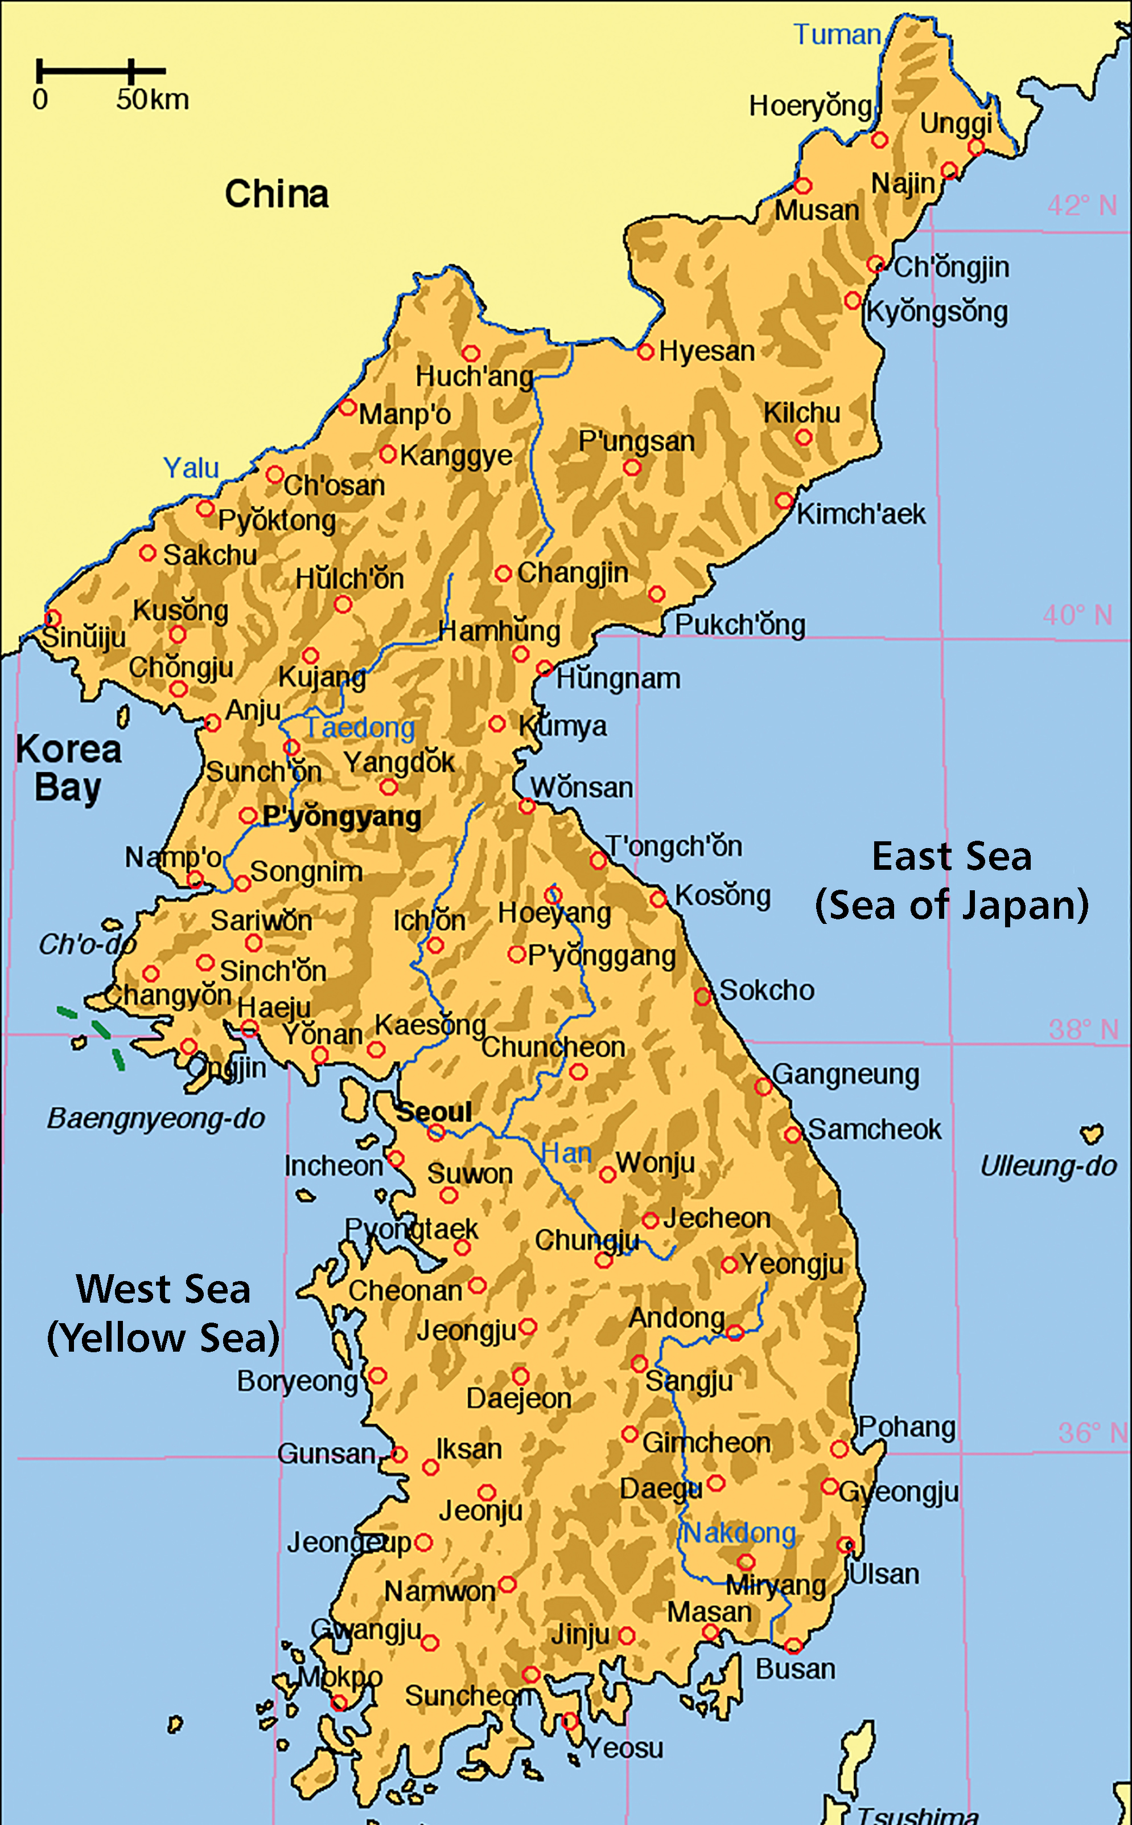
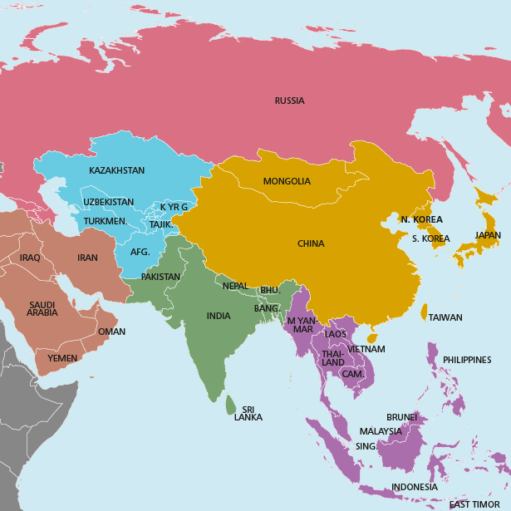
Resource sheet 7.3B
On these two maps, mark where each event or factor on Slides 5 and 6 took place or occurred.
Notes:
Korean map accessed at: https://commons.wikimedia.org/wiki/File:Map_of_korea_en.png
Map of Asia accessed at: https://commons.wikimedia.org/wiki/File:Map_of_Asia_(it).svg

