Slide 1
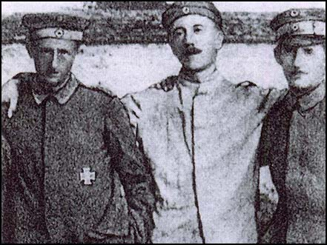
What events transformed Hitler from a “nobody” to a “somebody”?
Starter: In the back of your books, list anything you already know about Adolf Hitler.

Slide 2
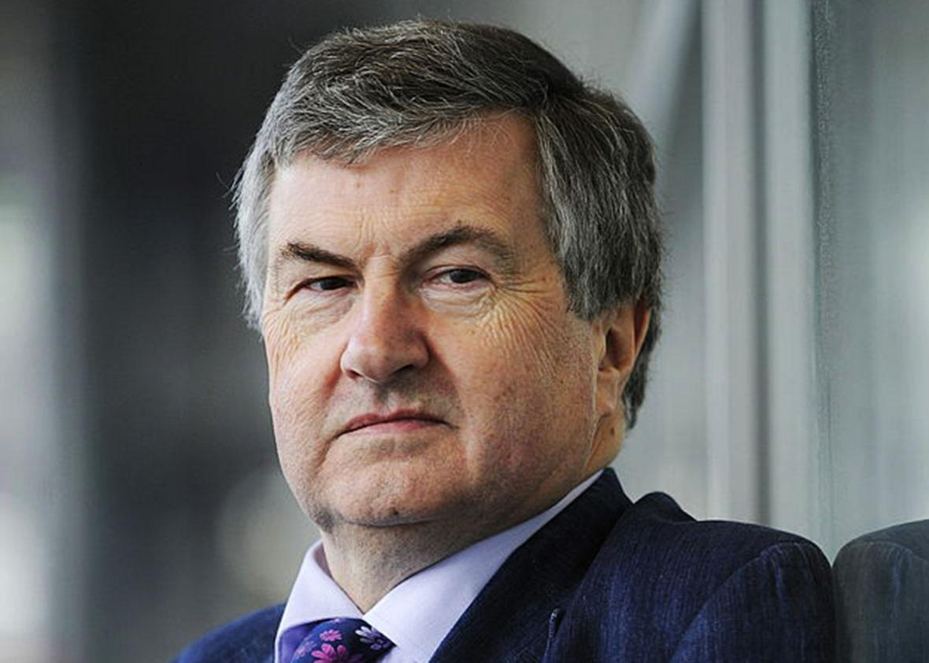
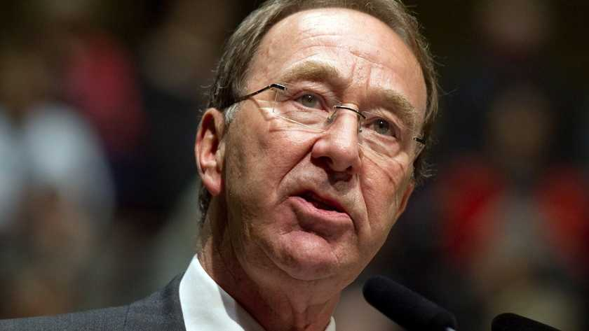
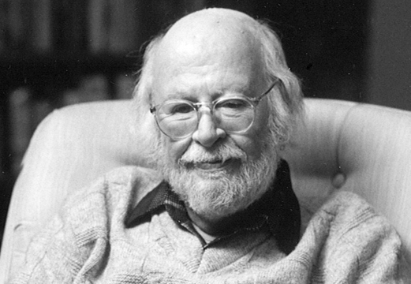
Meet our resident historians for Nazi Germany:
Richard Evans
Ian Kershaw
William L. Shirer

Slide 3
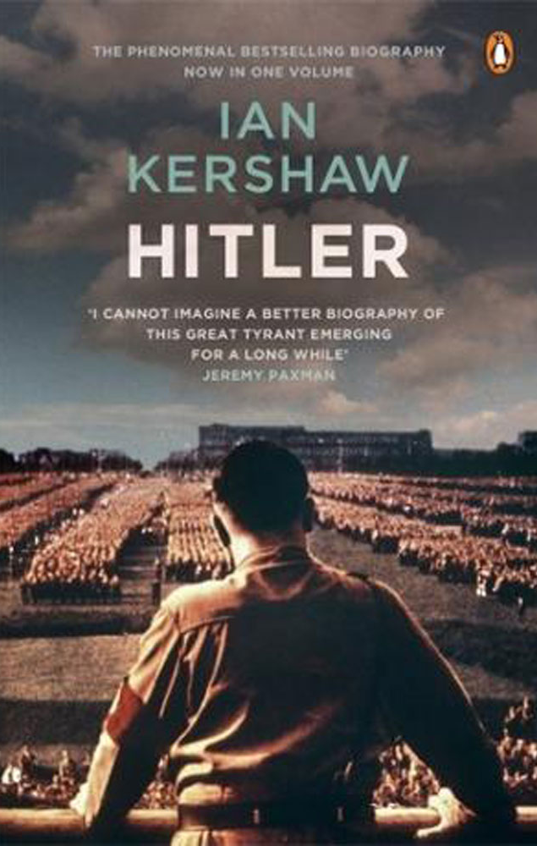
“Without the changed conditions, the product of a lost war, revolution, and a pervasive sense of national humiliation, Hitler would have remained a nobody.”
― Ian Kershaw, Hitler

Slide 4
What is Ian Kershaw referring to?
“a lost war”?
“revolution”?
“national humiliation”?
Using our learning today (and some from our previous lessons), we will work out what Kershaw means by these events.

Slide 5
Hitler: 1888 to 1914
Create a mind map in your books, with “Hitler before WWI” at the centre.
As we watch the video, write down:
1. Anything you think might help shape the type of person Hitler becomes.
2. Anything interesting you didn’t know before.
https://www.youtube.com/watch?v=yMVy8_98I-o (-9:06)

Slide 6
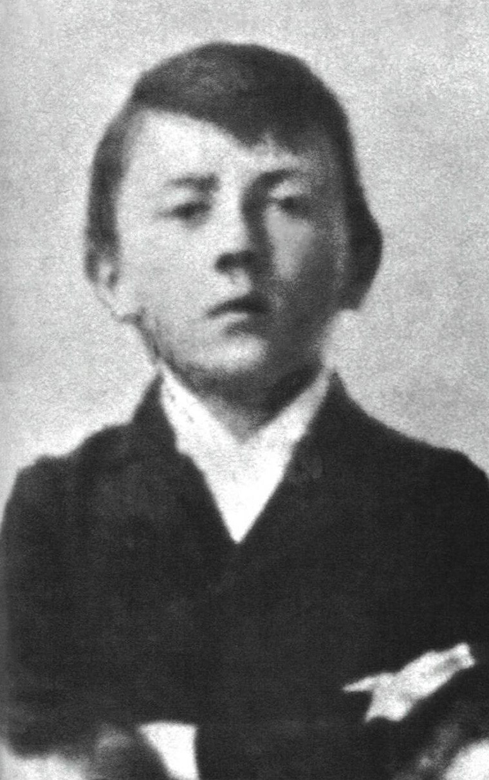
What did we find out?
Hitler had an abusive father.
He moved to Vienna then Munich at a young age, and was for a brief period of time, homeless.
He was an artist (a failed one).

Slide 7
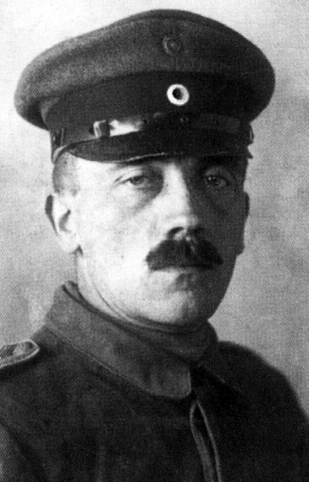
Hitler, the soldier
Create a mind map in your books, with “Hitler, the soldier” at the centre.
How did Hitler’s time as a soldier in WWI, and then his experience of the surrender, affect his view of himself and the world?
https://www.youtube.com/watch?v=yMVy8_98I-o (until 20:12).

Slide 8
What do historians think?
William Shirer, in The Rise and Fall of the Third Reich, wrote this about Hitler’s transformation during WWI.
Read it with the person next to you, and note down any questions you have, and we’ll see your classmates can answer them.

Slide 9
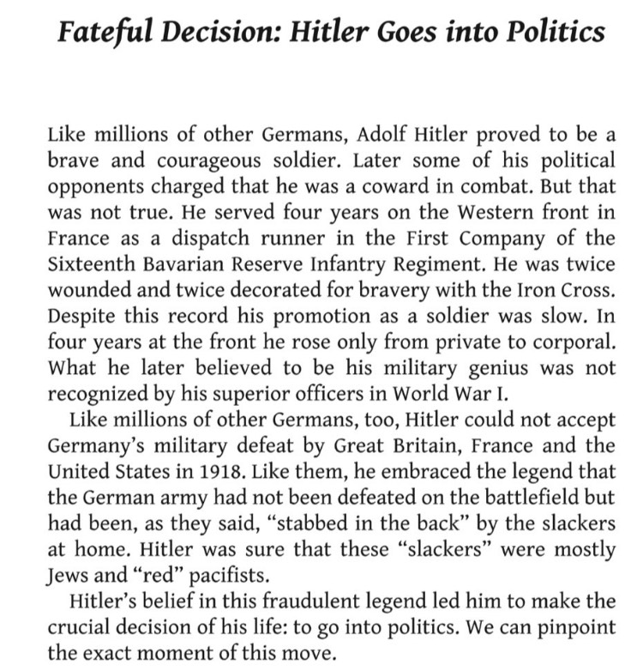
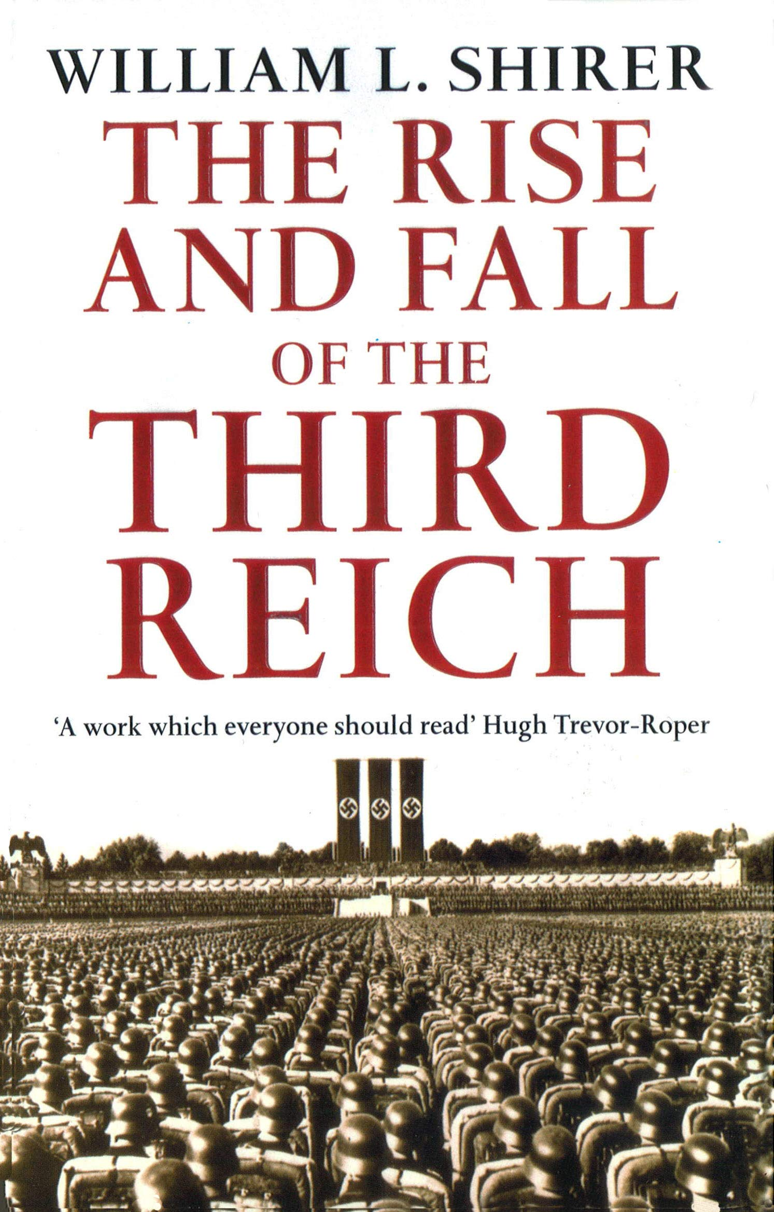
William L. Shirer, The Rise and Fall of the Third Reich

Slide 10
What event was most important in transforming Hitler from a “nobody” to a “somebody”?
In a paragraph, decide which event you think was most important in turning Hitler from a “nobody” to a “somebody”, was it...
“a lost war”?
“revolution”?
“national humiliation”?
“The most important event in transforming Hitler from a “nobody” to a “somebody” was...

