Slide 1
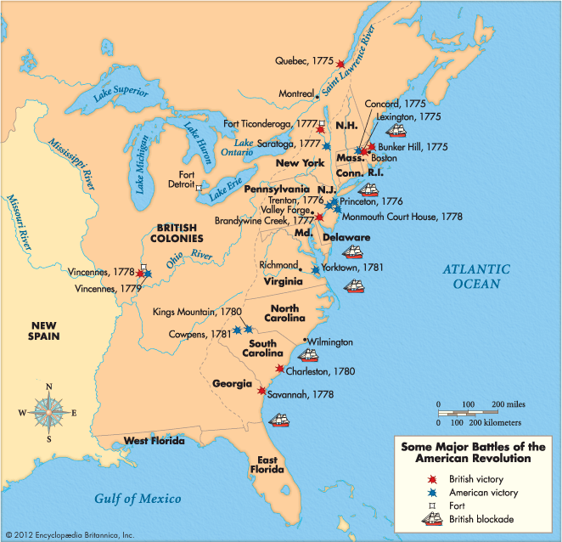
On the blank timeline in front of you…
You need to add:
- Pilgrims arrive in America
Seven Years’ War
Tea Act
Signing of the Declaration of Independence
Stamp Act
Common Sense was written
Boston Tea Party
Battle of Concord and Lexington
For each one, decide which event should be paired with each of these words:
France
Puritan
Militia
Sons of Liberty
Founding Fathers
Thomas Paine

Slide 2
On your timeline, you need to add:
Pilgrims arrive in America
Seven Years’ War
Tea Act
Signing of the Declaration of Independence
Stamp Act
Common Sense is written
Boston Tea Party
Battle of Concord and Lexington
For each one, decide which event should be paired with each of these words:
France
Puritan
Militia
Sons of Liberty
Founding Fathers
Thomas Paine
Can you now recall some associated words of your own?
With your partner, verbally create a narrative of the events of the American Revolution up to 1776.

Slide 3
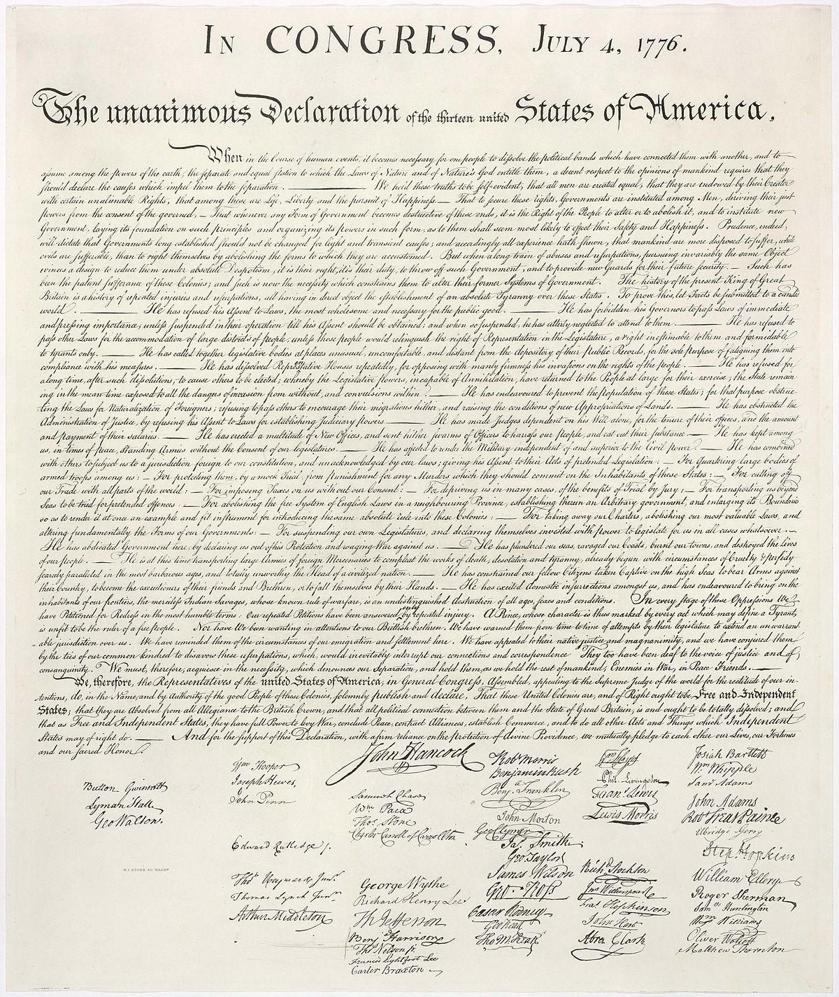
SHOCKWAVES AROUND THE WORLD! The Thirteen Colonies of European migrants had managed to break free from the British rule…
REVOLUTION!
However, just because they broke free, it didn’t mean the revolution was over…

Slide 4
How far did the aims of the American Revolution change AS it was happening?

Slide 5
Throughout history, just because a revolution has occurred, it doesn’t mean that the revolution is over.
Historian Ben Marsh argues there are four key stages of a revolution:
1. Process (e.g. people are disenchanted or see an opportunity)
2. Event puts pressure on government (e.g. a riot)
3. Programme (new regime installed)
4. Myth of the revolution is created

Slide 6
Today we are thinking about what happens here
Historian Ben Marsh argues there are four key stages of a revolution:
1. Process (e.g. people are disenchanted or see an opportunity)
2. Event puts pressure on government (e.g. a riot)
3. Programme (new regime installed)
4. Myth of the revolution is created
Between the new regime and the myth being created: revolutions are disputed, people become suspicious of each other, there is resistance against the revolution…

Slide 7
What happened during the REST of the American revolution, 1776–1790?
Reading the information sheet together… be ready for questions!
1776: The Thirteen Colonies declared independence
1763
1790
The bit we have looked at
The bit we are looking at today.

Slide 8
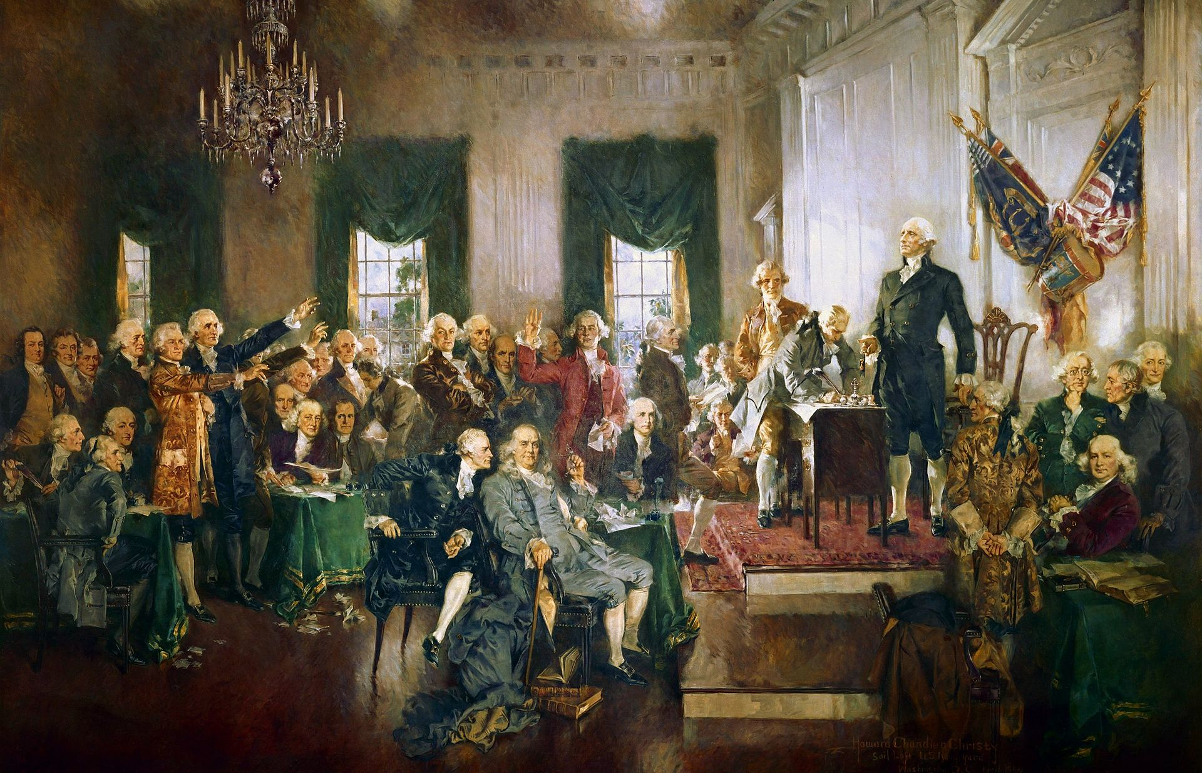
With all this information in mind, we are going to focus on the ‘framers’ of the American Constitution:
George Washington
Thomas Jefferson
James Madison
Alexander Hamilton
Benjamin Franklin
John Jay
John Adams
Your task is to answer the following questions using the character cards.
Writing the surnames will suffice.

Slide 9
Who was a plantation owner?
Who came from a big city?
Who wanted strong central government?
What were the different arguments for why strong central government was needed?
Who wanted lots of individual liberties?
Who argued for freedom to include slaves as well?
Who wanted the states to have lots of power?
Who really wanted the other states to accept the Constitution?
Is there anyone who wouldn’t have seen the Constitution as a bit of a compromise?
Why do you think Washington was chosen to preside over the Constitutional Convention?
Can you summarise each person’s views on the revolution between 1776 and 1788?
Where can you find evidence of anyone’s views changing on what the revolution was about after 1776?

Slide 10
Who was a plantation owner? Madison, Jefferson, Washington
Who came from a big city? Hamilton, Jay, Adams, Franklin
Who wanted strong central government? Madison, Jay, Hamilton, Washington
What were the different arguments for why strong central government was needed? Money and supplies in times of war, less need to borrow from other countries, allows a strong foreign policy.
Who wanted lots of individual liberties? Jefferson (also Madison ,when drawing up Bill of Rights)
Who argued for freedom to include slaves as well? Franklin, Jay
Who wanted the states to have lots of power? Jefferson
Who really wanted the other states to accept the Constitution? Madison, Hamilton, Jay
Is there anyone who wouldn’t have seen the Constitution as a bit of a compromise? No
Why do you think Washington was chosen to preside over the Constitutional Convention? He wanted change but also saw the views of the plantation owners
Can you summarise each person’s views on the revolution between 1776 and 1788?
Where can you find evidence of anyone’s views changing on what the revolution was about after 1776?
Washington – increasingly strong central because of war with British
Jay – increasingly strong central because of war with British, increasingly abolitionist
Hamilton – increasingly strong central because of war with British
Franklin – increasingly abolitionist
Jefferson – increasingly supportive of individual liberties

Slide 11
How far did the aims of the American Revolution change AS it was happening?
Time to discuss the BIG question
1776–1790
Stayed the same from 1776–1790
Everyone’s aims completely changed from 1776–1790

Slide 12
How far did the aims of the American Revolution change AS it was happening?
Bringing EVERYTHING together to stretch yourselves
1763–1790
Stayed the same from 1763–1790
Everyone’s aims completely changed from 1763–1790

Slide 13
For next time
Complete a detailed timeline of the American Revolution using everything you have learned so far. Put the events on the timeline you were given at the start of the lesson.
Use your homework from last lesson to try to add at least three new things to your timeline in a different colour.

