Slide 1
Session 5: Opinions and evidence
Who was to blame for the Peterloo Massacre?

Slide 2
STARTER
http://www.nationalarchives.gov.uk/education/politics/g4/g4_game.htm

Slide 3
Who do you believe?
Statements | Supporting evidence | Source of evidence
The protest was peaceful.
People had walked from the entire Manchester area.
The magistrates were afraid of the protesters.
The people were attacked by the yeomanry with their sabres and trampled by horses.
The yeomanry did not attack the people. People died accidentally.
The events at St Peter’s Field were reported in the newspapers.

Slide 4
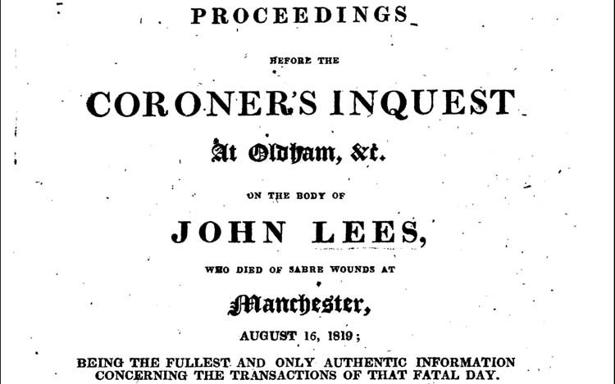
Inquest document
1

Slide 5
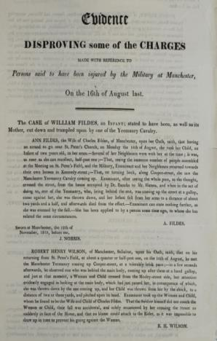
Evidence disproving charges
2
Sworn at Manchester, 12th of November, 1819, before me, J. NORRIS
ROBERT HENRY WILSON, of Manchester, Solicitor, upon his Oath, saith, that on his returning from St. Peter’s Field, at about a quarter or half-past one, on the 16th of August, he met the Manchester Yeomanry coming up Cooper Street, at a tolerably brisk pace; – in a few seconds afterwards, he observed one who was behind the main body, coming up after them at a hand gallop, and just at that moment, a Woman and Child crossed from the Mosely Street side, her attention evidently engaged in looking at the main body, which just passed her, in consequence of which, she was thrown down by the one coming up, and her child thrown from her by the shock, to a distance of two or three yards, and pitched upon its head. Examinant took up the Woman and the Child, whom he found to be the Wife and Child of Charles Fildes. That the Soldier himself did not touch the Woman or the Child, their fall was accidental, and solely occasioned by her crossing the Street so suddenly in the face of the Horse, and that no blame could attach to the Rider, as it was impossible to draw up in time to prevent his going against the Woman.
R. H. WILSON

Slide 6
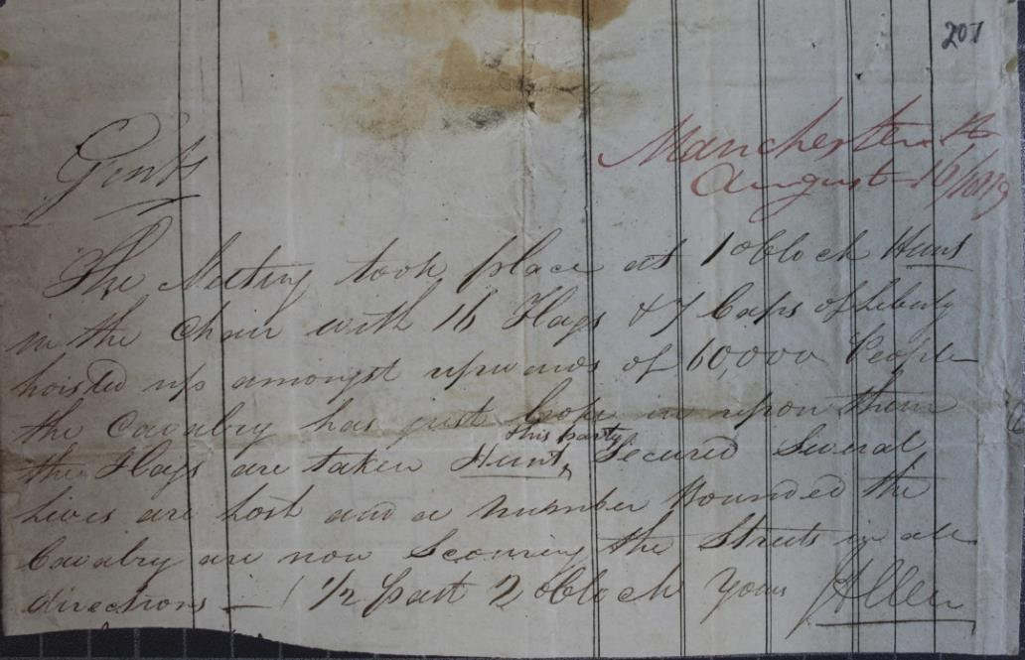
First account of events on a note
3
A scrap of paper giving an account of events in Manchester shows that few expected the Yeoman Cavalry to be used to break up the crowd. This brief, vivid, immediate account is our earliest report of Peterloo, 16 August 1819. This information was received in London the following day and sent to Lord Sidmouth’s office. | Manchester August 16, 1819 Gents, The meeting took place at 1o’ clock. Hunt in the chair with 16 flags and 7 caps of Liberty hoisted up amongst upwards of 60,000 people, the cavalry has just broke in upon them, the flags are taken, Hunt and his party secured, several lives are lost and a number wounded. The cavalry are now securing the streets in all directions, ½ past 2 o’clock, Yours J. Allen
http://www.nationalarchives.gov.uk/education/resources/protest-democracy-1818-1820/first-account-peterloo/

Slide 7
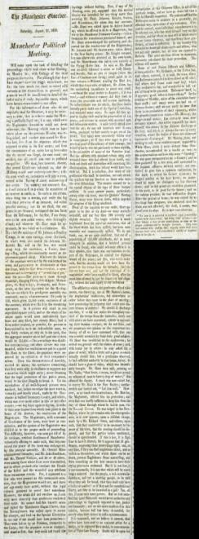
Manchester Observer article, 21 August 1819
4
As soon as Mr. Hunt was secured, followed a scene so truly bloody and horrific, that no pen or tongue… could paint in its true colours. Without reading the Riot Act, which that despicable sycophant, Mr. Aston, has the unblushing impudence to assert was read; without the usual notice to disperse, if it was read; and without ceremony did they dash in upon this peaceable and defenceless multitude. So indiscriminate was the attack, that these lambs literally put to death one of the Special Constables, and wounded many more. So eager did they appear to display their zeal in the preservation of the peace, and to come in contact with unarmed men and defenceless women. A most terrific shriek now rent the air; we many add hundreds were thrown down, produced by their anxiety to get out of the crowd. Very many were necessarily ridden over in consequence…

Slide 8
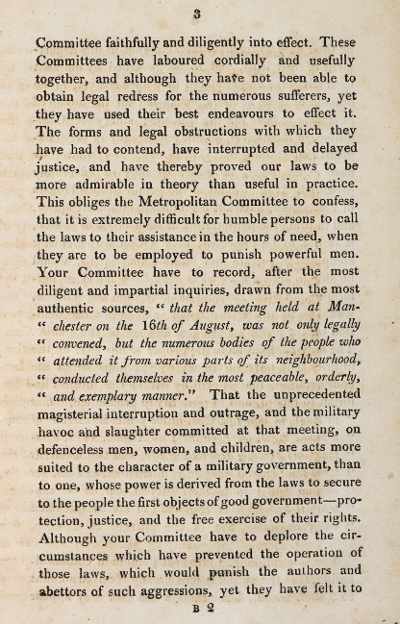
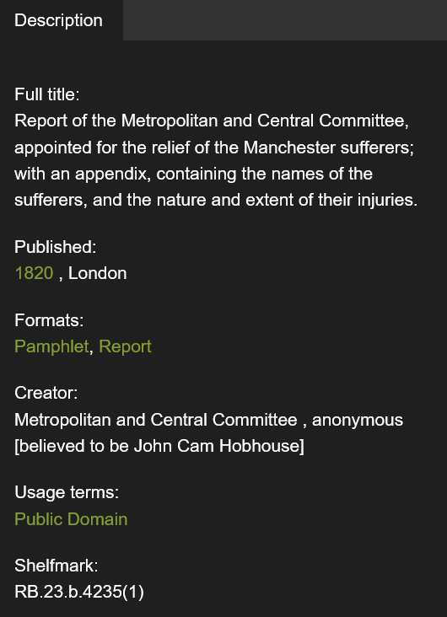
Report
5
https://www.bl.uk/collection-items/lists-of-the-killed-and-wounded-from-the-peterloo-massacre

Slide 9
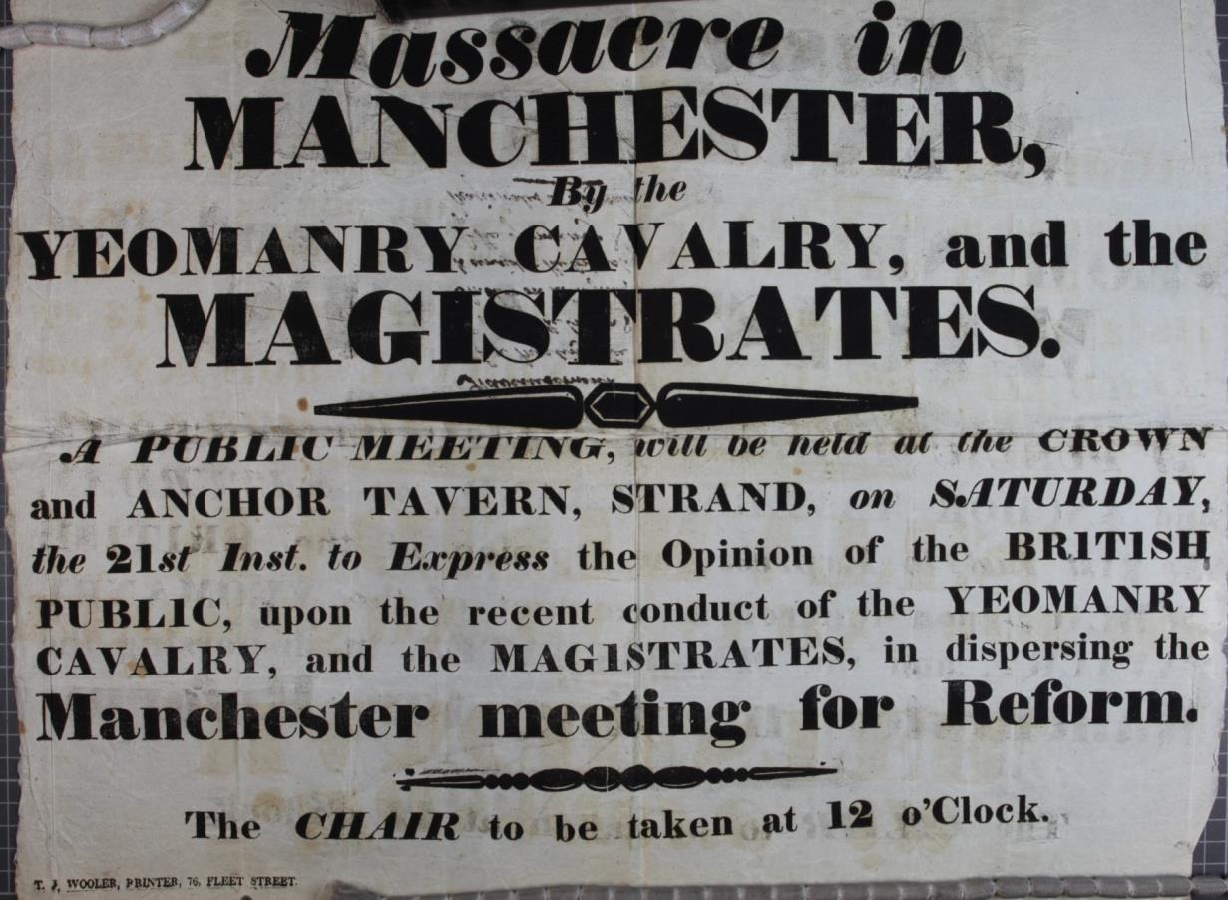
Pamphlet
6
http://www.nationalarchives.gov.uk/education/resources/protest-democracy-1818-1820/response-peterloo/

Slide 10
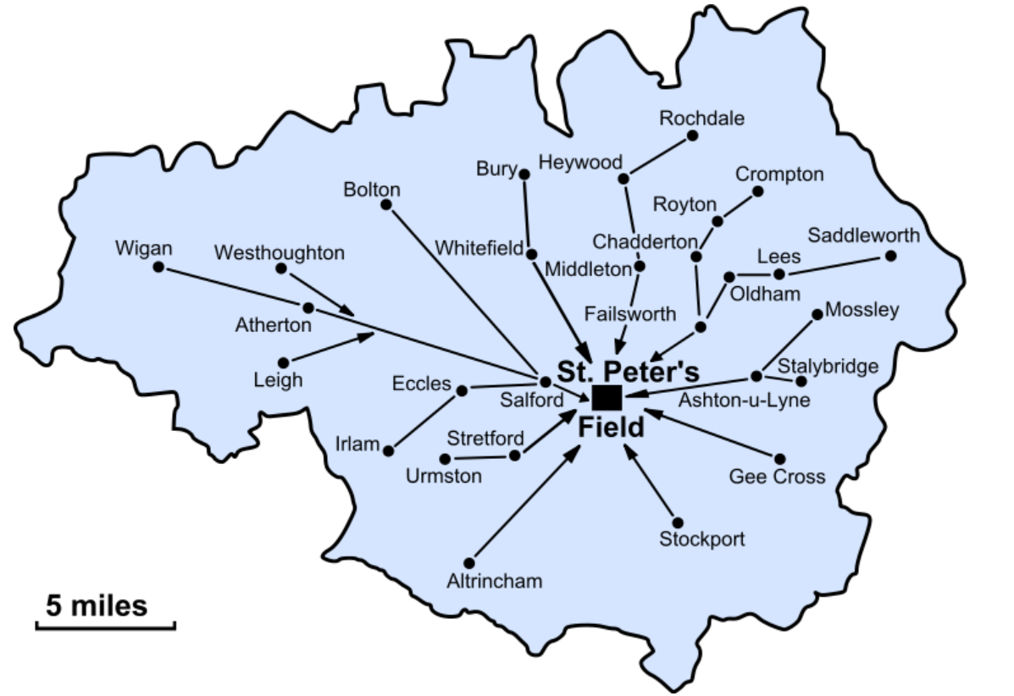
Map of area surrounding Manchester
7

Slide 11
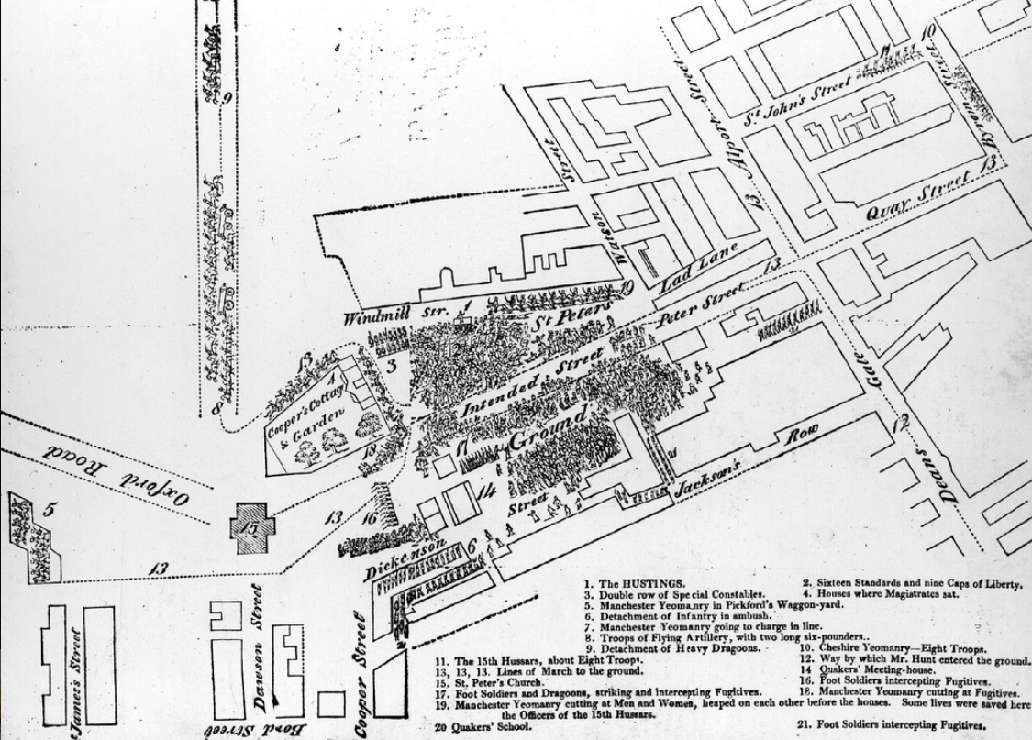
Map of St Peter’s Field, Manchester
8

Slide 12
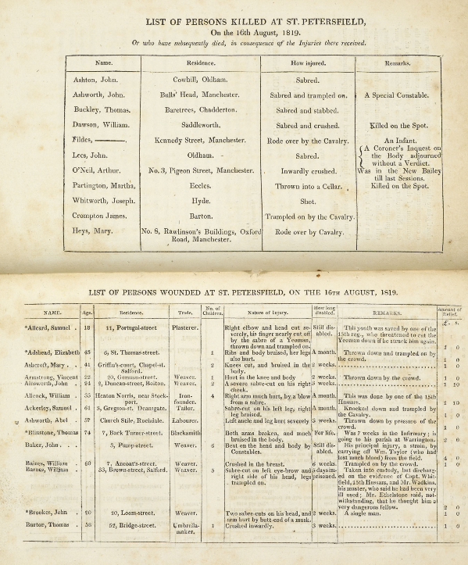
9
List of persons killed at St Peter’s Field

Slide 13
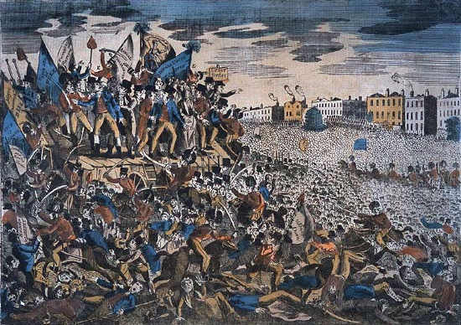
10
This poster demonstrates the way in which the ‘Peterloo Massacre’ immediately became part of positive radical propaganda.
The picture had been purchased by John Jenkins, an ex-weaver and ex-Royal Marine. In November 1819, Jenkins had been exhibiting the picture at Chudleigh, in Devon, when his activities came to the attention of Gilbert Burrington, the vicar of Chudleigh and an active magistrate.
Burrington committed Jenkins to the Exeter house of correction as a vagrant and passed information of his seditious conduct to the Home Secretary.
http://www.nationalarchives.gov.uk/humanrights/1815-1848/doc-peterloo-image.htm

Slide 14
‘The Mask of Anarchy’ by Shelley
11
The poet Shelley, upon hearing of the event, wrote ‘The Masque of Anarchy’, which was banned for 30 years.
As I lay asleep in Italy
There came a voice from over the Sea,
And with great power it forth led me
To walk in the visions of Poesy
I met Murder on the way—
He had a mask like Castlereagh—
Very smooth he looked, yet grim;
Seven blood-hounds followed him…
… Last came Anarchy: he rode
On a white horse, splashed with blood;
He was pale even to the lips,
Like Death in the Apocalypse.
And he wore a kingly crown;
And in his grasp a sceptre shone;
On his brow this mark I saw—
‘I AM GOD, AND KING, AND LAW!’
With a pace stately and fast,
Over English land he passed,
Trampling to a mire of blood
The adoring multitude.
And with a mighty troop around
With their trampling shook the ground,
Waving each a bloody sword,
For the service of their Lord…

Slide 15
TASK: Newspaper report
Choose the newspaper you represent.
You are an eyewitness.
Language must be detailed, as there is no other way of providing information for people.
Choose your vocabulary carefully for maximum impact.
Include quotes from others who were present.

Slide 16
REFLECTION
‘The Peterloo Massacre’ – why do you think people use this term?

