Slide 1
Session 4: Protest, riot or revolution?
What happened at St Peter’s Field?

Slide 2
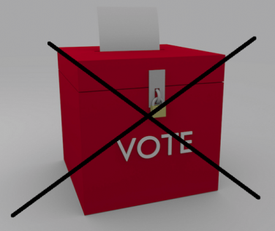
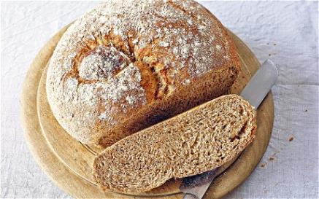
What do these represent?

Slide 3
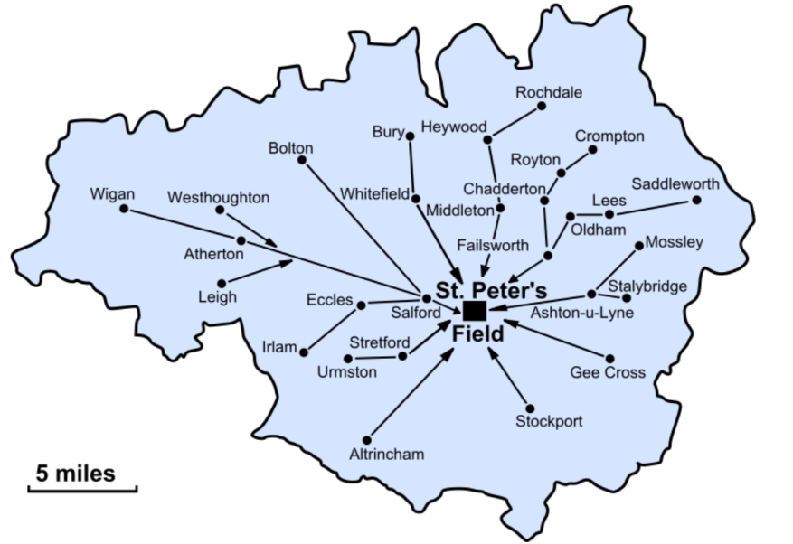
https://wikivisually.com/wiki/Peterloo_Massacre

Slide 4
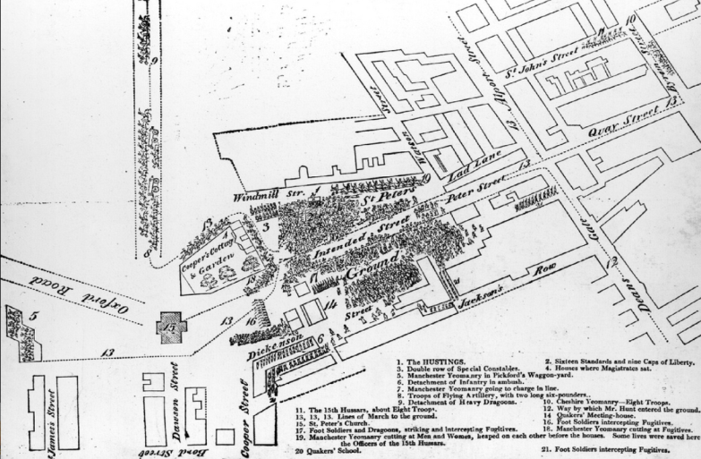
http://peterloo.mlfhs.org.uk/official/maps.php

Slide 5
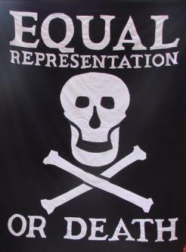
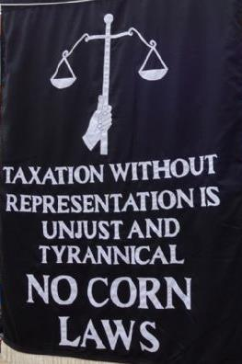
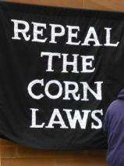
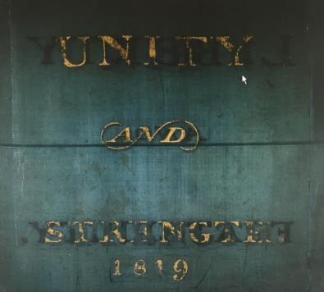
Banners
https://www.boltonsocialistclub.org.uk/index.php/galleries/152-peterloo-walk-commemoration
http://www.salfordstar.com/article.asp?id=3400
http://salfordstar.com/article.asp?id=2877
http://www.gmmg.org.uk/our-connected-history/item/peterloo-banner/

Slide 6
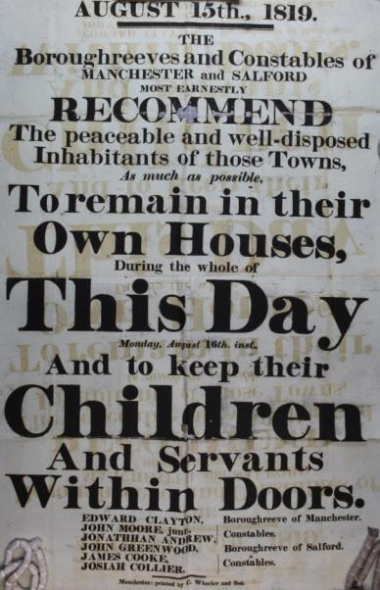
What do the magistrates think will happen?
http://www.nationalarchives.gov.uk/education/resources/protest-democracy-1818-1820/stay-home/

Slide 7
Role play
WORKERS/ SPEAKERS (four groups) | MAGISTRATES/ YEOMANRY/ HUSSARS (one/two groups)
MANCHESTER AREA MAP: Work out how you are going to get to St Peters Field. Assign areas: Saddleworth, Wigan, Rochdale Bolton, etc. FAMILIES: Who will come with you? Your children, whole families. What will you need to pack? Lunch, best clothes. BANNERS: How will you show people on the way who you are and why you are protesting? VETERANS: John Lees – former Waterloo soldiers – what will you sing on the way? HENRY HUNT: Prepare your speech for the crowds you hope to speak to. | ST PETER’S FIELD MAP: Work out how you are going to control the crowd prior to the event. MAGISTRATES: Fearful of a riot. Believe that protesters will come armed with weapons and rocks. Ready to read ‘The Riot Act’. Can you stop them from coming? YEOMANRY: Part-time soldiers, in pubs having free drinks before the meeting, sharpen swords, get on to horses. HUSSARS: Regular soldiers practise drilling, only use flats of the sword.

Slide 8
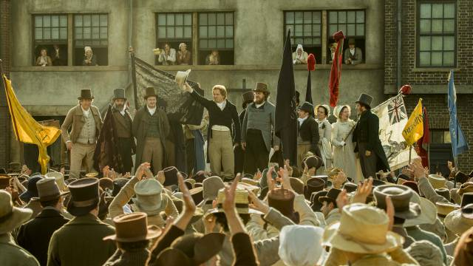
Freeze-frame
https://variety.com/2018/film/news/entertainment-one-mike-leigh-peterloo-uk-1202826501/
PAIRS: What do you think happened next?

Slide 9
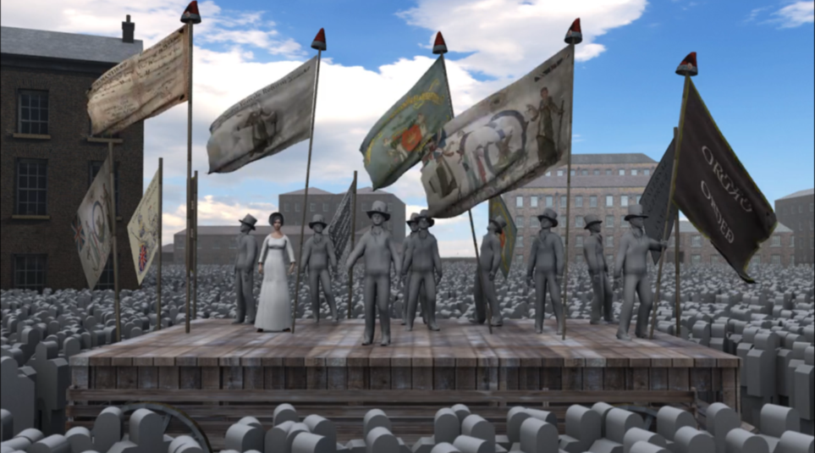
St Peter’s Field 1819 - https://vimeo.com/156157535

Slide 10
PAIR A: ‘The Mask of Anarchy’ by Shelley
As I lay asleep in Italy
There came a voice from over the Sea,
And with great power it forth led me
To walk in the visions of Poesy
I met Murder on the way—
He had a mask like Castlereagh—
Very smooth he looked, yet grim;
Seven blood-hounds followed him…
… Last came Anarchy: he rode
On a white horse, splashed with blood;
He was pale even to the lips,
Like Death in the Apocalypse.
And he wore a kingly crown;
And in his grasp a sceptre shone;
On his brow this mark I saw—
‘I AM GOD, AND KING, AND LAW!’
With a pace stately and fast,
Over English land he passed,
Trampling to a mire of blood
The adoring multitude.
And with a mighty troop around
With their trampling shook the ground,
Waving each a bloody sword,
For the service of their Lord…

Slide 11
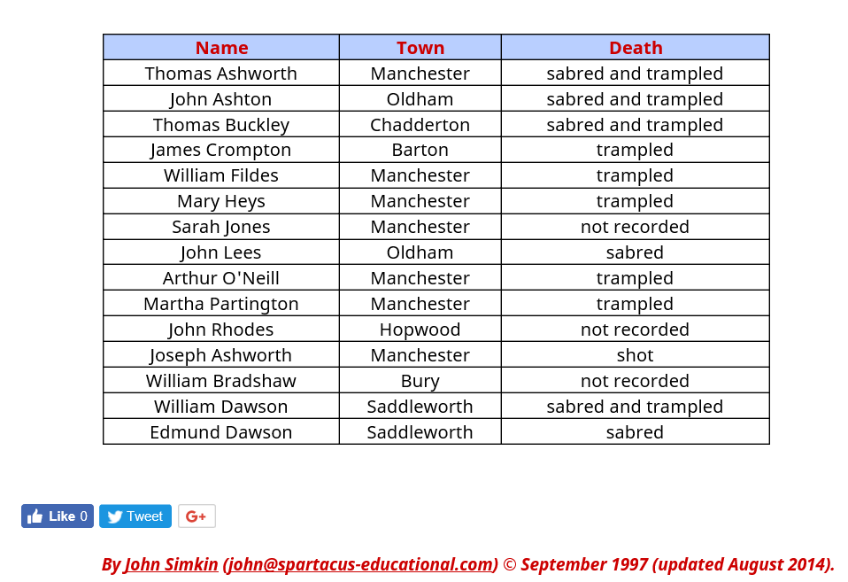
PAIR B: List of the dead at St Peter’s Field
http://spartacus-educational.com/PRdeaths.htm

Slide 12
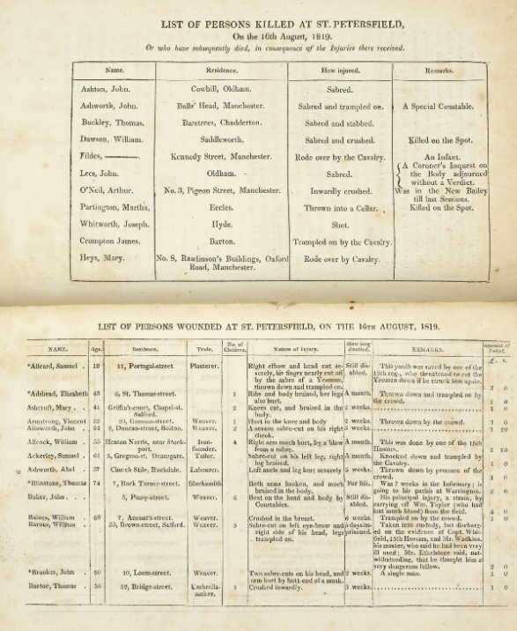
PAIR C: List of persons killed at St Peter’s Field
https://www.bl.uk/collection-items/lists-of-the-killed-and-wounded-from-the-peterloo-massacre

Slide 13
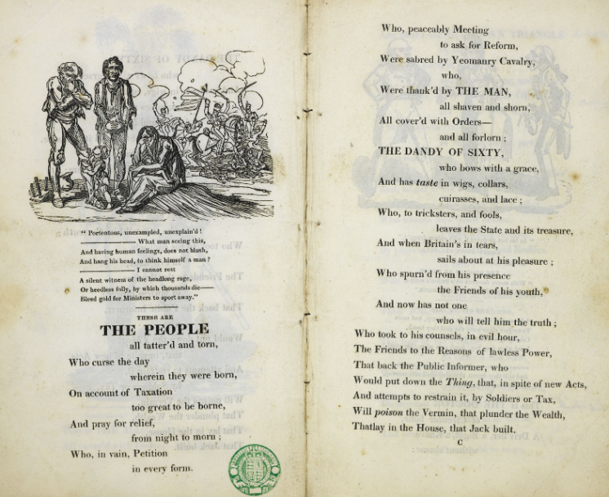
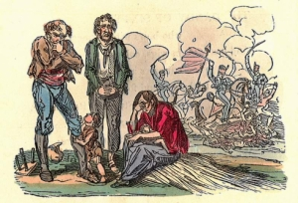
Pair D: This is the House that Jack Built
https://www.wcml.org.uk/our-collections/object-of-the-month/william-hones-1819-pamphlet-the-political-house-that-jack-built/
https://www.bl.uk/collection-items/the-political-house-that-jack-built-a-radical-political-satire-by-william-hone-and-george-cruikshank

Slide 14
These are THE PEOPLE all tatter'd and torn,
Who curse the day wherein they were born,
On account of Taxation too great to be borne,
And pray for relief, from night to morn;
Who, in vain, Petition in every form,
Who, peaceably Meeting to ask for Reform,
Were sabred by Yeomanry Cavalry
https://www.wcml.org.uk/our-collections/object-of-the-month/william-hones-1819-pamphlet-the-political-house-that-jack-built/

Slide 15
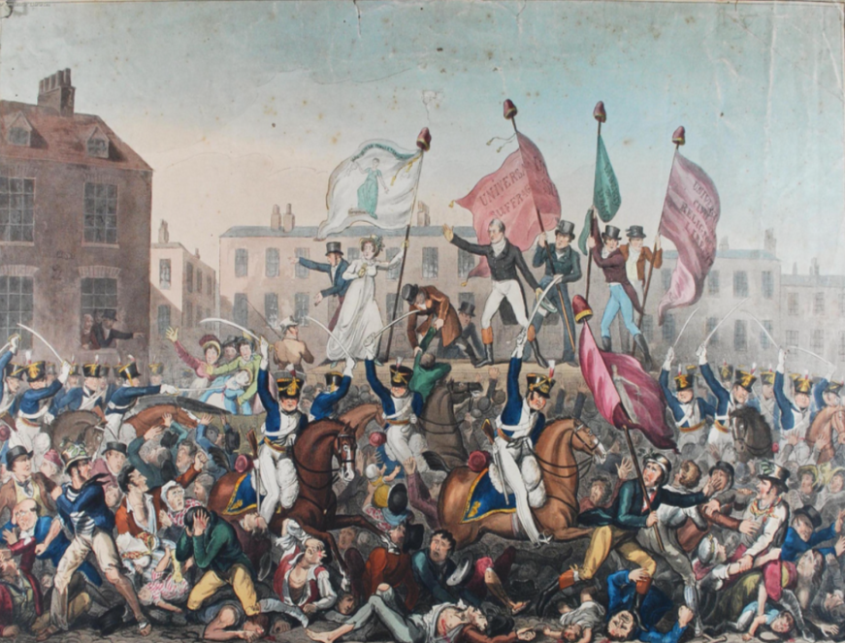
Manchester Archives https://www.flickr.com/photos/manchesterarchiveplus/6045102539

Slide 16
TASK: POETRY
As a class, agree a set of 15–20 words linked to the events at St Peter’s Field.
Write a poem using only words selected from the list.
Words can be repeated.

