Slide 1
Session 2: Memorials
How do we remember people and events from the past?

Slide 2
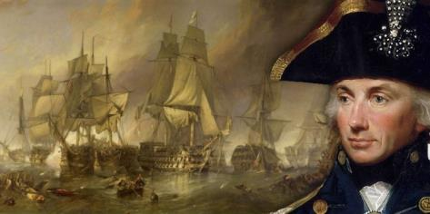
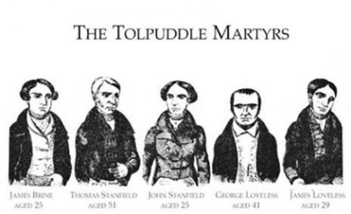
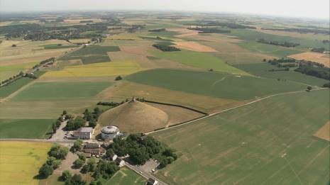
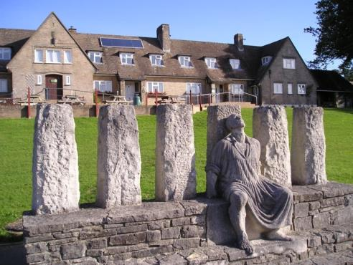
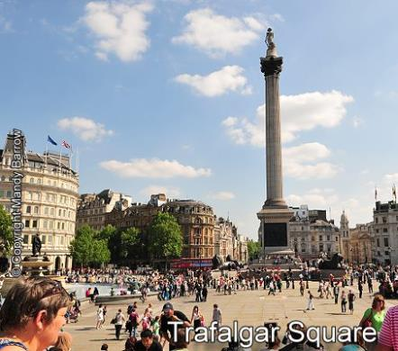
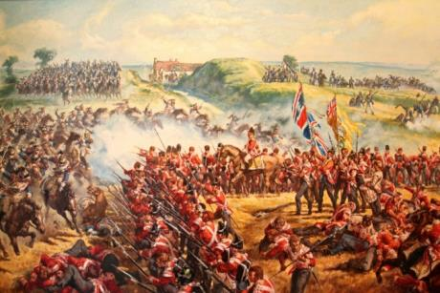
Match the memorial
A
B
C
http://fiveminutehistory.com/british-hero-admiral-lord-nelson-victor-at-the-battle-of-trafalgar-1805/
http://www.bookofdaystales.com/tolpuddle-martyrs/
http://footage.framepool.com/en/shot/698251224-lion%27s-mound-battle-of-waterloo
1
3
2
https://www.squaducation.com/blog/sentencing-tolpuddle-martyrs
https://www.royal-irish.com/events/battle-honour-waterloo

Slide 3
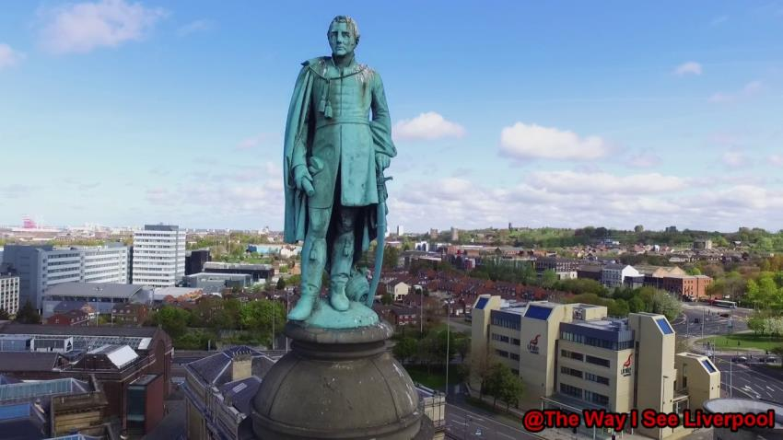
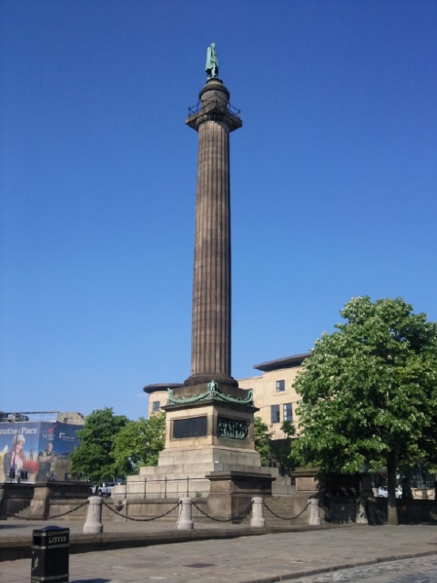
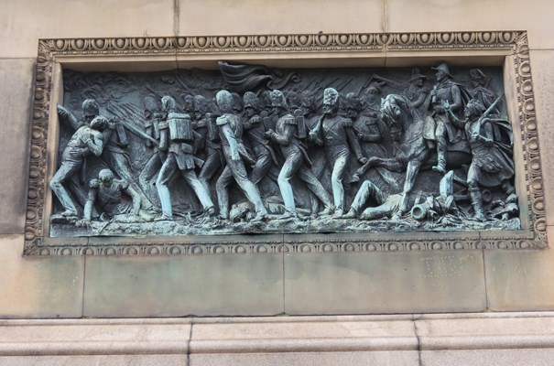
Liverpool
http://liverpoolhiddenhistory.co.uk/wellingtons-wait/
https://historicengland.org.uk/listing/the-list/list-entry/1063784#contributions

Slide 4
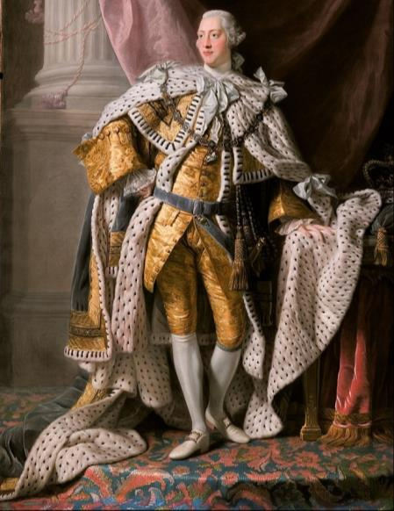
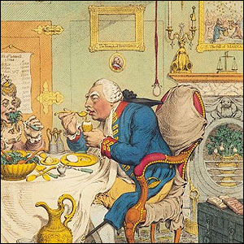
King George III (1760–1820)
© National Portrait Gallery, London https://www.npg.org.uk/collections/search/portrait/mw61578/Temperance-enjoying-a-frugal-meal-Sophia-Charlotte-of-Mecklenburg-Strelitz-King-George-III
https://www.rct.uk/collection/405307/george-iii-1738-1820
What does the King think of himself?
How does he want others to see him?
What do other people think of him?
How do other people see him?

Slide 5
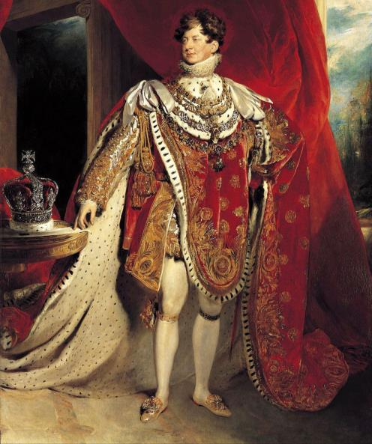
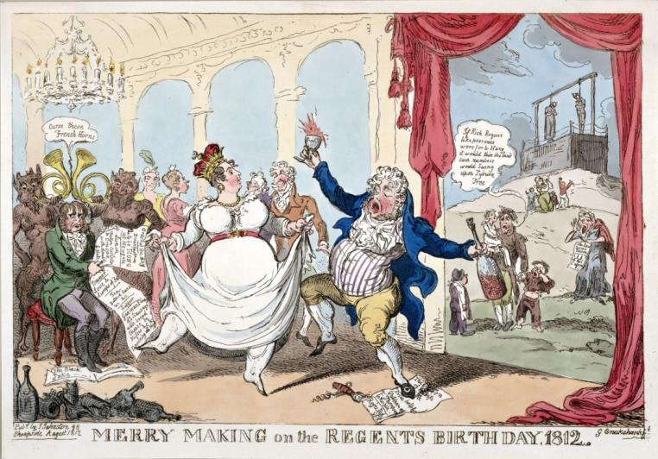
King George IV (1820–1830)
https://www.loc.gov/item/2003689159/
https://www.rct.uk/collection/405918/george-iv-1762-1830
What do other people think of him?
How do other people see him?
What does the King think of himself?
How does he want others to see him?

Slide 6
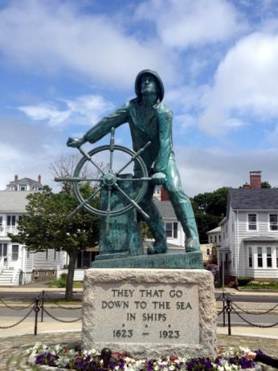
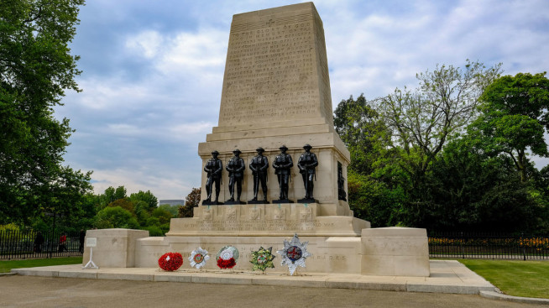
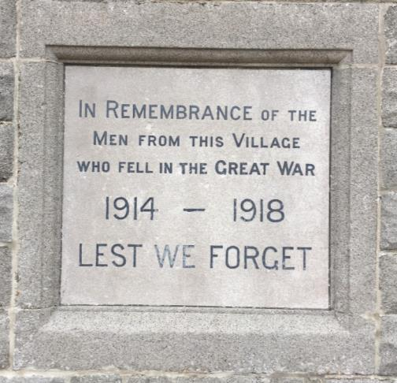
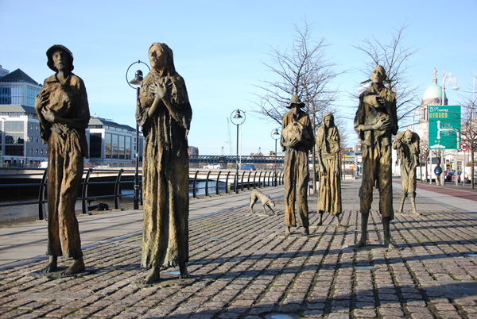
Recording the past
https://www.pinterest.co.uk/pin/368661919467628211/?lp=true
https://yesterday.uktv.co.uk/war-memorials/article/what-you-need-know-about-uk-war-memorials/
https://irishfaminememorials.com/

Slide 7
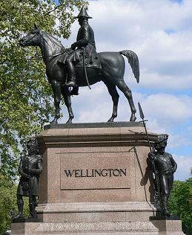
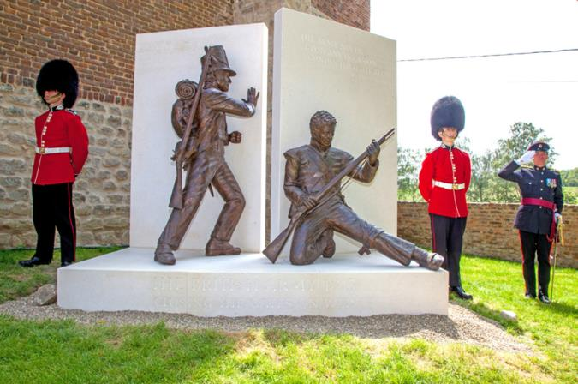
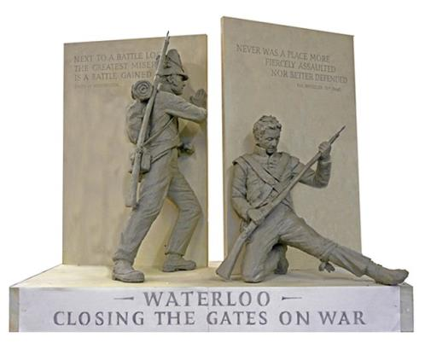
Compare memorials of Waterloo
http://talosartfoundry.co.uk/portfolio-item/waterloo-memorial/
Unveiled: 2014
TASK: How have people’s ways of remembering this event changed from 1846 to 2014?
http://britainunlimited.com/duke-of-wellington/
Unveiled: 1846
http://www.dailymail.co.uk/news/article-2882154/Wellington-s-heroes-finally-win

Slide 8
How have memorials changed over time?
English Heritage
http://blog.english-heritage.org.uk/10-things-you-probably-didnt-know-about-londons-war-memorials/
TASK:
How have people’s views of war and types of memorials changed over time?
Do you agree or disagree with English Heritage?
Why?

Slide 9
EXTENSION: Learn a song from the Georgian era ‘Over the Hills and Far Away’ – https://www.youtube.com/watch?v=VhH8IFUrpP8
What is this song about?
Who do you think sang it?
Why do you think it became popular?
Why do we still remember it today?

Slide 10
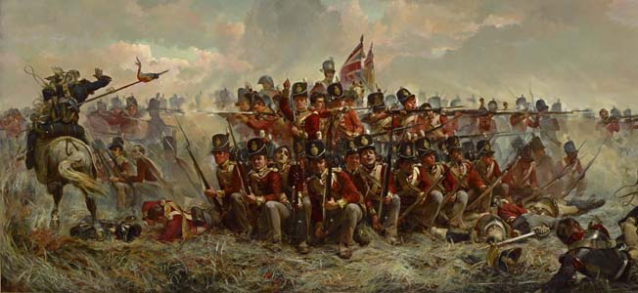
1819 in Flanders (Belgium)
PAIRS: What is happening?
http://warfarehistorynetwork.com/daily/military-history/napoleon-bonapartes-prelude-to-the-battle-of-waterloo/

Slide 11
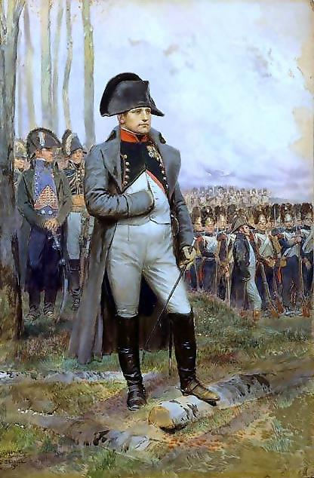
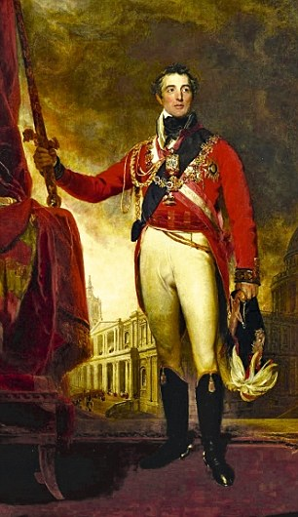
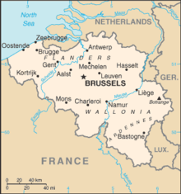
Battle of Waterloo 1819
Flanders
(Belgium)
http://napoleonistyka.atspace.com/Napoleon_tactics.htm
http://napoleonistyka.atspace.com/Napoleon_tactics.htm
Napoleon
France
Duke of Wellington
England

Slide 12
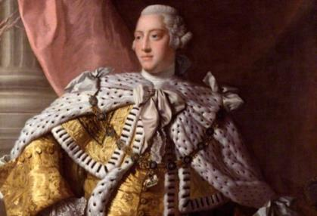
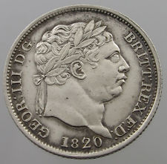
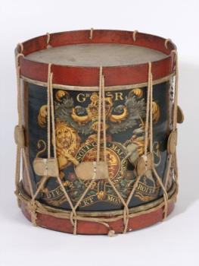
Over the Hills and Far Away
CHORUS O'er the hills and o'er the main.
Through Flanders, Portugal and Spain.
King George commands and we obey.
Over the hills and far away.
Here's forty shillings on the drum
For those who'll volunteer to come
To 'list and fight the foe today.
Over the hills and far away.
When duty calls me, I must go
To stand and face another foe.
But part of me will always stray
Over the hills and far away.
If I should fall to rise no more,
As many comrades did before,
Then ask the fifes and drums to play.
Over the hills and far away.
Then fall in lads behind the drum,
With colours blazing like the sun.
Along the road to come-what may.
Over the hills and far away.

Slide 13
EXTENSION: O’er the Hills and Far Away
What is this song about?
Who do you think sang it?
Why do you think it became popular?
Why do we still remember it today?
TASK: Write a new verse
What message do you want to convey about war from 2019?

Slide 14
TASK: Write a new verse
__________________________,
___________________________,
____________________, (e.g. say, play, sway, today,)
Over the hills and far away.
O'er the hills and o'er the main.
Through Flanders, Portugal and Spain.
King George commands and we obey.
Over the hills and far away.

