Slide 1
Session 1: LO: Use historical vocabulary and ask historical questions
Escape Room Challenge

Slide 2
HISTORY DETECTIVES
Each team will be given a set of picture clues.
Complete the mystery word(s) in order to move on to the next challenge.
For Challenge 3, you will need the ‘CODE BREAKER’.
When you have completed all four challenges, use the vocabulary to ask historical questions about the topic.
Can your team score 10/10 and BECOME FULLY FLEDGED HISTORY DETECTIVES?

Slide 3
On your marks…
Get set…
Go!

Slide 4
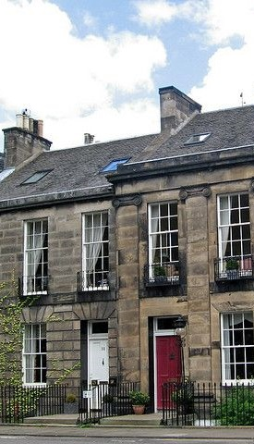
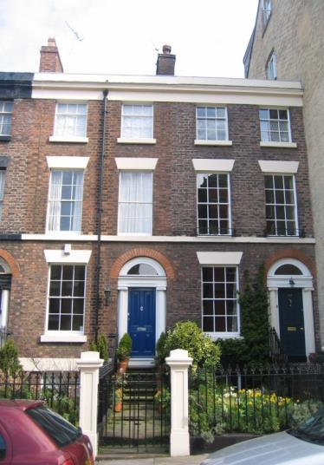
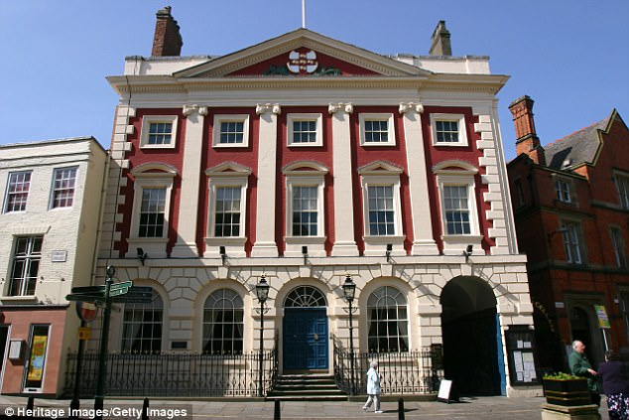
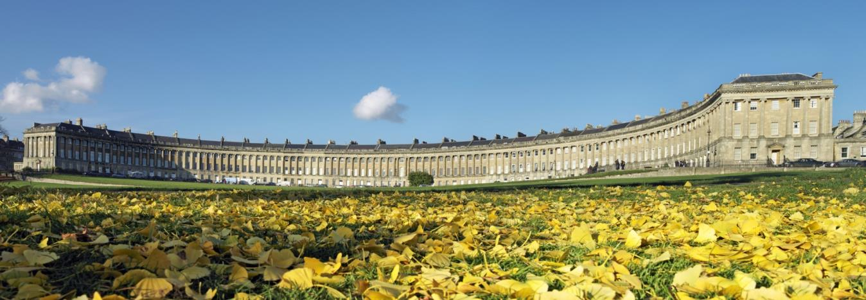
1
Image © Bath Tourism Plus/Colin Hawkins https://www.visitbritain.com/gb/en/georgian-bath#IVlLSKGHtjqvdDzD.97

Slide 5
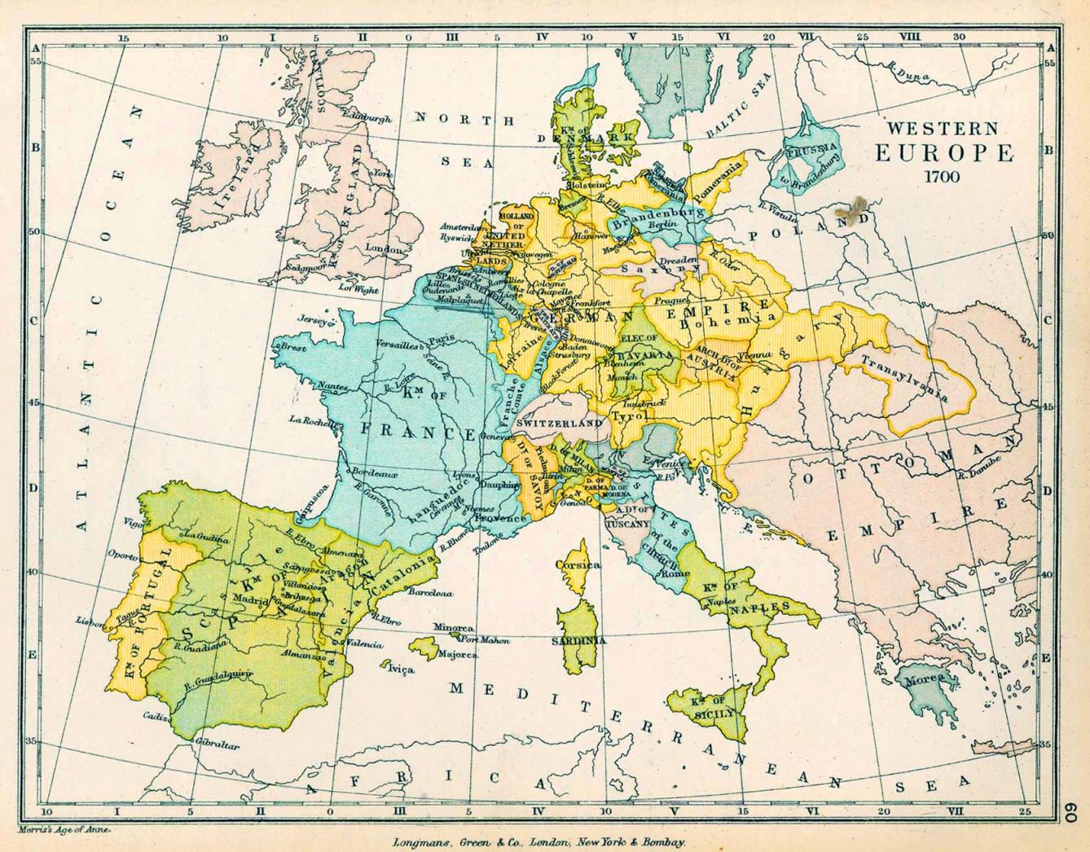
1
The Public Schools Historical Atlas by Charles Colbeck. Longmans, Green; New York; London; Bombay. 1905. https://www.gifex.com/detail-en/2009-09-17-805/Western-Europe-in-1700.html

Slide 6
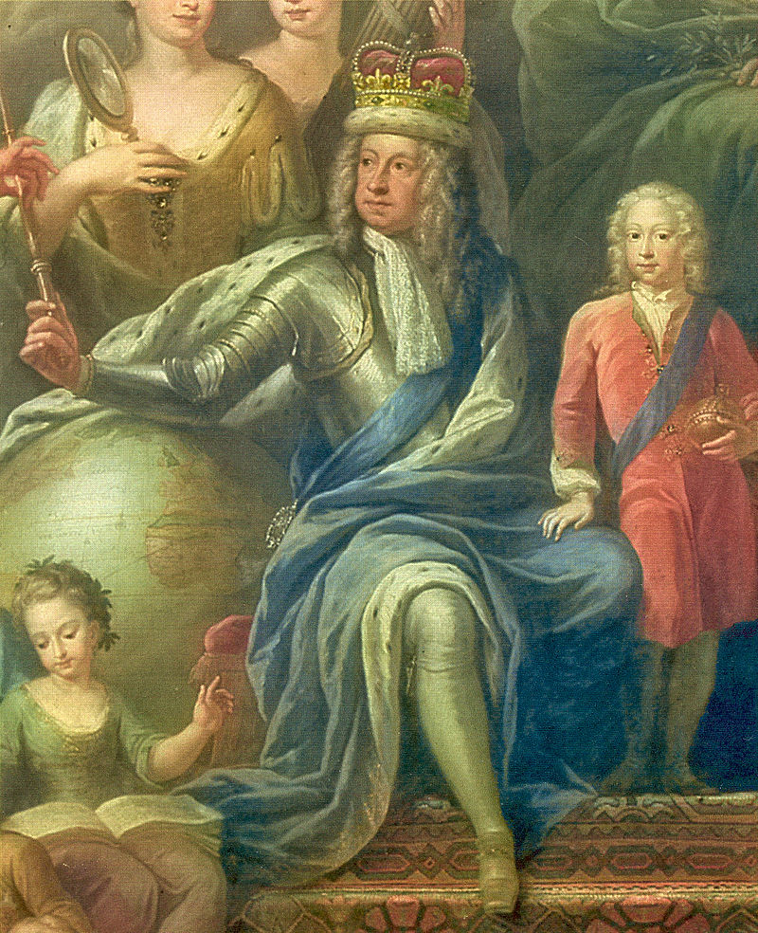
1
https://en.wikipedia.org/wiki/George_I_of_Great_Britain#/media/File:GeorgeIThornhill.jpg

Slide 7
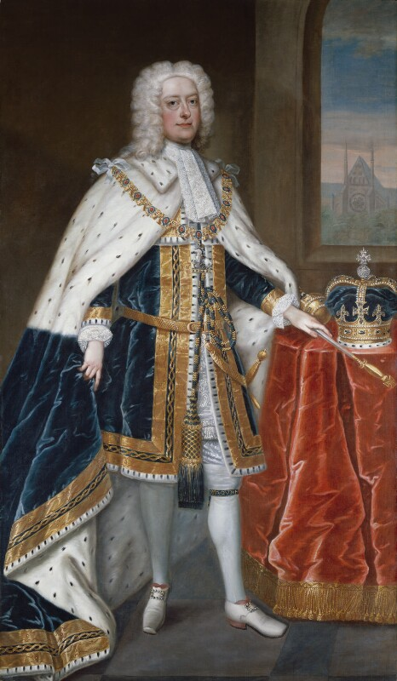
1
Image © National Portrait Gallery, London https://www.npg.org.uk/collections/search/portrait/mw02449/King-George-II

Slide 8
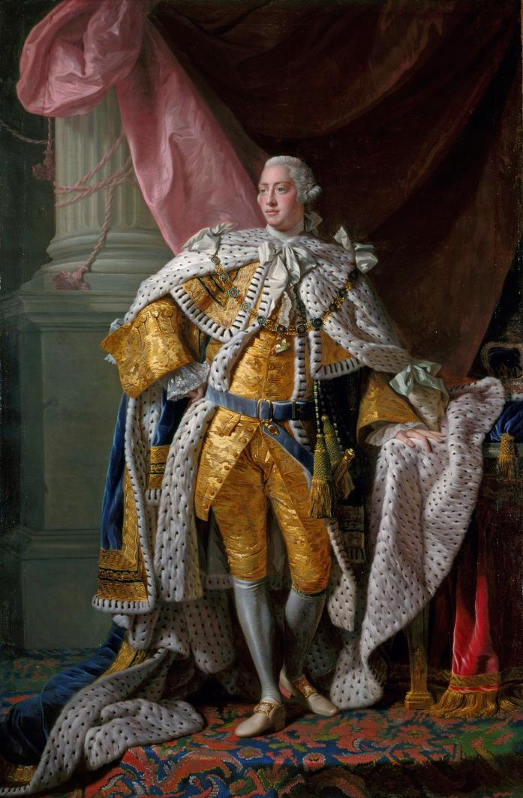
1
Image: Royal Collection Trust / © Her Majesty Queen Elizabeth II https://www.rct.uk/collection/405307/george-iii-1738-1820

Slide 9
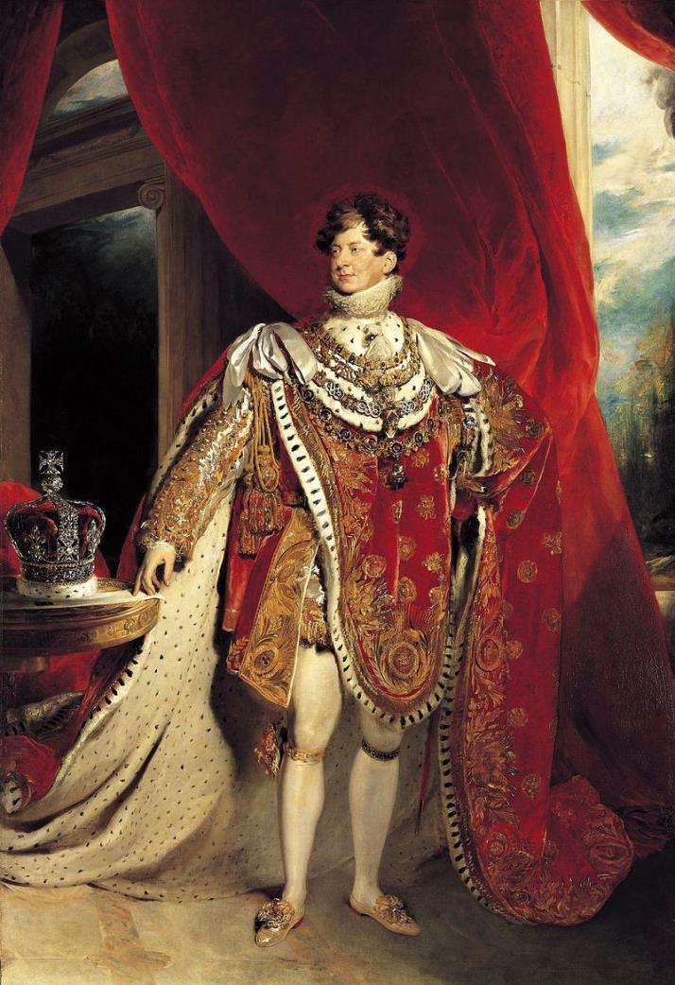
1
Image: Royal Collection Trust / © Her Majesty Queen Elizabeth II https://www.rct.uk/collection/405918/george-iv-1762-1830

Slide 10
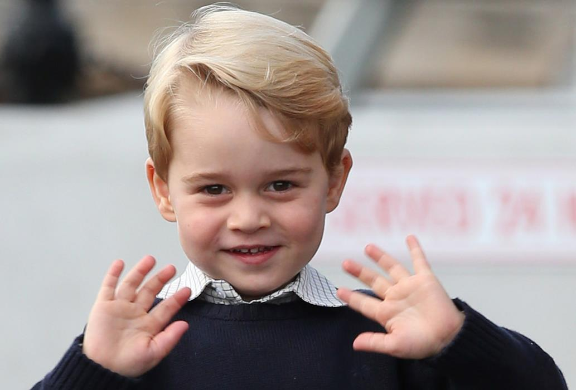
1
The Royal Household © Crown Copyright https://www.royal.uk/prince-george

Slide 11
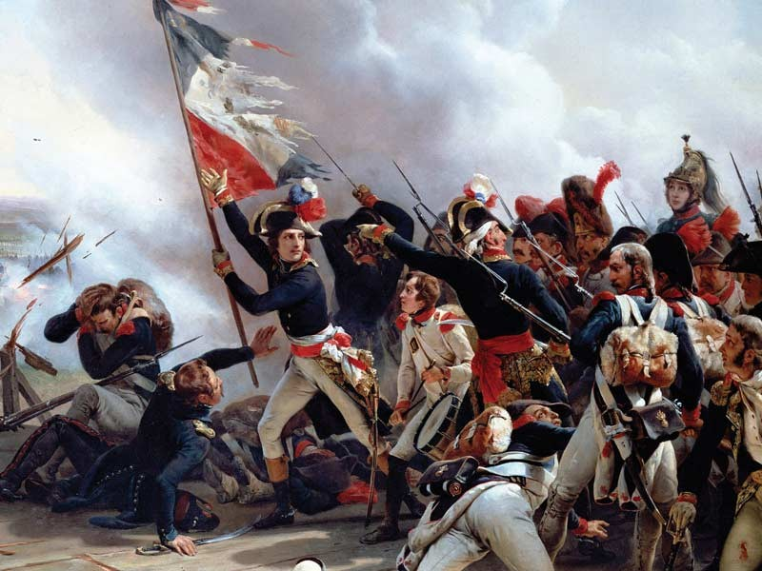
2
https://commons.wikimedia.org/wiki/File:La_Bataille_du_Pont_d%27Arcole.jpg

Slide 12
2
http://freestock.ca/flags_maps_g80-france_grunge_flag_p1023.html

Slide 13
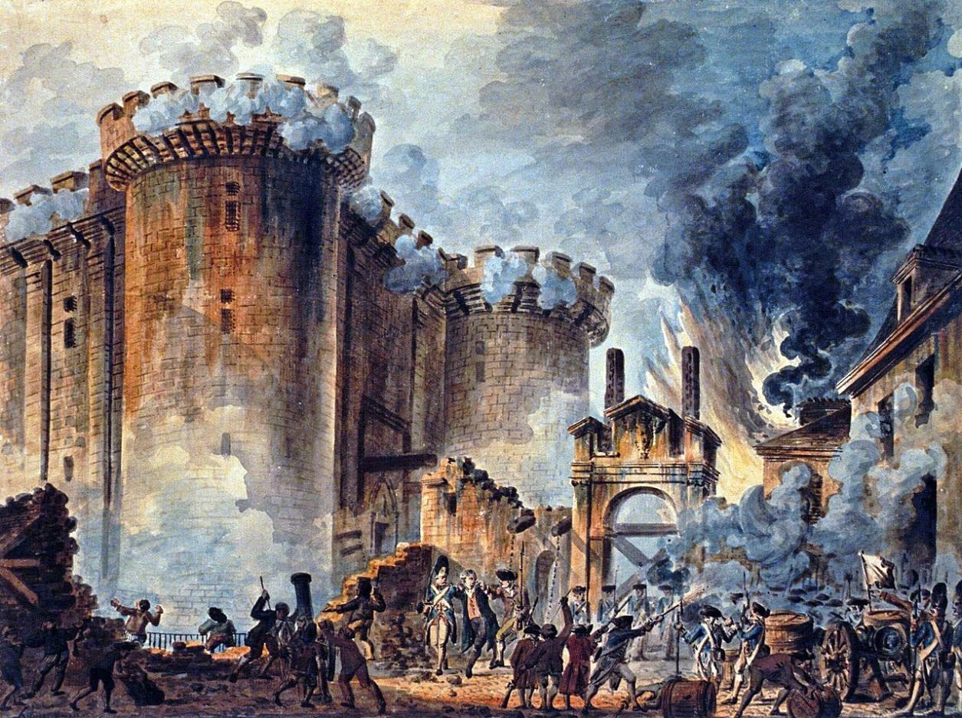
2
Image: Bibliothèque nationale de France https://commons.wikimedia.org/wiki/File:Prise_de_la_Bastille.jpg

Slide 14
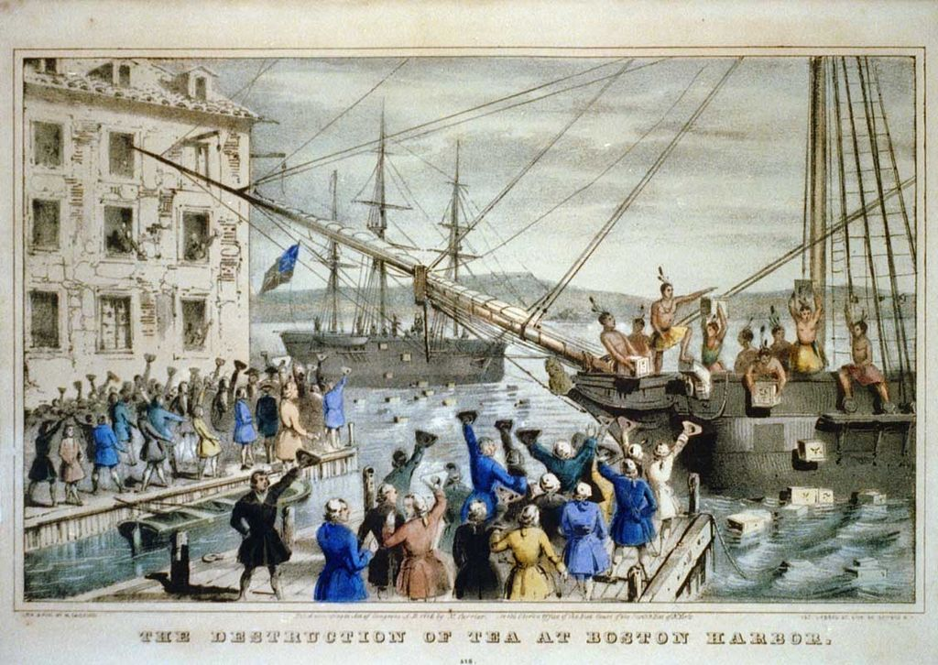
2
Image courtesy of the Springfield Museums https://springfieldmuseums.org/collections/item/the-destruction-of-tea-at-boston-harbor-nathaniel-currier/

Slide 15
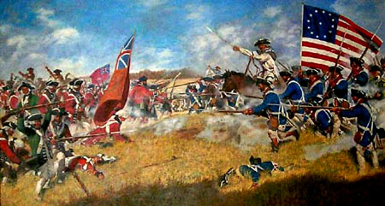
2
http://purehistory.org/battle-of-cowpens/

Slide 16
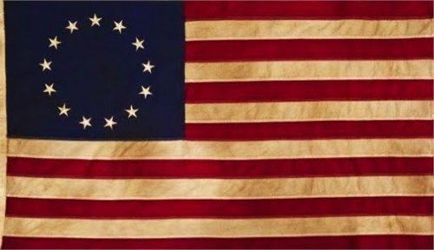
2
http://iassar.org/2016/12/30/patriot-bios/13_colonies_american_flag/

Slide 17
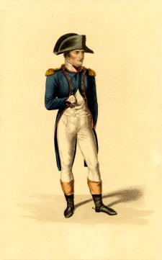
3
© Trustees of the British Museum https://www.britishmuseum.org/research/collection_online/collection_object_details.aspx?assetId=1165306001&objectId=3445381&partId=1

Slide 18
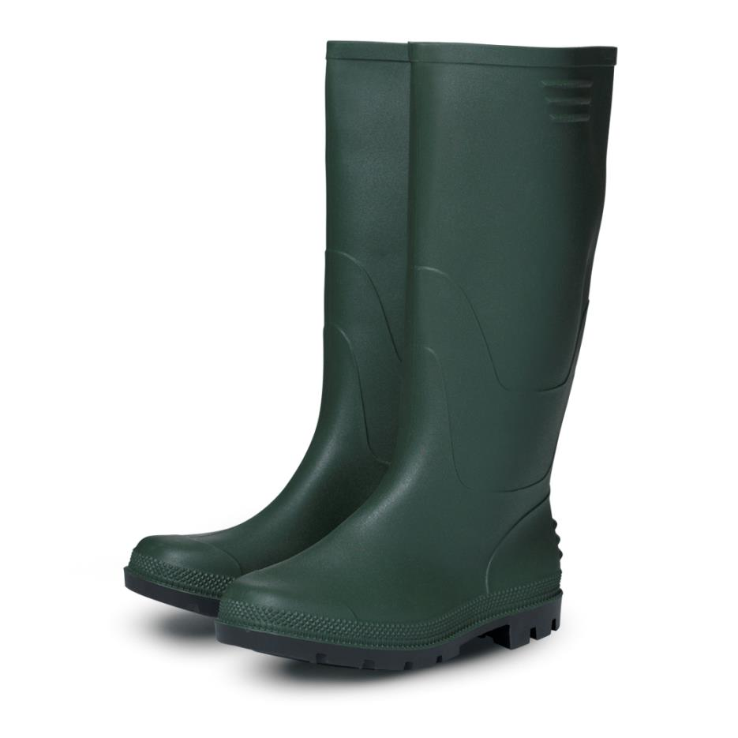
3

Slide 19
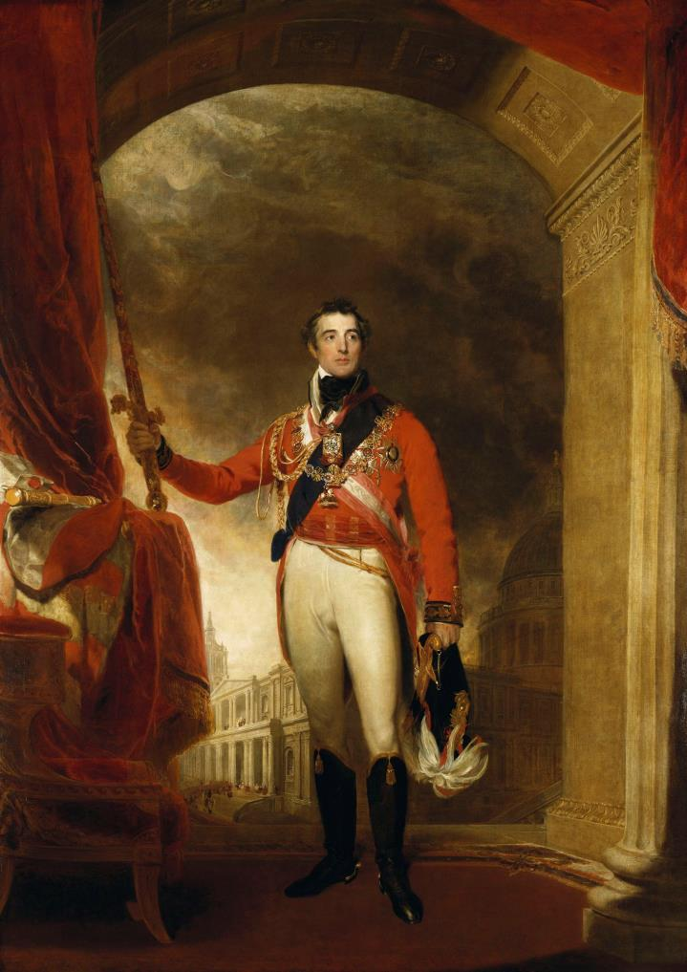
3
Image: Royal Collection Trust / © Her Majesty Queen Elizabeth II https://www.rct.uk/collection/405147/arthur-wellesley-1st-duke-of-wellington-1769-1852

Slide 20
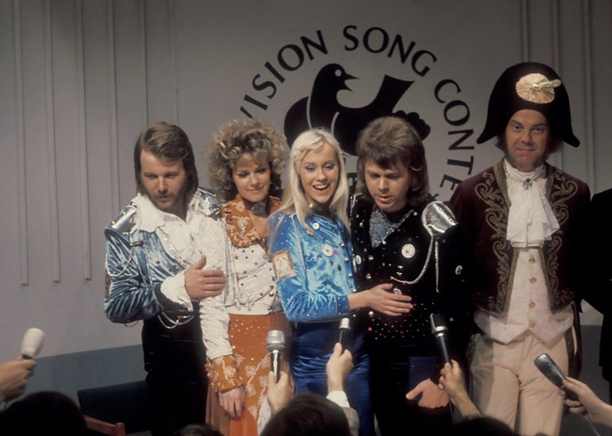
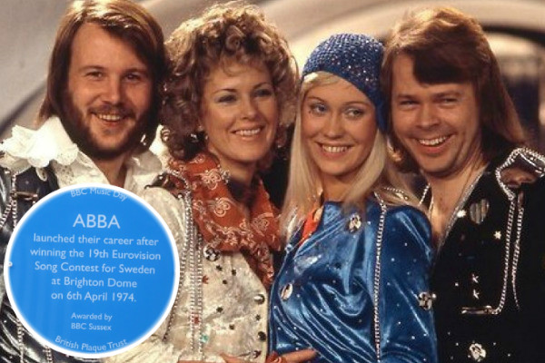
3
https://medium.com/the-eurovision-song-contest/eurovision-2017-theyre-not-going-to-be-abba-but-that-s-ok-3368a65ddf06
https://wiwibloggs.com/2017/06/26/abba-honoured-blue-plaque-brighton-dome-mark-eurovision-1974-victory/

Slide 21
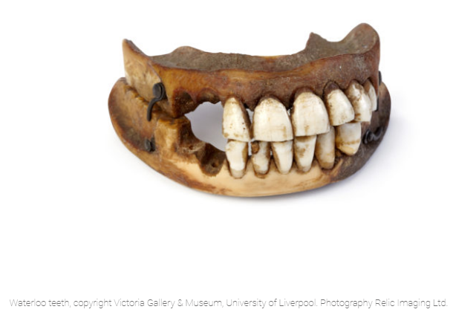
3
https://ageofrevolution.org/200-object/waterloo-teeth-1815-2/

Slide 22
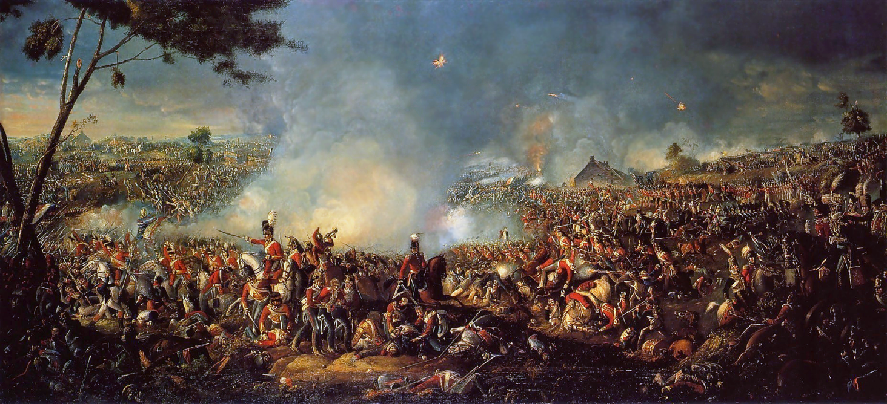
3
https://en.wikipedia.org/wiki/Battle_of_Waterloo#/media/File:Battle_of_Waterloo_1815.PNG

Slide 23
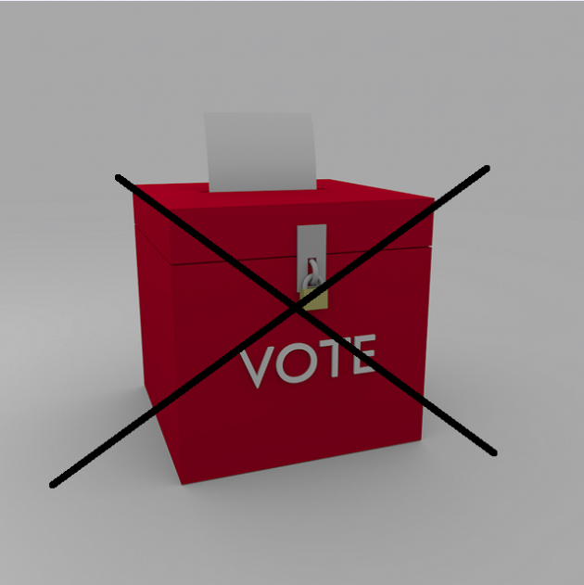
4
https://www.libdemvoice.org/ashcroft-battlegrounds-poll-both-tories-and-lib-dems-down-on-2010-but-its-the-tories-whod-make-gains-40989.html/ballot-box-2

Slide 24
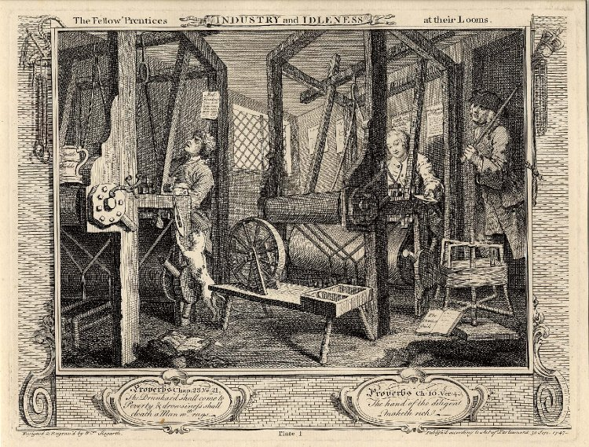
4
© Trustees of the British Museum https://www.britishmuseum.org/research/collection_online/collection_object_details.aspx?objectId=1434641&partId=1&people=122438&peoA=122438-3-18&view=list&page=1

Slide 25
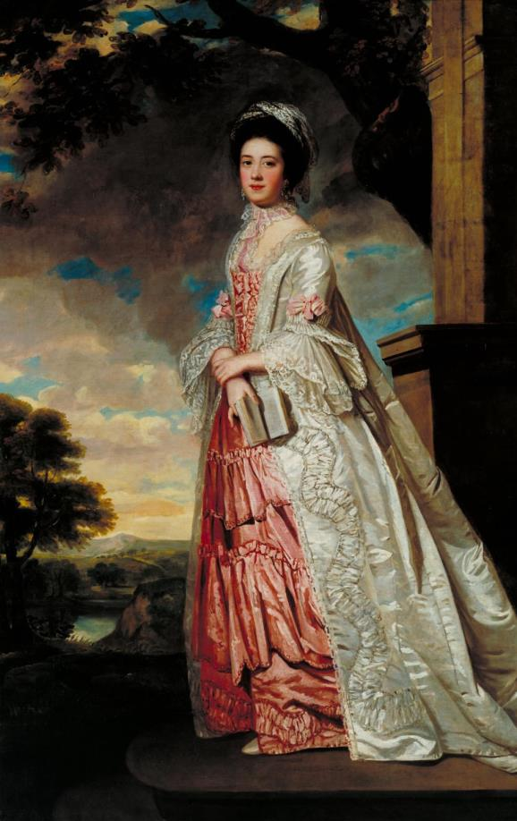
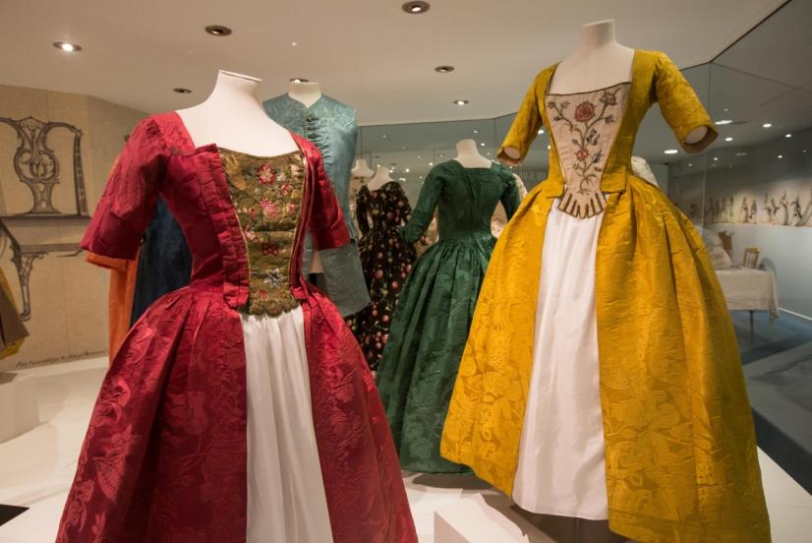
4
https://www.fashionmuseum.co.uk/georgians
https://www.tate.org.uk/art/artworks/unknown-artist-britain-mrs-cadoux-n03728

Slide 26
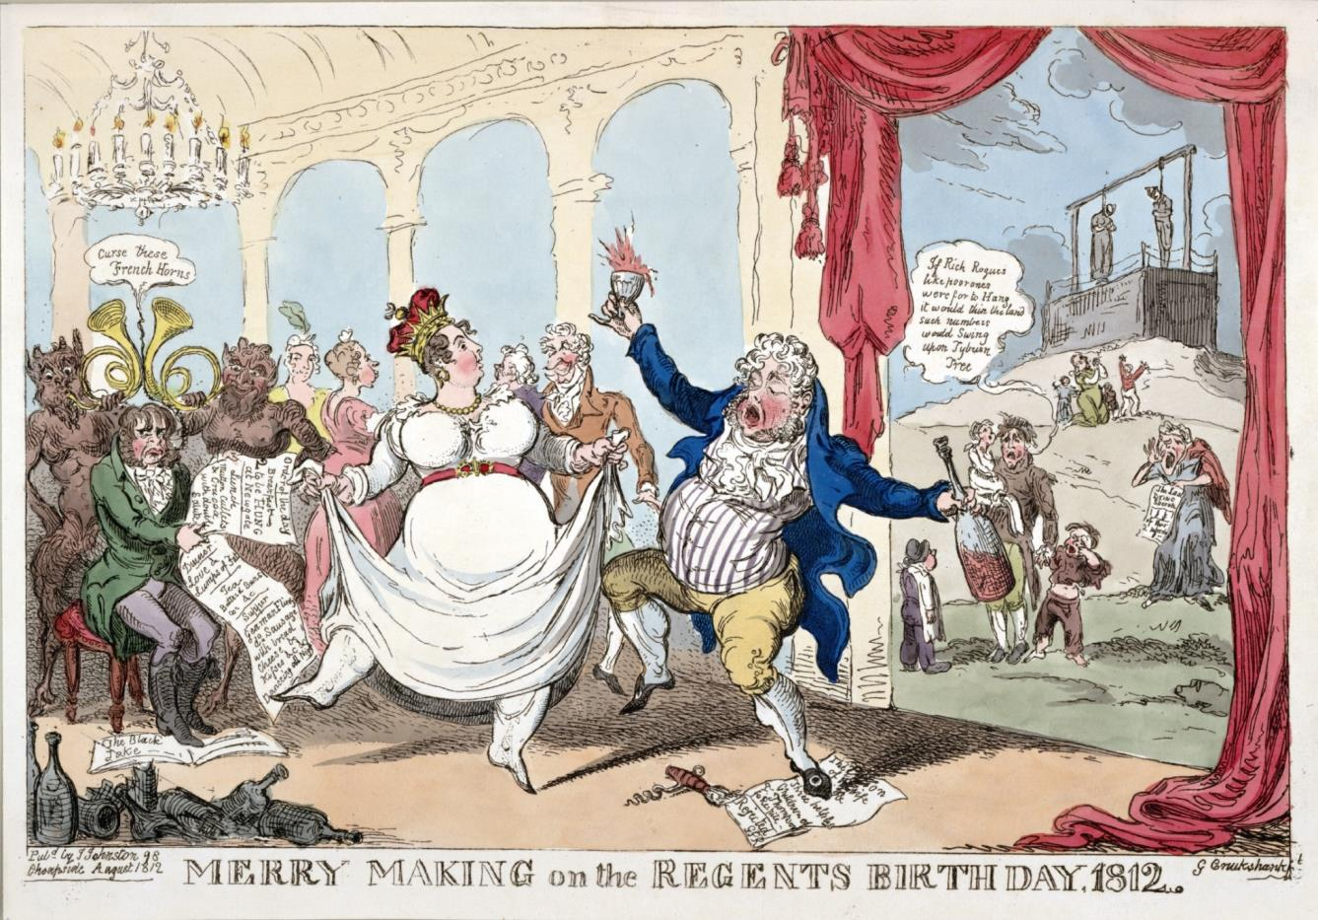
4
https://www.loc.gov/item/2003689159/

Slide 27
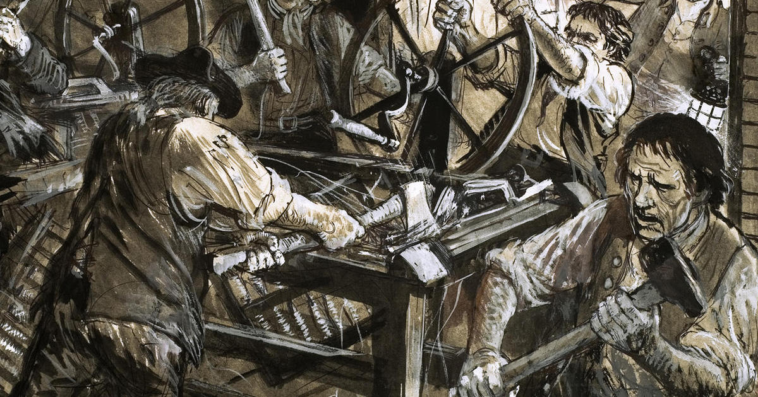
4
https://pocketmags.com/ca/history-revealed-magazine/december-2017/articles/255991/in-a-nutshell

Slide 28
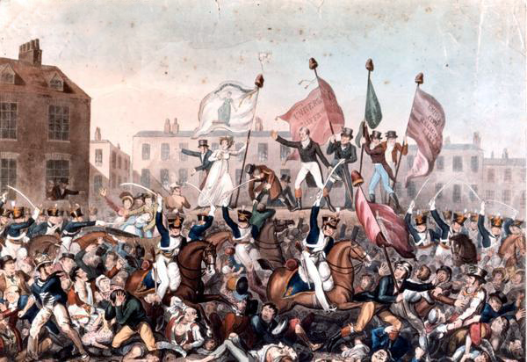
4
Courtesy of Manchester Libraries, Information and Archives https://commons.wikimedia.org/wiki/File:Peterloo_Massacre.png

Slide 29
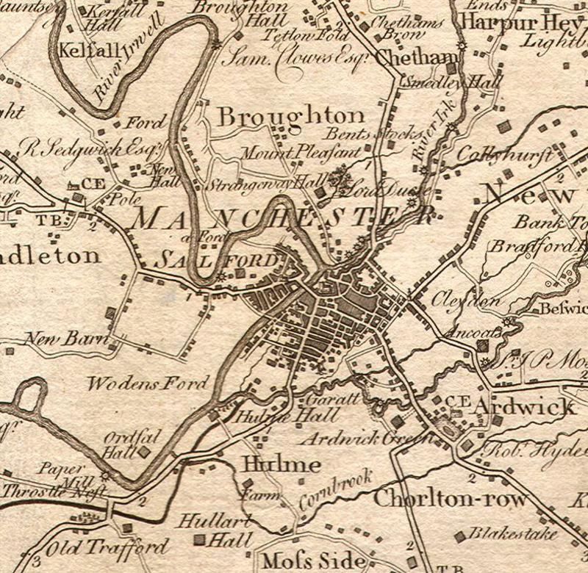
4
https://www.manlitphil.ac.uk/events/early-maps-real-lancashire-and-their-makers

Slide 30
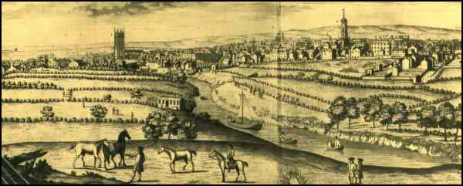
4
http://spartacus-educational.com/ITmanchester.htm

Slide 31
4
https://nickypenttila.com/getting-the-details-right-peterloo/#.W2SNEmaWwvM

Slide 32
Congratulations!
You have passed the test and BECOME FULLY FLEDGED HISTORY DETECTIVES!
Let’s find out more about this fascinating period of history…

