Slide 1
Lesson 1

Slide 2
To do: Turn your sheet over and draw what is described, but don’t share it with anyone… they may copy your amazing artwork!
History hint! You can draw one big picture or lots of little ones – be creative and use your imagination.
Challenge: What have you learnt from the description? Can you tell what our lesson is about?
Notes:
Roughly half of the class should have Interpretation One, and the other half, Interpretation Two.

Slide 3
Review!
What did you draw?
What is it supposed to be about?
Is everyone’s drawing the same?
Why do you think this is?

Slide 4
How far do the two views that we have looked at represent the events of 1798?
Objectives:
Identify two different views of 1798.
Explain the events leading to and during the 1798 Rebellion.
Judge how far the two views represent the events they describe.

Slide 5
To do: You are going to read a story as a class.
The person who has the card with ‘start →’ on it will go first.
You know it is your turn when someone reads the bit in red on the left-hand side of your domino!
History hint! Some members of the class have been given the full story; it is their job to put you back on track if someone gets lost.
Notes:
You will need to cut out the dominoes and hand them out to individual students. Those who don’t have one can have the full copy of the story.

Slide 6
To do: You now need to use your domino card to answer as many questions on your sheet as you can. Once you have written the answer down, sign your name in the box.
History hint! Some dominoes will answer one question, others may answer two and some may answer none, so look carefully!

Slide 7
To do: Now you must go around the room and ask your fellow classmates to help you answer the rest of the questions. Every time they give you an answer, get them to sign their name.
History hint! First to have all the correct answers wins!
Challenge: Write a 50-word summary of the Irish Rebellion using the facts that you have found out.

Slide 8
How did you do?
Certain religious groups and the poor were not treated fairly
Protestants
Poor people
Vote or become an MP
London (Britain)
French Revolution
Liberty, equality and brotherhood
United Irishmen
Theobald Wolfe Tone, Thomas Russell, Henry Joy McCracken and William Drennan
Reform of the Irish parliament and link Catholics and Protestants
Wolfe Tone
Bad weather
Used spies and informers

Slide 9
How did you do?
14. Leaders of the United Irishmen in prison
15. Mail coaches leaving Dublin were seized
16. The government
17. Wexford
18. The government’s campaign of terror
19. Father Murphy of Boolavogue
20. The fall of Wexford and Vinegar Hill
21. Rebels defeated by General Lake and 20,000 men
22. Loyalists
23. Rebels were captured and murdered (Father Murphy)
24. 8 September, 600 soldiers and 25,000 rebels killed

Slide 10
Review: Now you have a better idea of the events surrounding the 1798 Irish Rebellion, look at the two original viewpoints again…
Highlight facts in one colour.
Highlight opinion in another colour.
Highlight disagreements in another colour.
Big question: How far do the two views that we have looked at represent the events of 1798?

Slide 11
How far do the two views that we have looked at represent the events of 1798?
Objectives:
Identify two different views of 1798.
Explain the events leading to and during the 1798 Rebellion.
Judge how far the two views represent the events they describe.

Slide 12
Lesson 2

Slide 13
Recap: Give me five!
Who? The United Irishmen
What? Rebellion
When? 23rd May - 8th September 1798
Where? Ireland
Why? To win reform of the Irish Parliament and later, independence

Slide 14
To what extent were events in Ireland influenced by events abroad?
Objectives:
Recap basic details of 1798.
Analyse the impact of other revolutions on Ireland.
Judge to what extent events in Ireland were influenced by events abroad.

Slide 15
To do: In pairs, use the information you have been given about the country you are representing to answer the questions on your sheet.
History hint! Make sure you look at the information carefully and use the questions to guide you – you will be the experts in the next task.
Challenge: In 100 words or less, sum up the importance of events in your country on the Rebellion in Ireland.

Slide 16
Review: Find a pair that has covered a different country and ask them the questions on your sheet.
History hint! You have to talk to them; you can’t just copy their work because the questions are different – they have to use what they have learnt to help you answer them.
Challenge: Now you have heard about another country, do you think your country is more or less important? Explain fully.

Slide 17
Big question: To what extent were events in Ireland influenced by events abroad?
One way in which the events in Ireland were influenced by events abroad is…
Another example of Ireland being influenced is…
History hint! Fully explain your points, giving evidence to support them.
Challenge: Which of our views from last lesson would this evidence support and why?

Slide 18
To what extent were events in Ireland influenced by events abroad?
Objectives:
Recap basic details of 1798.
Analyse the impact of other revolutions on Ireland.
Judge to what extent events in Ireland were influenced by events abroad.

Slide 19
Lesson 3

Slide 20
What is in a picture?
In pairs…
Person A will have an image that they need to describe to their partner.
Person B will have to draw what they hear!

Slide 21
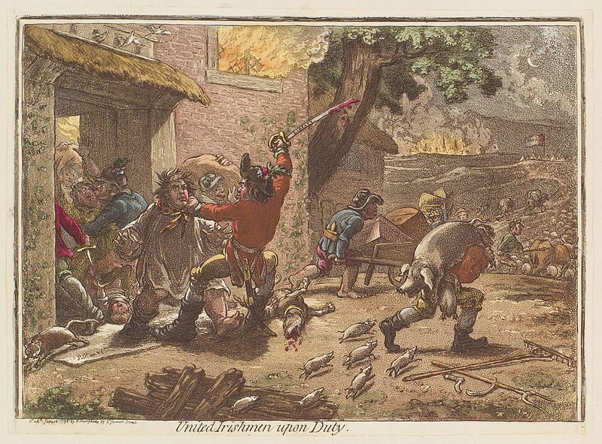
https://commons.wikimedia.org/wiki/File:United_Irishmen_upon_duty_by_James_Gillray.jpg?uselang=en-gb [Accessed 1/8/18]
What did you come up with?
Did you miss anything ‘important’?
What does it show about the events of 1798?
Who do you think created it and why?

Slide 22
What can cartoons tell us about the events of 1798?
Objectives:
Describe what the sources show.
Analyse their nature, purpose and origin.
Evaluate what they show about the original interpretations.

Slide 23
To do: Complete your inference grid on the new cartoon, thinking about the prompts on your sheet.
History hint! Start with what you can see first, and work your way out.
Challenge: How do the two cartoons compare? (Think about what they show and their overall message.)

Slide 24
Review: Read through each piece of information in the table and decide whether it makes the view given by the cartoons more or less reliable.
History hint! Some pieces of information could do both. Start from the top and work your way down; it gets harder as you go on!
Challenge: What would a historian need to look at next to get a better view of the events of 1798?

Slide 25
Big question: To what extent are the cartoons we have looked at a useful representation of the events of 1798?
One way in which the cartoons are useful is…
However, the cartoons…
History hint! Fully explain your points, giving evidence to support them. Remember, all sources are useful.
Challenge: Which of our views from the first lesson would this evidence support and why?

Slide 26
What can cartoons tell us about the events of 1798?
Objectives:
Describe what the sources show.
Analyse their nature, purpose and origin.
Evaluate what they show about the original interpretations.

Slide 27
Lesson 4

Slide 28
What can songs tell us about the events of 1798?
Objectives:
Describe what the sources show.
Analyse their nature, purpose and origin.
Evaluate what they show about the original interpretations.

Slide 29
To Do: What is in a song?
Read through your lyrics as you listen.
Now read through them again and try to answer the questions on your sheet.
https://www.youtube.com/watch?time_continue=213&v=xeSW-bKMuu8
History hint! Look back at the work you did on the events of the Rebellion.
Challenge: Why might someone write this 44 years after the Rebellion?

Slide 30
What did you come up with?
Review: Let’s go through the questions and see what ideas you came up with.
What does it show about the events of 1798?
Who do you think created it and why?

Slide 31
To Do: What is in a song?
Read through your lyrics as you listen.
Now read through them again and try and answer the questions on your sheet.
https://www.youtube.com/watch?time_continue=7&v=ATucV4Ugqsw
History hint! Look back at the work you did on the events of the rebellion.
Challenge: Why might someone write this 100 years after the rebellion?
Notes:
Stop at 5.05

Slide 32
What did you come up with?
Review: Let’s go through the questions and see what ideas you came up with.
What does it show about the events of 1798?
Who do you think created it and why?

Slide 33
To do: Read through each piece of information in the table and decide whether it would weaken or strengthen the view or message given by the songs.
History hint! Some pieces of information could do both or neither. Start from the top and work your way down; it gets harder as you go on!
Challenge: What would a historian need to look at next to get a better view of the events of 1798?

Slide 34
Big question: To what extent are the songs we have looked at a useful representation of the events of 1798?
One way in which the songs are useful is…
However, the songs…
History hint! Fully explain your points, giving evidence to support them.
Challenge: Which of the interpretations from the first lesson would this evidence support and why?

Slide 35
What can songs tell us about the events of 1798?
Objectives:
Describe what the sources show.
Analyse their nature, purpose and origin.
Evaluate what they show about the original interpretations.

Slide 36
Lesson 5

Slide 37
Who was Wolfe Tone?
'To break the connection with England, the never failing source of all our political evils, and to assert the independence of my country – these were my objects. To unite the whole people of Ireland, and to substitute the common name of Irishman, in the place of the denominations of Protestant, Catholic, and Dissenter – these were my means.’
Wolfe Tone, September 1791
What were his views leading to 1798?
Why might Tone be a controversial figure?

Slide 38
What can attitudes towards Wolfe Tone tell us about the history of 1798?
Objectives:
Analyse the aims of Wolfe Tone.
Evaluate his life and attitudes towards him.
Judge what attitudes towards Tone can tell us about the history of 1798.

Slide 39
To do: On your sheet, you have different interpretations of Tone and the events of 1798.
Answer the questions in the thought bubbles.
Read through the information and colour-code it according to which interpretation it supports.
History hint: Not all of the information should be highlighted; you need to select specific points.
Challenge: If Tone’s aims were clear, why is he such a contested figure?

Slide 40
Review: Hang each interpretation about Tone on the washing line according to how accurate you think they are, and be prepared to explain your judgement.
History hint! Use some of the evidence you have just looked at to help support your judgement.
Challenge: How else could the interpretations be sorted? Is this a useful way of doing it?

Slide 41
Big question: What can the attitudes towards Wolfe Tone tell us about the history of 1798?
Think! Pair! Share!
History hint! Think about how history is made and the work we have done on interpretations. Is it a simple case of finding the evidence and writing it up?
Challenge: Which of our views from the first lesson would this evidence support and why?

Slide 42
What can attitudes towards Wolfe Tone tell us about the history of 1798?
Objectives:
Analyse the aims of Wolfe Tone.
Evaluate his life and attitudes towards him.
Judge what attitudes towards Tone can tell us about the history of 1798.

Slide 43
Lesson 6

Slide 44
How convincing are the two interpretations in relation to the events of 1798?
Objectives:
Recap the interpretations studied.
Analyse evidence to support or challenge the interpretations.
Judge how convincing the interpretations are.

Slide 45
Review: Look at the following interpretations again – what are they arguing about the Rebellion?
History hint! You have looked at the interpretations before, so you are just looking for key points to recap.

Slide 46
Interpretation One: Catholics in Ireland were treated badly; they couldn’t vote or become a Member of Parliament and they had very few rights so they were not very happy. They heard about the French Revolution and thought they could do the same in Ireland to try to get a better deal. A group known as the United Irishmen was set up to try to include everyone in the protest, and they decided to rebel in 1798. Thanks to heroic leaders like Father Murphy of Boolavogue, the rebels had some successes; however, they were surrounded at Vinegar Hill and slaughtered. Ultimately, the rebellion failed.

Slide 47
Interpretation Two: Protestants in Ireland were the most powerful group and they, along with the British government, were in control of Ireland to make sure that it was run properly. They were happy with how things were and didn’t want change. France had a revolution and influenced some Catholic rebels in Ireland to rise up against the government. They resented not being as powerful as the Protestants and were trying to cause trouble. Ireland wasn’t united in the Rebellion; it was just a Catholic plot against Protestants. This was shown when they massacred Protestants by stabbing them to death with their pikes on Wexford Bridge. They were Catholic savages without any real aims, and they failed.

Slide 48
To Do: In pairs, use your table to recap some of the evidence you have looked at in your lessons on the Irish Rebellion.
History hint! You need key points, and not everything you know about each piece of evidence. Do they support or challenge each interpretation?
Challenge: What other sources may have been useful for studying the Irish Rebellion?

Slide 49
Review: Class discussion!
Interpretation One: ‘Poorly treated Catholics in Ireland rebelled; their heroic leaders, inspired by the French Revolution; had some successes but ultimately failed to win freedom.’
You must decide whether to…
A – Agree with the interpretation and give evidence to support.
B – Build on the interpretation by giving extra detail.
C – Challenge the interpreatation and give evidence to contradict it.
You then need to pick someone else to continue the debate.
History hint! Use your tables from the previous task to help.

Slide 50
Review: Class discussion!
Interpretation Two: ‘Catholics rebelled, as they resented British rule and the power of the Protestants. It wasn’t a united rebellion; the Catholics were savages without any real aims.’
You must decide whether to…
A – Agree with the interpretation and give evidence to support.
B – Build on the interpretation by giving extra detail.
C – Challenge the interpretation and give evidence to contradict it.
You then need to pick someone else to continue the debate.
History hint! Use your tables from the previous task to help.

Slide 51
Assessment question: How convincing are the two interpretations in relation to the events of 1798?
History hint! You are supporting or challenging the interpretations based on the knowledge you gained from the sources.

Slide 52
How convincing are the two interpretations in relation to the events of 1798?
Objectives:
Recap the interpretations studied.
Analyse evidence to support or challenge the interpretations.
Judge how convincing the interpretations are.

