Slide 1
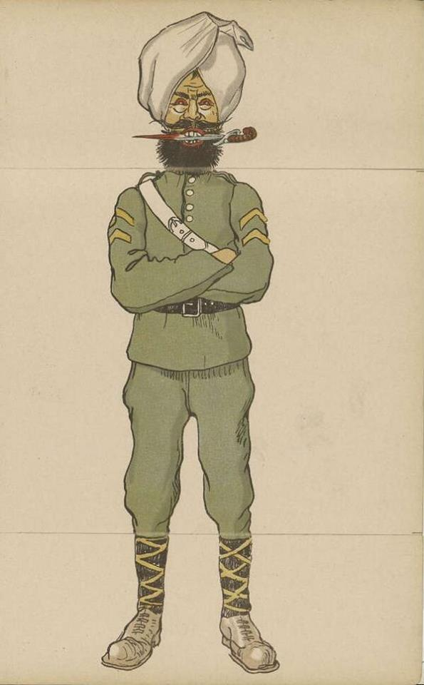
LIONS OF THE GREAT WAR LESSON 4: RESOURCE M
Notes:
Slide 1
A blood thirsty depiction of a Sikh soldier from a German children's picture book of 1914 entitled “Our Enemies”.
Courtesy of Robin Schäfer, Military Historian, Dinslaken, Germany

Slide 2
How did German propaganda want Sikh (and other Indian) soldiers to be seen?
LIONS OF THE GREAT WAR LESSON 4: RESOURCE M
Magnificent
Mysterious
Cruel
Savage
Weak
Powerful
Equal to white Europeans
Handsome
Loyal
Bloodthirsty
Superior to white Europeans
Disciplined
Frightening
Strong
Fierce
Inferior to white Europeans
Aggressive
Brave
Healthy
Barbaric

Slide 3
LIONS OF THE GREAT WAR LESSON 4: RESOURCE M
Notes:
Slide 3
A German propaganda image printed in 1915 entitled “Destruction of an Indian Brigade west of Aubers”.
Courtesy of Peter Bance Collection

Slide 4
LIONS OF THE GREAT WAR LESSON 4: RESOURCE M
Notes:
Slide 4
A German postcard from early on in the war with an image of a German soldier holding a captured Indian soldier. The phrase “Der Gefangene Inder” translates as “The Captured Indian”.
By kind permission of Timothy Moore

Slide 5
What did Germans fear about Sikhs?
LIONS OF THE GREAT WAR LESSON 4: RESOURCE M
“Brown fellows wearing tall turbans. We were all sure that things would become even more dangerous from now on as they would probably sneak over to us at night time to murder our pickets (sentries) using their long knives.”
German infantry officer

Slide 6
LIONS OF THE GREAT WAR LESSON 4: RESOURCE M
Notes:
Slide 6
The commandant of the prison camp at Wunsdorf speaks with a group of British Indian prisoners (including Sikhs) in the prison compound.
UKPHA Archive

Slide 7
IMAGE CREDITS
LIONS OF THE GREAT WAR LESSON 4: RESOURCE M
Slide 1 A blood thirsty depiction of a Sikh soldier from a German children's picture book of 1914 entitled “Our Enemies”. Courtesy of Robin Schäfer, Military Historian, Dinslaken, Germany.
Slide 3 A German propaganda image printed in 1915 entitled “Destruction of an Indian Brigade west of Aubers”. Courtesy of Peter Bance Collection.
Slide 4 A German postcard from early on in the war with an image of a German soldier holding a captured Indian soldier. By kind permission of Timothy Moore.
Slide 6 The commandant of the prison camp at Wunsdorf speaks with a group of British Indian prisoners (including Sikhs) in the prison compound. UKPHA Archive.

