Slide 1
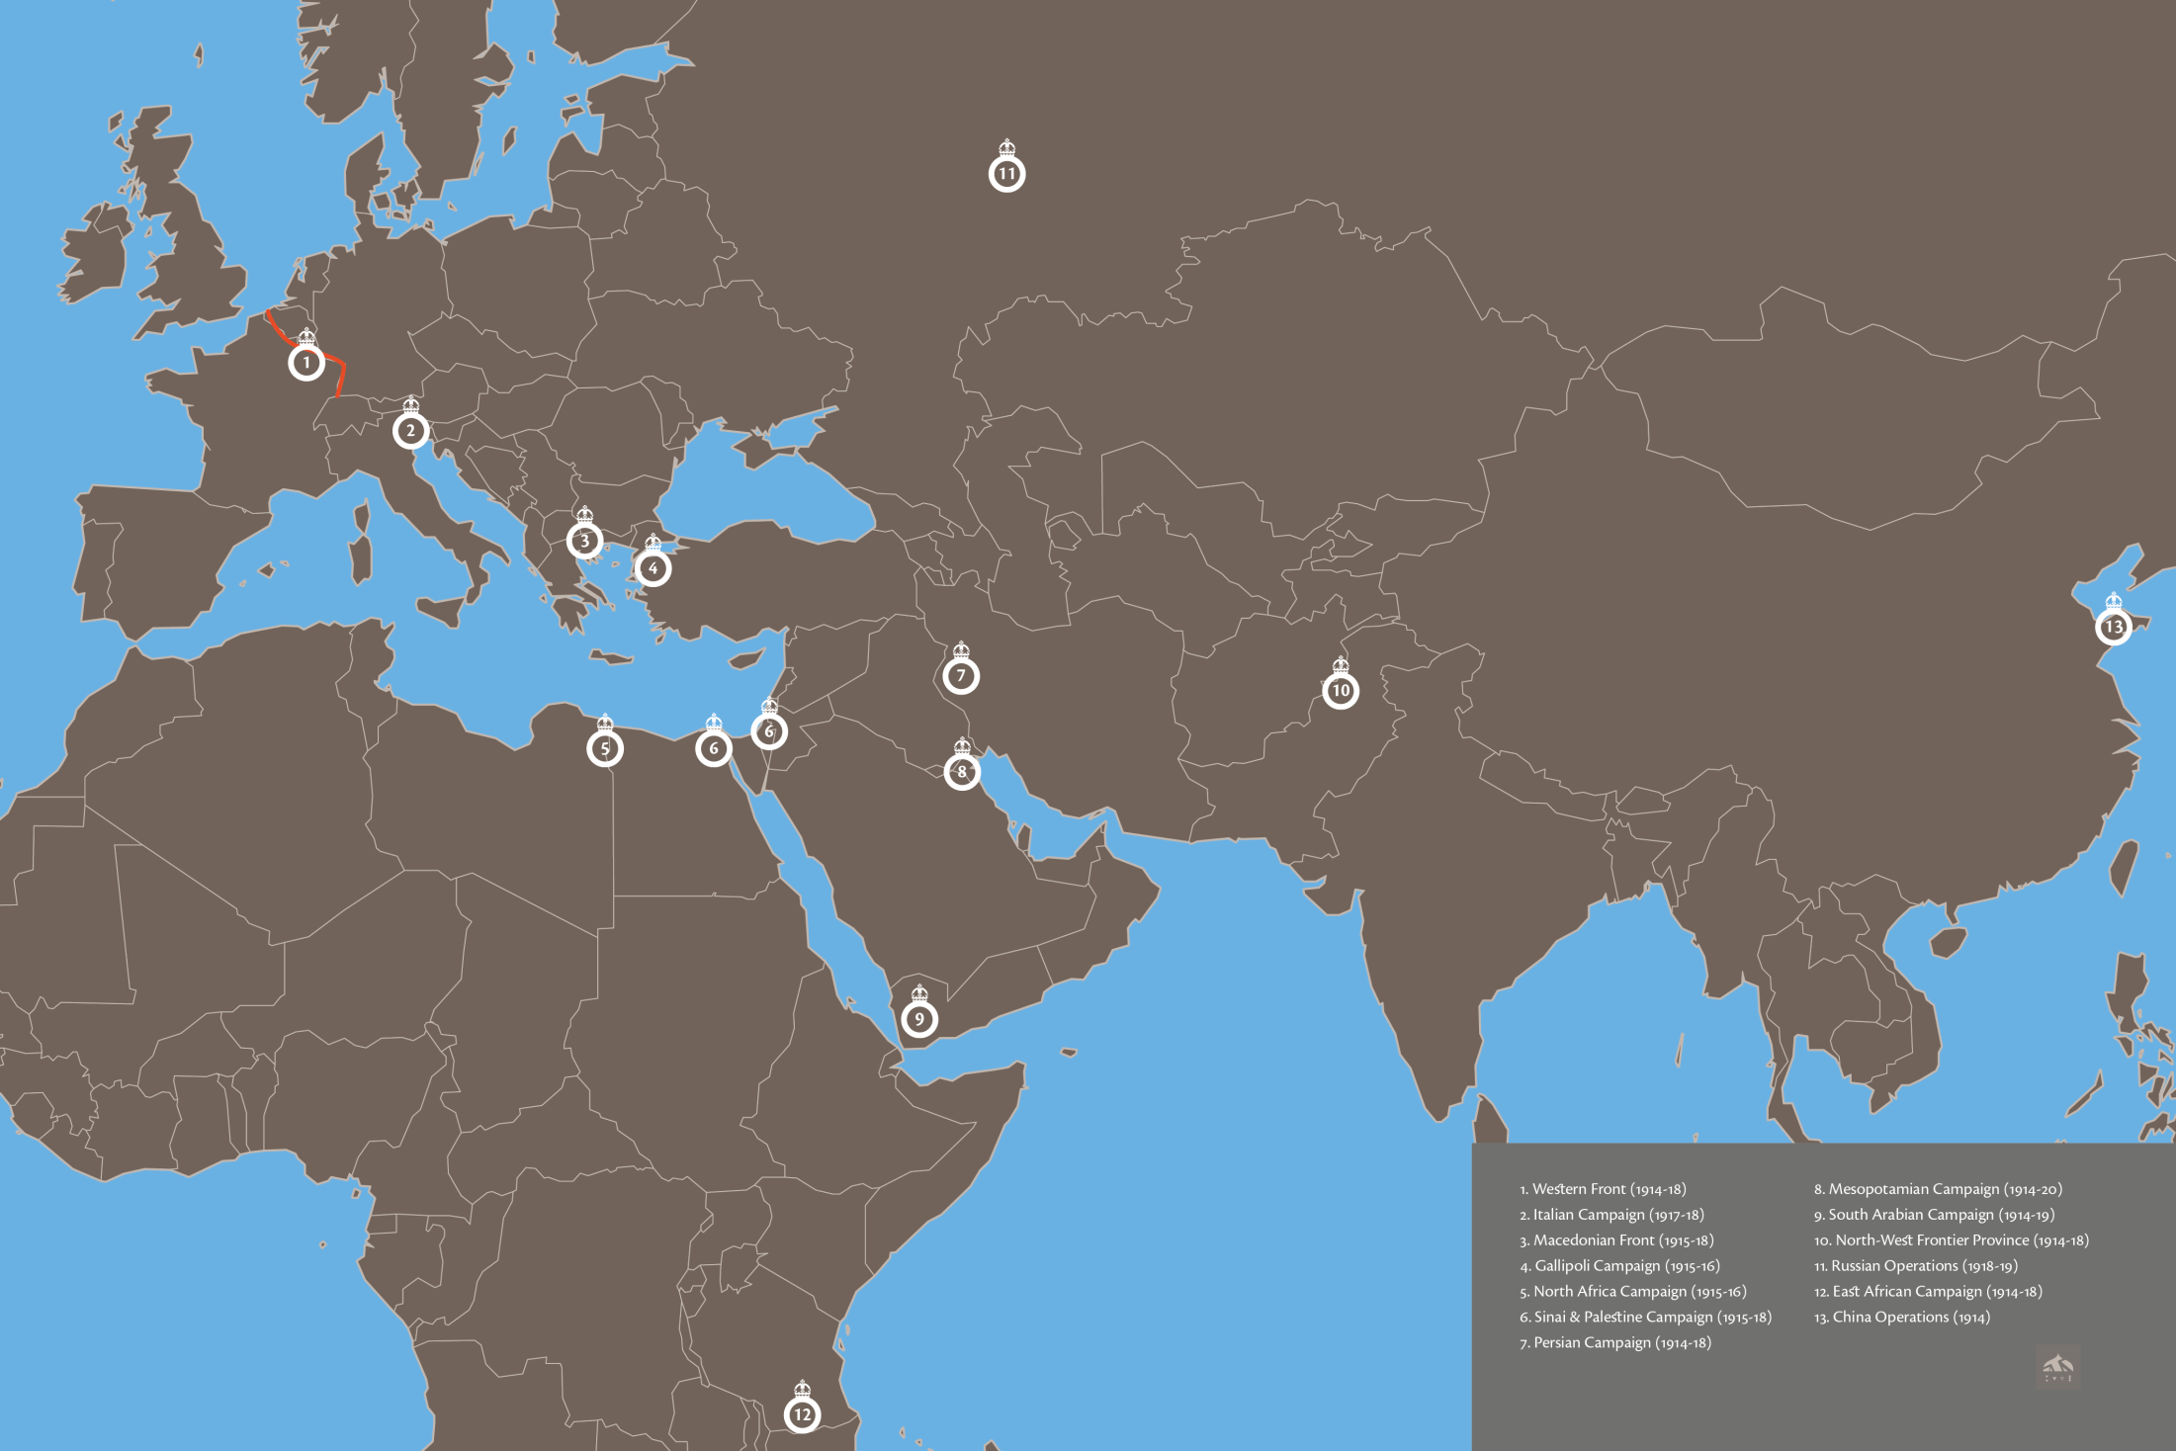
LIONS OF THE GREAT WAR LESSONS 2&3: RESOURCE I
Notes:
Slide 1
The worldwide locations where Sikh (and other Indian) soldiers fought on behalf of the British Empire between 1914 and 1920. These locations represent the campaign theatres of the First World War.
Designed by Jugasingh.com/Grfik.com

Slide 2
LIONS OF THE GREAT WAR LESSONS 2&3: RESOURCE I
Notes:
Slide 2
A celebratory Japanese propaganda print of the role of Indian soldiers fighting in World War One captioned ‘The Brave Indian Troops Great Victory German Army Great Reverse at Rower’.
Anne S.K. Brown Military Collection, Brown University Library

Slide 3
LIONS OF THE GREAT WAR LESSONS 2&3: RESOURCE I
Notes:
Slide 3
A French woman pins flowers onto the tunic of a soldier marching through Paris on Bastille Day, 14 July 1916.
Toor Collection

Slide 4
How did British propaganda want Sikh (and other Indian) soldiers to be seen?
LIONS OF THE GREAT WAR LESSONS 2&3: RESOURCE I
Magnificent
Mysterious
Cruel
Savage
Weak
Powerful
Equal to white Europeans
Handsome
Loyal
Bloodthirsty
Superior to white Europeans
Disciplined
Frightening
Strong
Fierce
Inferior to white Europeans
Aggressive
Brave
Healthy
Barbaric
Notes:
Slide 4

Slide 5
LIONS OF THE GREAT WAR LESSONS 2&3: RESOURCE I
Notes:
Slide 5
A typical Sikh naik (corporal) of the 14th Ferozepore Sikhs, c. 1910.
Courtesy of the Council of the National Army Museum, London (acc. no. 1994-05-50-716)

Slide 6
IMAGE CREDITS
LIONS OF THE GREAT WAR LESSONS 2&3: RESOURCE I
Slide 1 The worldwide locations where Sikh (and other Indian) soldiers fought on behalf of the British Empire between 1914 and 1920. Designed by Jugasingh.com/Grfik.com.
Slide 2 A celebratory Japanese propaganda print of the role of Indian soldiers fighting in World War One. Anne S.K. Brown Military Collection, Brown University Library.
Slide 3 A French woman pins flowers onto the tunic of a soldier marching through Paris on Bastille Day, 14 July 1916. Toor Collection.
Slide 5 A typical Sikh naik (corporal) of the 14th Ferozepore Sikhs, c. 1910. Courtesy of the Council of the National Army Museum, London (acc. no. 1994-05-50-716).

