Slide 1
The story of the Museum Project

Slide 2
Around two years ago, a pupil and a teacher came to me in the same week to show me two items their family owned. A helmet warn by a pupils’ Hungarian Grandfather as he fought his own people as a Soviet tank driver during the uprising of 1956, and a box of letters sent during World War One.
These humble, yet fascinating, items got me thinking....

Slide 3
What would happen if we brought together all the historical items that our pupils, their parents, our staff and friends owned? Surely this would create a very powerful connection to our shared past?
The Museum Project was born.

Slide 4
Project Aims:

Slide 5
The primary aim of this project is to raise the profile of History within two school communities. It aims to celebrate the wealth of fascinating history that exists within every family, and to enable the whole school community to learn by accessing that, as well as to connect with students and families, who may not feel very engaged with History, through personal stories.

Slide 6
A core output is to excite students not just about the transferable skills which History offers, which so often dominates dialogue about ‘why History matters’, but rather the inherent value and fascination that comes from doing actual History, and hopefully stimulate them through this to seriously consider continuing History as an academic discipline and potentially as a career. Through delivery of this project, for a period of time, History as a subject will become central to the schools’ day to day activities.

Slide 7
A further output is to allow the pupils and teachers of a local schools to benefit from the resources and expertise of Trinity, thus providing new opportunities for gifted and talented pupils, and other keen historians, as well as forging a partnership which it is intended will develop to incorporate other initiatives and other schools. Around 300 primary and prep school pupils will visit the Museum over the next two and a half weeks, doing workshops which develop their understanding of historical evidence.

Slide 8
Doing History

Slide 9
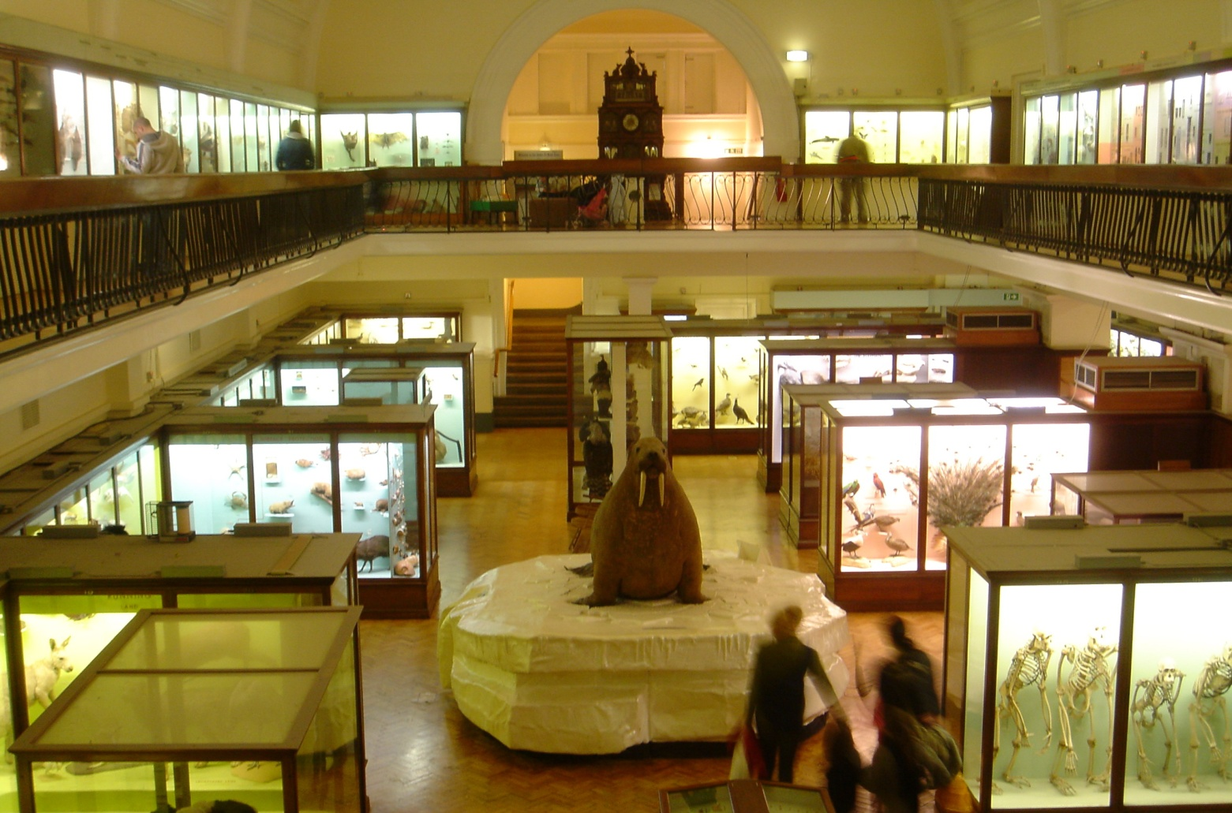
In the Autumn Term we visited the Horniman Museum’s ‘Hands On Base’, where we learnt more about how Curators plan exhibitions and research and connect different objects.
The Horniman’s extensive collection of anthropological items, displayed in multiple different ways, gave us lots of food for thought....

Slide 10
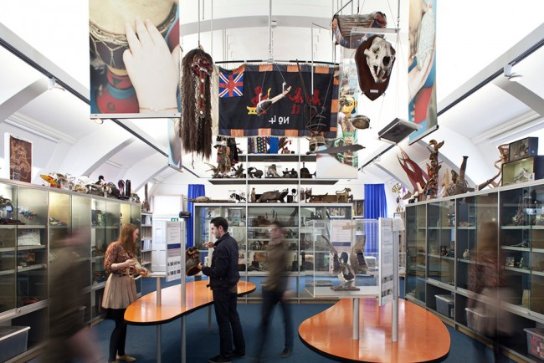
(C) Horniman Museum

Slide 11
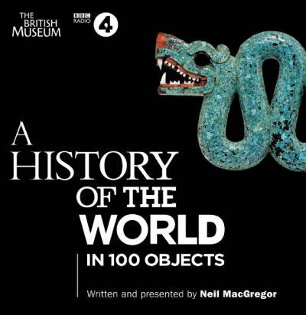
Alongside, we met weekly to learn how to curate and plan a major historical exhibition. We researched lots of London Museums, and developed our questioning and research skills using real artefacts and brilliant web-based resources such as the British Library’s amazing History of the World in 100 Objects website.

Slide 12
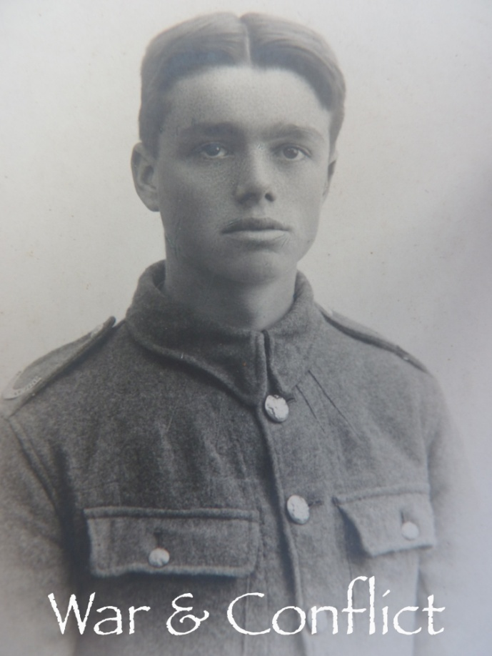
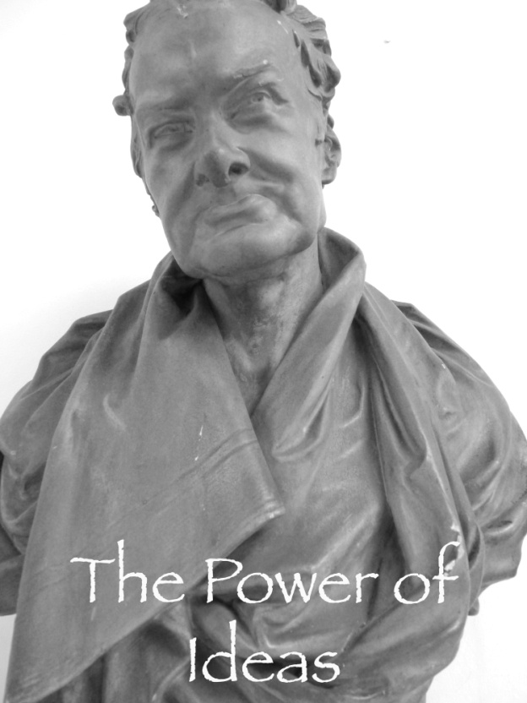
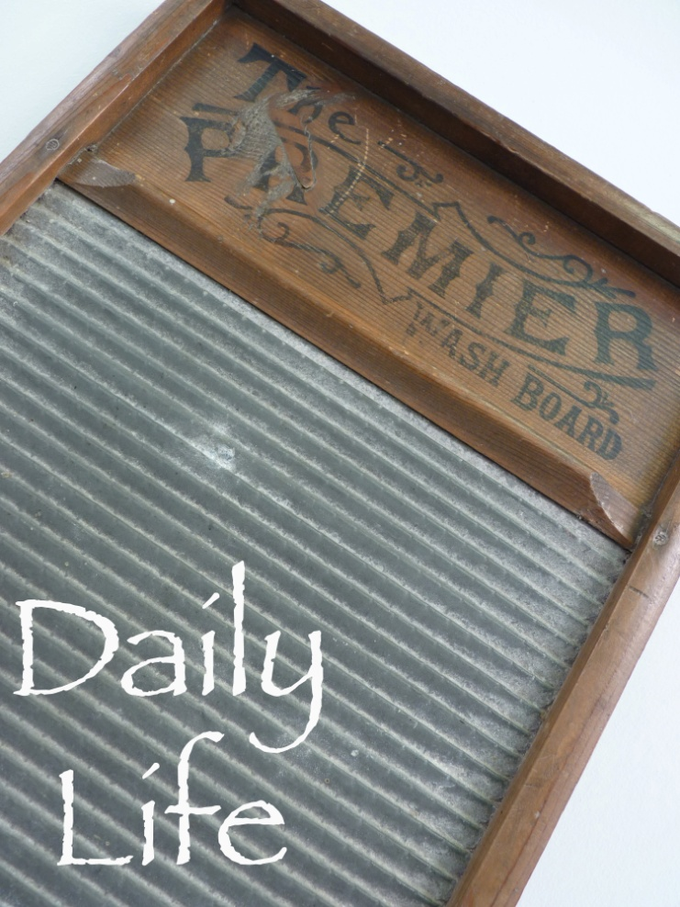
Once parents had started offering the loan of artefacts, we were able to begin exploring connections between the items, and to plan the different themes for the exhibition.

Slide 13
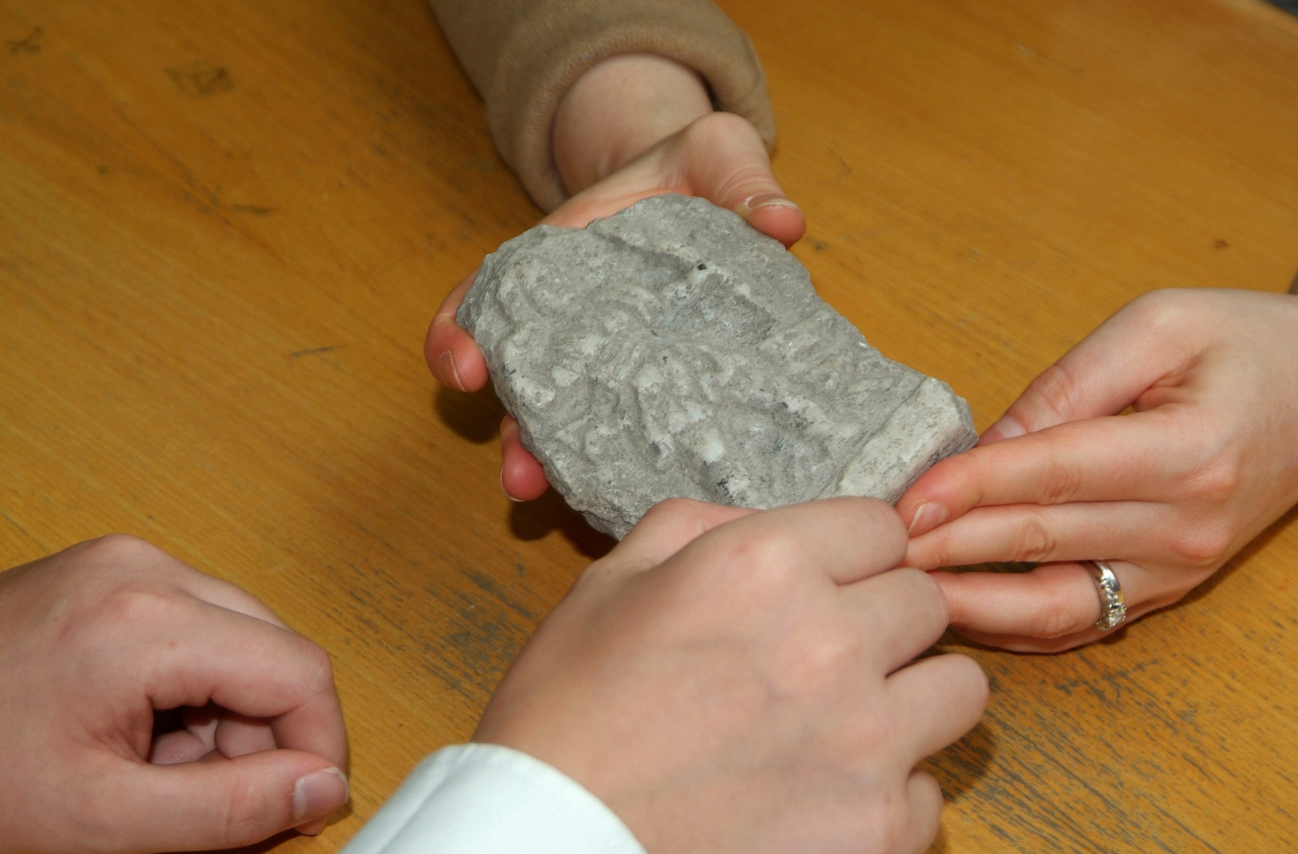
We used the Spring Field Day, working with a group of Third Year pupils, to research the background to every artefact in detail.

Slide 14
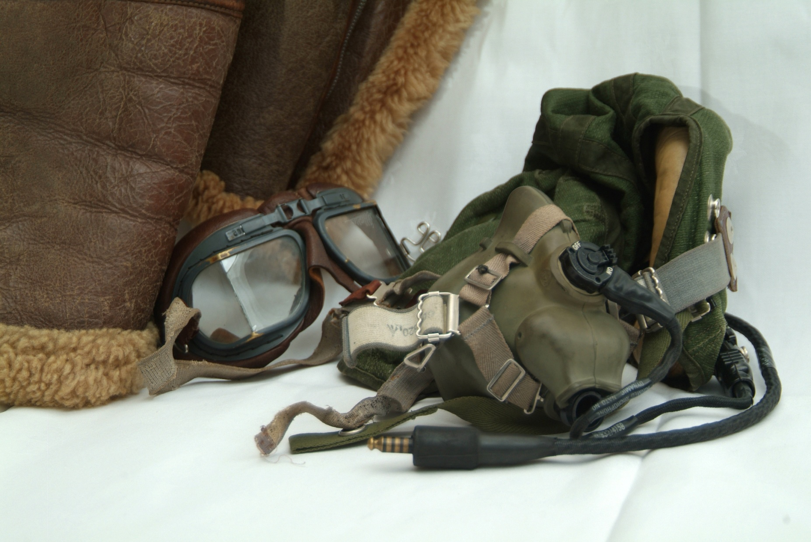
In the Summer Term we have finished writing about all the artefacts, and asked for help from some of our teachers and other pupils. We planned the layout of the exhibition, and worked hard bringing it all together. We have enjoyed giving some of our friends a sneaky peek of our work!

Slide 15
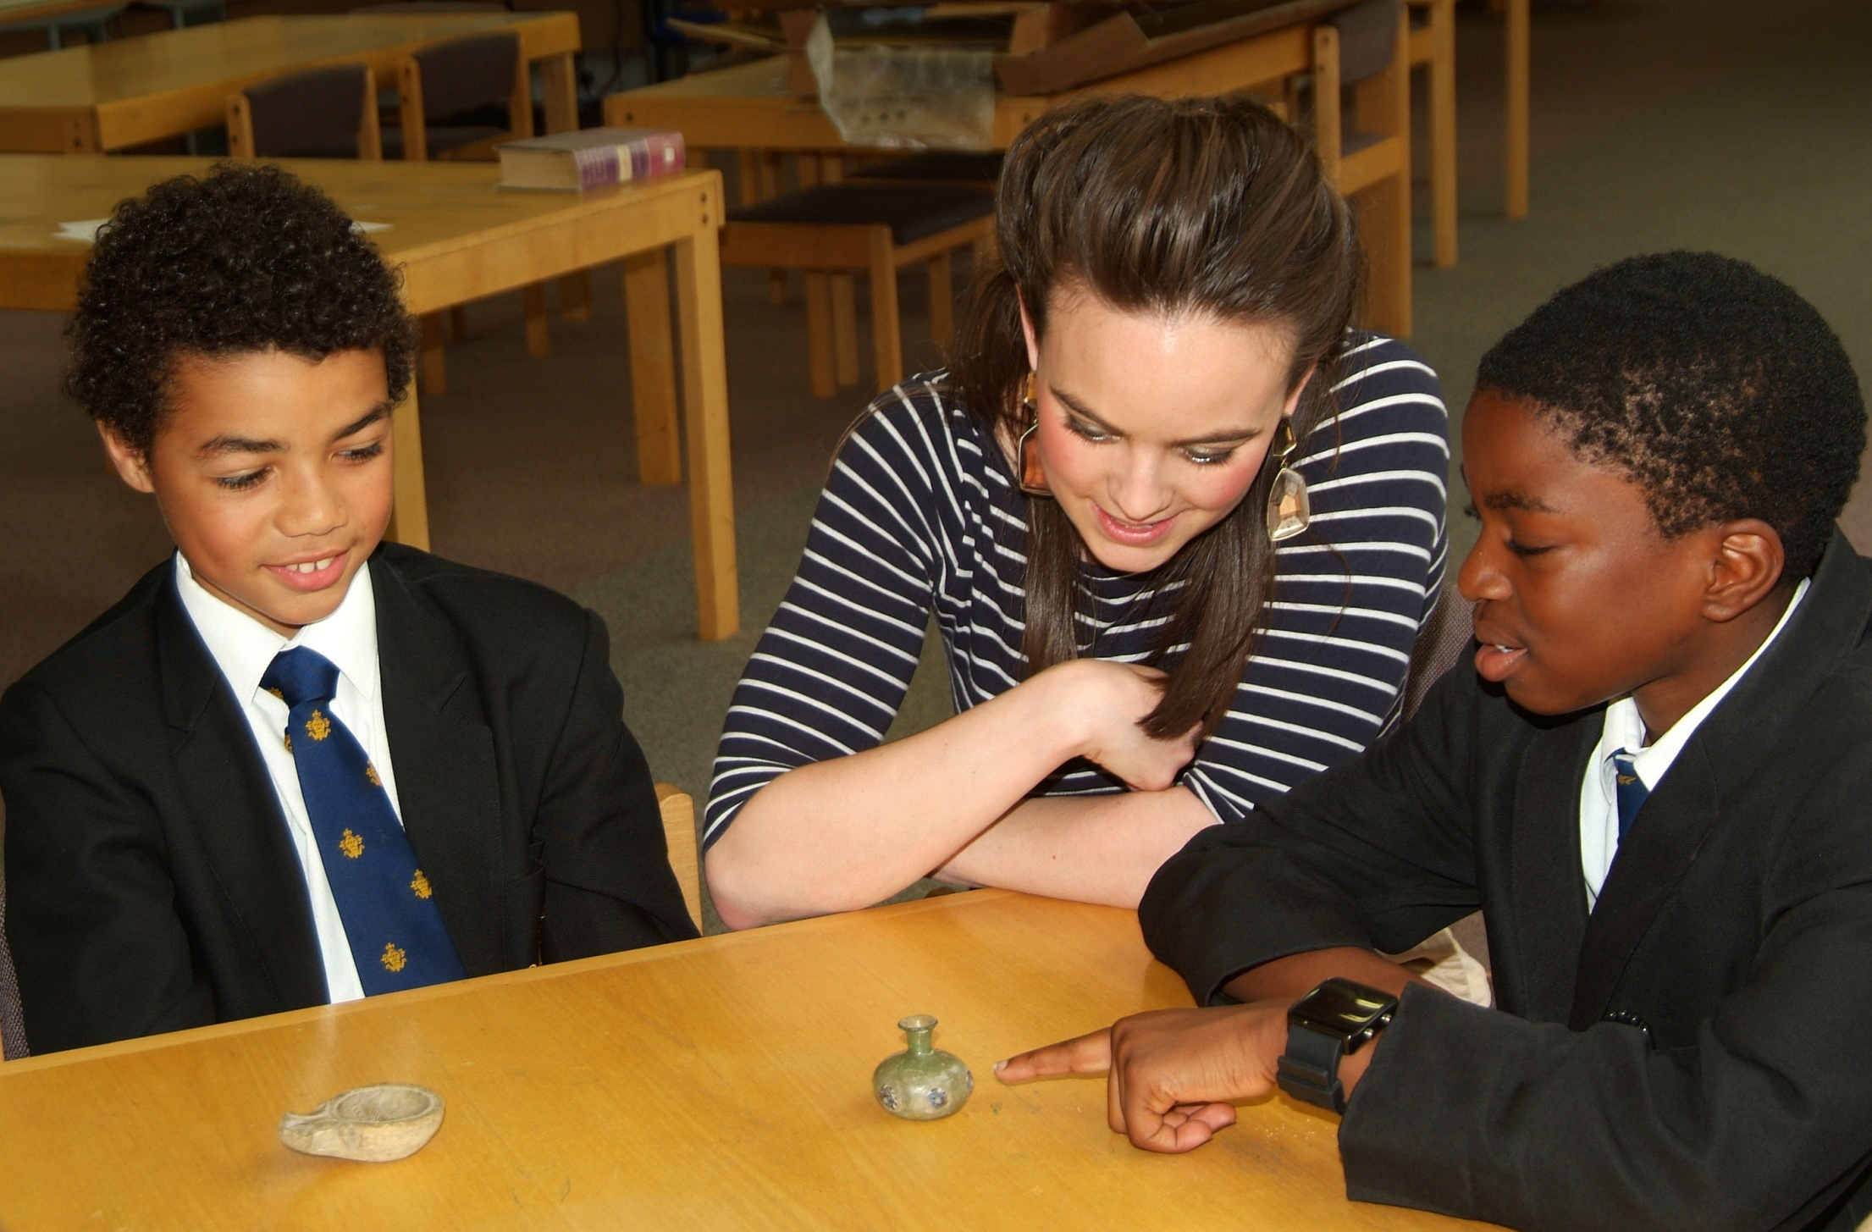

Slide 16
Pupil Curators:
Isobel Warner, Lower Sixth
Ronan Brennan, Lower Sixth
Alex Nichols, Upper Sixth
Phil Sheppard, Fifth Year
Jamie Cox, Fourth Year
Matthew Eagling, Fourth Year
Harry Petty, Fourth Year
Matthew Nixon-Welsby, Fourth Year

Slide 17
Joe Clacher, Third Year
William Brady, Third Year
Max Waller, Third Year
Dominic Linton, Second Year
Ridhwan Omar, Second Year
James Slater, Second Year
Matthew Ward-Perkins, First Year
Samuel Christie, First Year
Nathan Stephenson, First Year

Slide 18
Thank Yous

Slide 19
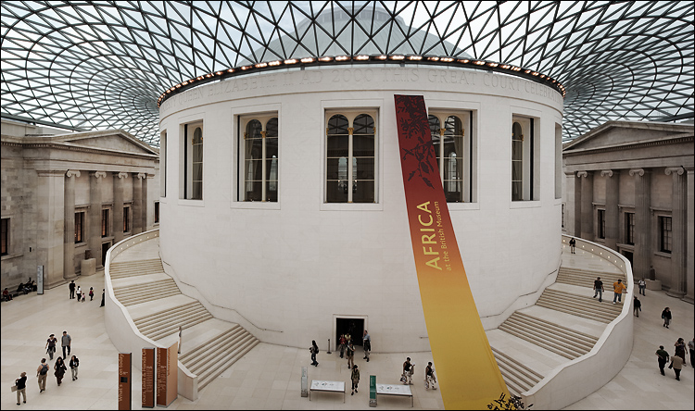
A special thank you to Mr Xerxes Mazda, Head of Learning, Volunteers and Audiences at the British Museum, for coming to open our Museum. We were very inspired by The History of the World in 100 Objects and are very grateful for the Museum’s support.

Slide 20
A huge thank you goes to Professor Sir Richard Evans who travelled from the University of Cambridge, where he is Regius Professor of History and Master of Wolfson College, to deliver the keynote lecture.
Professor Evans is one of the foremost historical scholars working in England today. He is a renowned expert on modern German history, and has published a seminal series on the history of the Third Reich as well as books on aspects of German social and cultural history. He has also written major works on the discipline of History itself, as well as serving as expert witness in the trial of David Irving for the crime of Holocaust Denial.

Slide 21
This project has been funded by a generous grant from the Historical Association. The Historical Association is an independent charity incorporated by Royal Charter. It has been supporting the study and enjoyment of history since 1906. With over 6000 members the HA is the major national organisation representing the case for an historical education to policy makers and ministers. It advises on curriculum issues at all levels and campaigns for access to specialist historical knowledge and collections.
The Joan Lewin Bursary scheme aims to provide bursaries of up to £1000 for projects that will add value in terms of research or teaching and learning in history.

Slide 22
We are grateful to the Whitgift Foundation for their support in providing access to Foundation-owned specialist display cases, and to Mr Bill Wood, Whitgift Foundation Archivist, in particular for his help with the provision of display cases.
Special thanks go to the Trinity School Grounds and Estates staff for all their help in making the exhibition a reality.
We thank the Trinity School Librarians for the use of the library space, and their help with setting up the exhibition.

Slide 23
The Trinity Archivists have provided many interesting documents and items relating to the school for display.
Many members of staff have provided input into the curatorial work, and the operational aspects of the exhibition. Thanks to Design and Technology in particular for their assistance with display materials and signs and ICT/AV for their technological help.
The marketing department have provided important input into the promotional materials, and have worked hard on our behalf to market the exhibition.
Victor Tokaraski took the excellent photographs.

Slide 24
The Horniman Museum provided a tailor-made learning session for our pupil-curators.
The pupils were introduced to traditional cultures, musical instruments and natural history collections via the handling collection and focused their discussions around the gallery in which this collection is housed – the Hands On Base.
The Museum has 4000 handling objects reflecting these main collecting areas which it uses with its visitors to further enhance the museum’s mission to understand more about the world, its cultures, its peoples and its environments. This collection, housed in the Hands On Base gallery, was introduced to the pupils and its display and interpretation explained. The gallery contains little written text and allows visitors to make connections between objects and ideas in a discussion based way with facilitation staff.

Slide 25
Above all, enormous thanks goes to all the pupils, parents, old boys, staff and friends who have made the project a reality by loaning their precious artefacts to us. Some of your ancestors feel like close friends to us by now, and we hope we have done them justice in our exhibition.

Slide 26
“The project sounds like an innovative and engaging way to increase an understanding of history for pupils and the wider community”
Nick Gibb MP, Minister for Schools

Slide 27
“Projects like this are exactly what our education system needs to ensure that the next generation continues to engage with the past”
Tristram Hunt MP, History Lecturer and Television Presenter

Slide 28
“I realise now that the objects people have in their homes can be just as historically valuable as the ones in the museum, but they are just not aware of it”
Jacob, Third Year

Slide 29
“After doing the project I have realised that anything can be researched and found out about, if we ask the right questions. Whereas before I believed that some things just couldn’t. My researching skills have really improved.”
Anthony, Third Year

Slide 30
“I really enjoyed this project. I’m much more likely to notice the historical objects around me now, and much more interested in visiting museums.”
Archie, Third Year

